Slide 1
BACE 1
(beta-site amyloid precursor protein cleaving enzyme 1)
Georgia McGaughey 22 Aug 2019

Slide 2
Disclosure !
Been aware of D3R since its inception
& previously, with CSAR
Vertex has provided data sets in previous years (e.g. HSP90)
Vertex was founded in 1989 as a structure-based design company
Whilst at Merck, worked on BACE for nearly 10 years
Also at Merck, co-authored (2007) a paper on examining scoring functions* and shape

Slide 3
BACE is inherently flexible & binds a variety of chemotypes
Aspartic acids
& different protonation states
Water mediated
10s loop
Flap motion

Slide 4
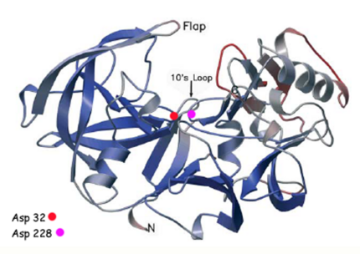
BACE is inherently flexible & binds a variety of chemotypes
Aspartic acids
& different protonation states
Water mediated
10s loop
Flap motion

Slide 5
Notes:
Don’t tell me the moon is shining, show me the glint of light on broken glass. Anton Chekhov (1860-1904)

Slide 6
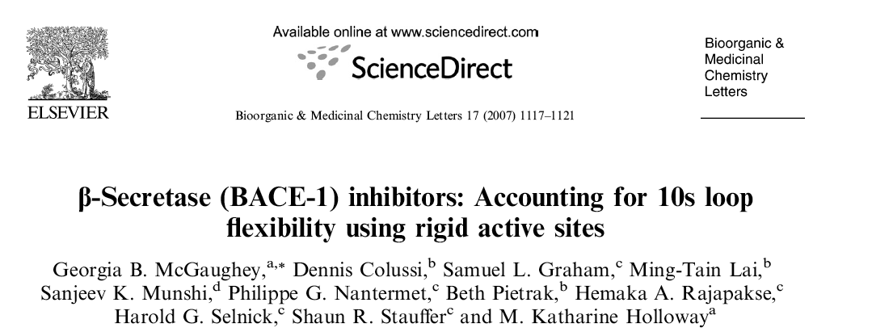
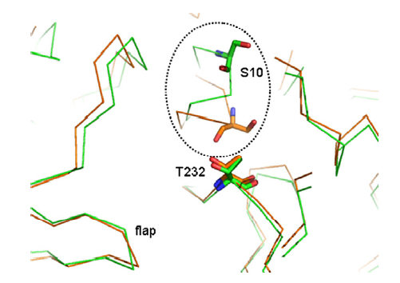
BACE = Flexibility = 10s loop

Slide 7
BACE & Macrocycles

Slide 8
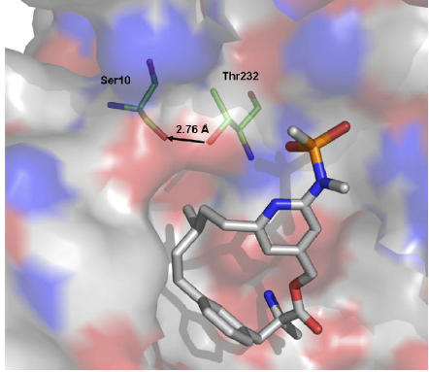
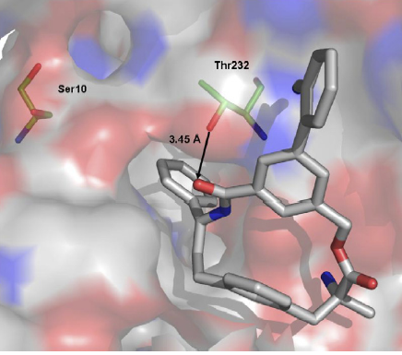
BACE, Macrocycles & 10s loop

Slide 9
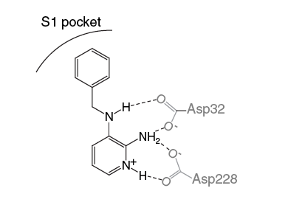
BACE = flexibility = aspartic acids

Slide 10
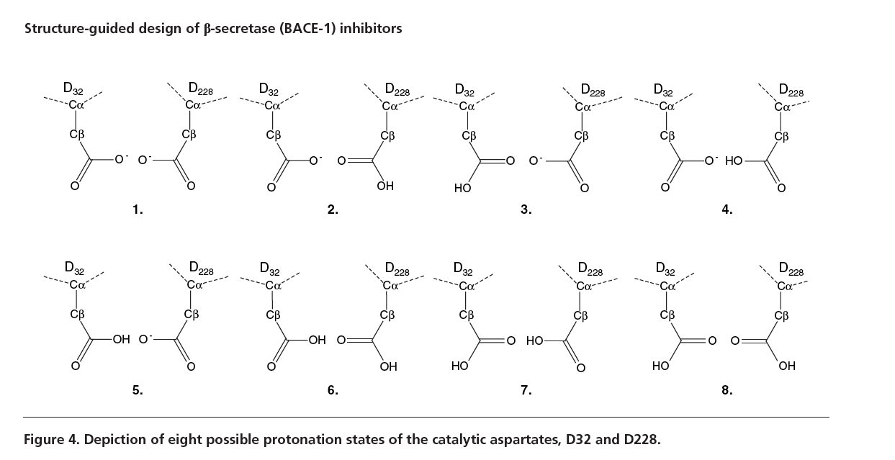
BACE = flexibility = aspartic acids

Slide 11
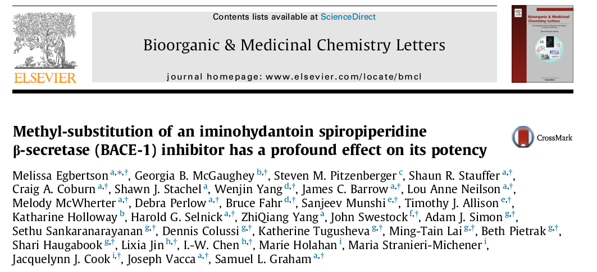
& water mediated interactions !

Slide 12
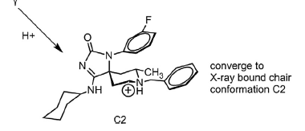
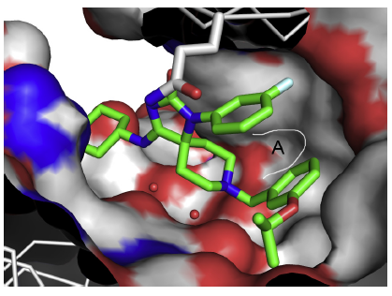
& water mediated interactions !

Slide 13
Thoughts (BACE) based on D3R Analysis
Scoring functions tend to perform well when multiple h-bonds are present
e.g. Glide/Gold
“Shape only” (using diverse chemotypes) would be a challenge
Macrocycles tend to have less flexibility than acyclic compounds

Slide 14
Next steps with BACE
Treatment of different protonation states
Different chemotypes for cross over design
Patent busting
Mitigation of safety risk
Role of waters
Water mediated interactions with aspartic acids
Water displacement with spiropiperidines

