Slide 1
Pose prediction and affinity ranking: Accuracy & best practices
Novartis Institutes for BioMedical Research
Hanneke Jansen
Global Discovery Chemistry
Emeryville, CA

Slide 2
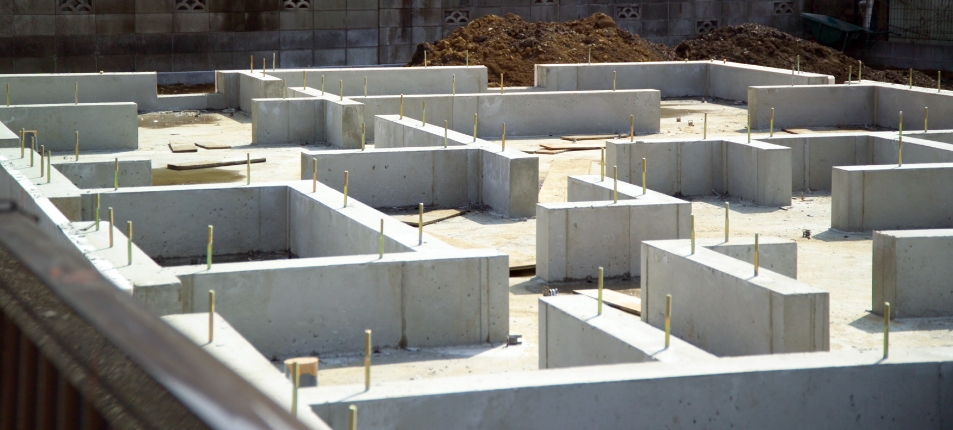
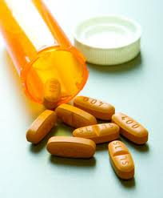
Pose prediction & affinity ranking are part of the CADD foundation
Multi-objective designs: target & off-target affinities, target affinity & ADMET properties, target affinity & chemical diversity (scaffold hopping)

Slide 3
Ligand docking in the late ’90s
Type-1 kinase inhibitors
Type-2 & Type 1.5 kinase inhibitors
Growth factor receptor kinase inhibitors: Lot of structural information for type-1 kinase inhibitors but scoring functions insufficient to select relevant binding poses
Expert system developed: “Magnet”
Raf kinase inhibitors: DFG-out conformation not yet known
Ligands could be docked but SAR did not track
SBDD on hold until we figured out the large conformational rearrangement from DFG-in to DFG-out
TKI258, Dovitinib (Ph-III)
J. Med. Chem. 2008, 51, 7049-7052
RAF265 (POC)
Encorafenib (launched; out-licensed to Array BioPharma)
J. Med. Chem. 2009, 52, 278-292

Slide 4
D3R is part of a global community commitment to shore up our foundation
We’ve seen progress but also know there is room for improvement
Accuracy / Innovation
Pose prediction, affinity ranking, affinity prediction
Objective testing to measure progress (determine state of the art, which components need to be improved)
Best practices / Execution
Starting points for new applications
Education

Slide 5
What follows ....
..... is a personal perspective on the results and analyses from GC4
Thank you to those who gathered and analyzed all the submissions:
Zied Gaieb
Conor Parks
Mike Chiu
Mike Gilson
Rommie Amaro
Pat Walters
And thank you to all the participants !
Notes:
Conor D. Parks^{1⊥}, Zied Gaieb^{1⊥}, Michael Chiu¹, Huanwang Yang², Chenghua Shao², W. Patrick Walters³, Johanna M. Jansen⁴, Georgia McGaughey⁵, Richard A. Lewis⁶, Scott D. Bembenek⁷, Michael K. Ameriks⁷, Tara Mirzadegan⁷, Stephen K. Burley², Rommie E. Amaro^{1*}, Michael K. Gilson^{1*}

Slide 6
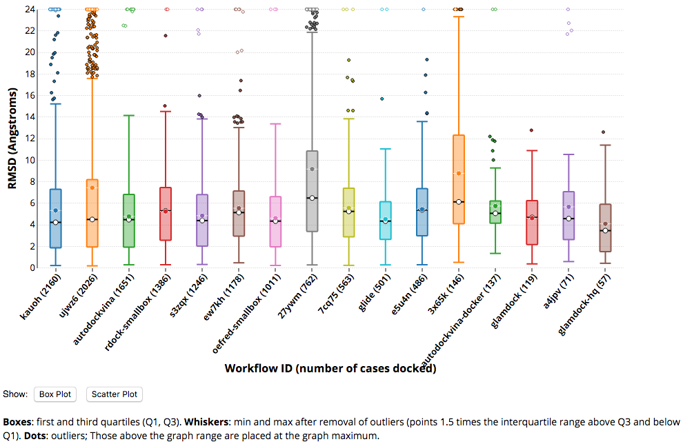
Reference for pose-prediction: CELPP Continuous Evaluation of Ligand Protein Prediction
Weekly blinded challenges for ligand pose prediction (cross-docking)
4384 targets
88 weeks as of 2019/Week 33 (2019-08-18)
16 automated workflows
Median RMSD of highest performing workflows: 4-5 Å
Notes:
Candidate protein solved with ligand having largest maximum common substructure with target ligand (LMCSS)

Slide 7
BACE1 cross-docking (20 ligands): Excellent performance
CELPP
2.5 Å
BACE1 – GC4: 60% achieved median Pose 1 RMSD < 2.5 Å

Slide 8
Compare CatS in GC3 cross-docking (24 ligands)
BACE1 – GC4: 60% achieved median Pose 1 RMSD < 2.5 Å
CatS – GC3: 19% achieved median Pose 1 RMSD < 2.5 Å
Note that CatS and BACE1 ligand sets had similar 1nn distribution !

Slide 9
GC2 and GC2015 comparisons
GC2015, HSP90 (5 ligands)
GC2 (FXR, 36 ligands)
GC2015, MAP4K4 (30 ligands)
BACE1 – GC4: 60% achieved median Pose 1 RMSD < 2.5 Å
CatS – GC3: 19% achieved median Pose 1 RMSD < 2.5 Å
FXR (GC2) & HSP90 (GC2015): ~50% achieved median Pose 1 RMSD < 2.5 Å
MAP4K4 (GC2015): ~10% achieved median Pose 1 RMSD < 2.5 Å

Slide 10
Pose prediction: Observations and best practices
Multiple methods, including open source, can achieve high pose prediction accuracy
Many computational steps required in producing high quality pose prediction
Need to consider “best practice” for the various steps – effective workflows often combine various software packages
Performance is dependent on target
Attributes of binding site (shape, polarity, flexibility), availability of co-structures with similar ligands
If structure of target exists, look for models with similar ligands – but don’t be discouraged if the Tanimoto coefficient to a known ligand is low
If you have a new target, try benchmarking workflow with similar target that has known ligands
Performance is dependent on skill of practitioner
Workflows using the same docking engine end up at top and bottom of the list (multistep workflows, variables & parameters)
Across the GC’s, visual inspection tends to augment performance, but visual inspection is not a guarantee of success (GC4: 6/10 in top, 2/10 in bottom)
We have more to learn and need to invest in teaching

Slide 11
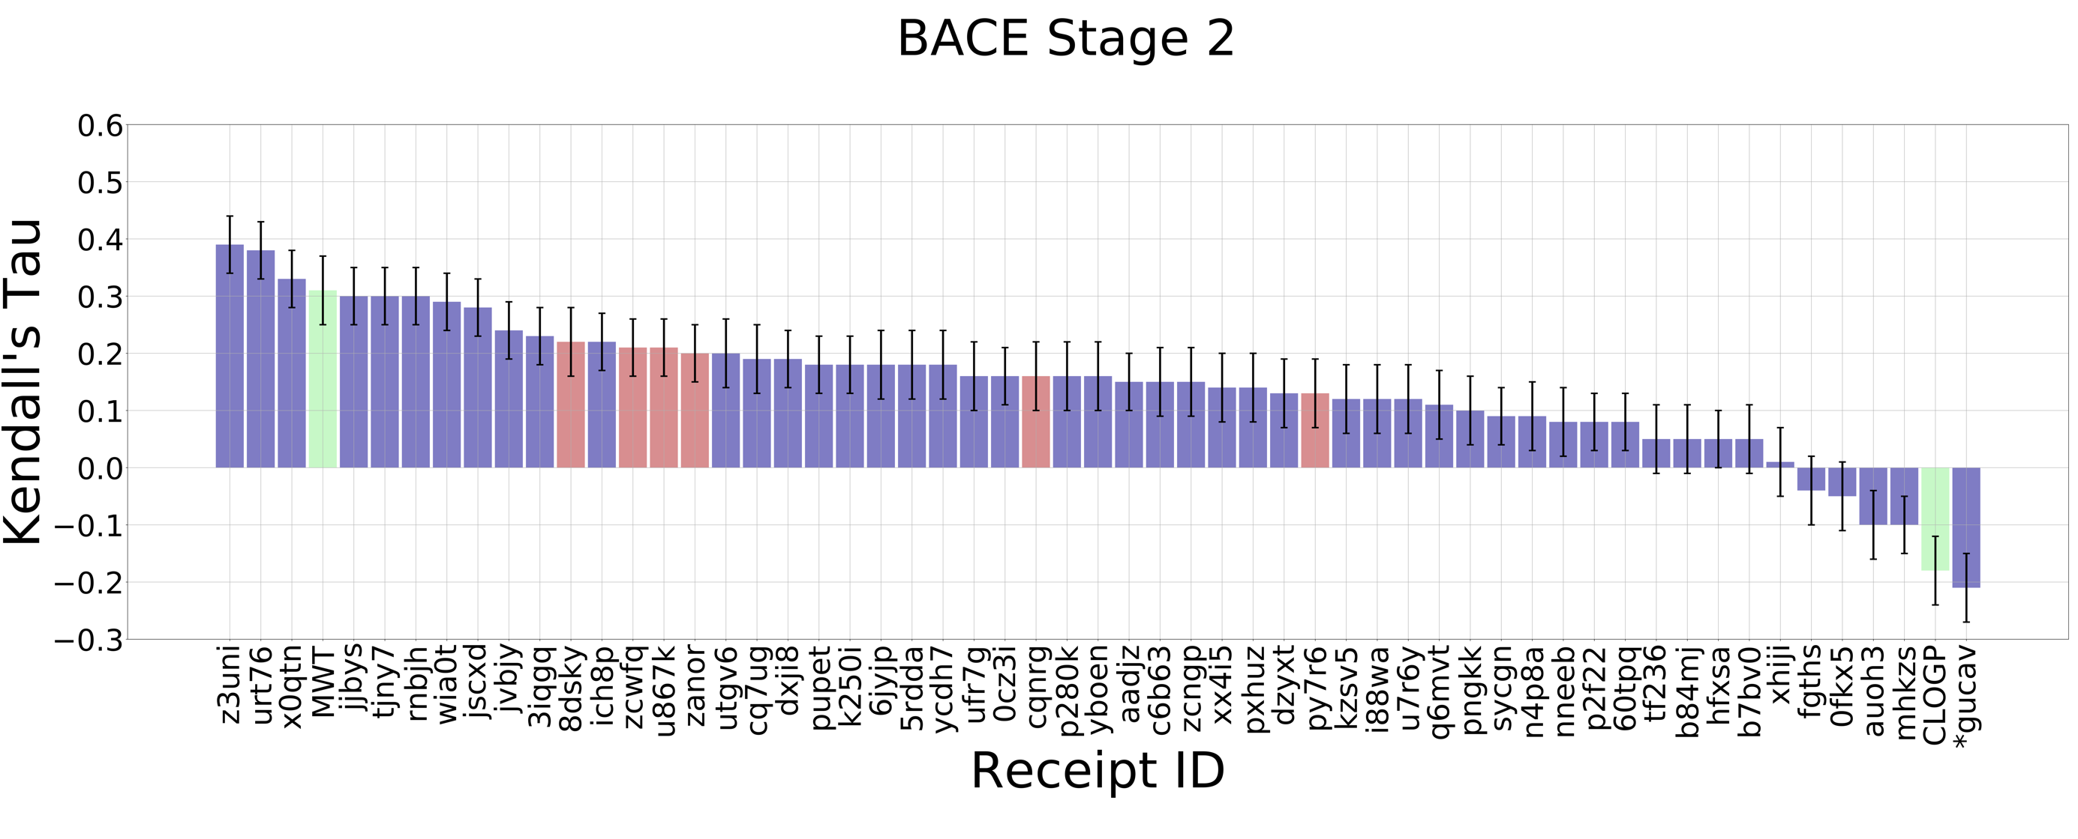
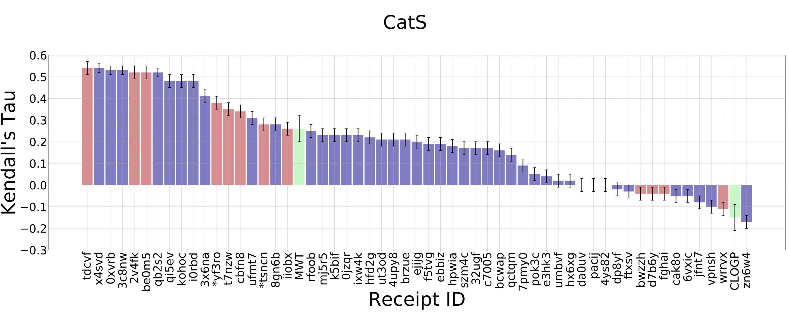
GC4: Better affinity ranking performance for CatS compared to BACE1
Purple: structure-based scoring
Red: ligand-based scoring
Green: null models (MW & clogP)
CatS pose prediction accuracy was worse
Ligand-based methods perform as well as structure-based methods
CatS: Higher Kendall’s Tau for top-performers and more submissions outperform best null-model
CatS: slight improvement compared to GC3
Best performing methods in GC4 have a Kendall’s τ of 0.54, compared to 0.45 in GC3
Mean Kendall’s τ for the top 20% of methods in GC4 is 0.50, compared to 0.38 in GC3
Participant experience, availability of more data, better methods?
Note: The null models are ‘‘Mwt’’, in which the affinities are ranked by decreasing molecular weight; and “clogP,” in which affinities are ranked based on increasing (calculated) octanol–water partition coefficient

Slide 12
Across the Grand Challenges
Target | max Kendall's Tau | best null model | #submissions better than best null | #submissions
BACE1 | 0.38/0.39 | MW (0.31) | 2/3 | 39/55
CatS (GC4) | 0.54 | MW (0.26) | 18 | 55
CatS (GC3) | 0.45/0.39 | MW (0.2) | 20/26 | 54/81
JAK2 (SC2) | 0.55 | clogP (0.27) | 2 | 31
JAK2 (SC3) | 0.71 | MW (0.56) | 3 | 18
p38-α | 0.21 | clogP (0.32) | 0 | 29
TIE2 | 0.57 | MW (0.36) | 4 | 18
VEGFR2 | 0.43 | MW (0.11) | 29 | 34
FXR | 0.44/0.46 | clogP (0.45) | 0/1 | 59/82
HSP90 | 0.32/0.32 | MW (0.14) | 27/15 | 41/30
MAP4K4 | 0.48/0.38 | clogP (0.18) | 18/18 | 40/26
Most challenges show top-performer using structure-based methods, but ligand-based methods do well too
Almost all of the submitted rankings correlate positively with the experimental rankings
Many submissions do not show a convincing difference with the best null-model
Best performing null-model is different for different datasets
Machine learning in general may have had an edge in GC4 for CatS, but not for BACE1; also no difference in GC3 for machine learning submissions

Slide 13
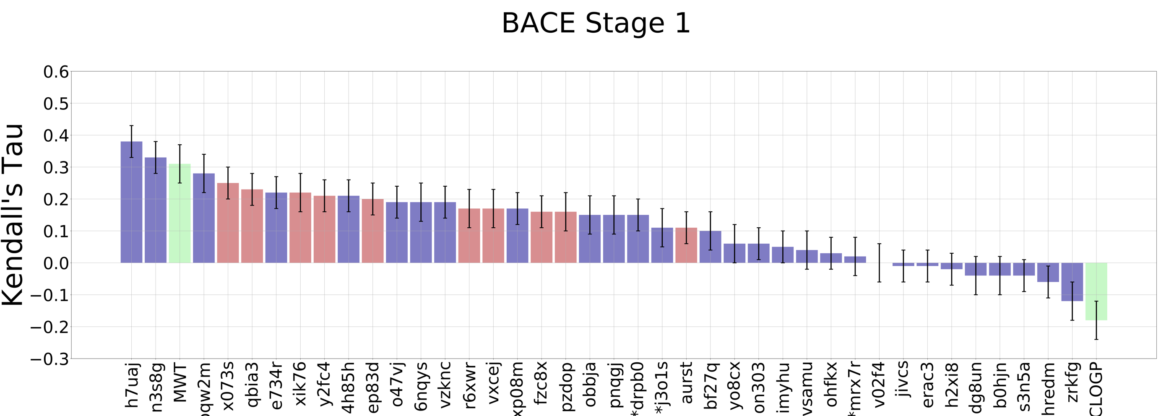
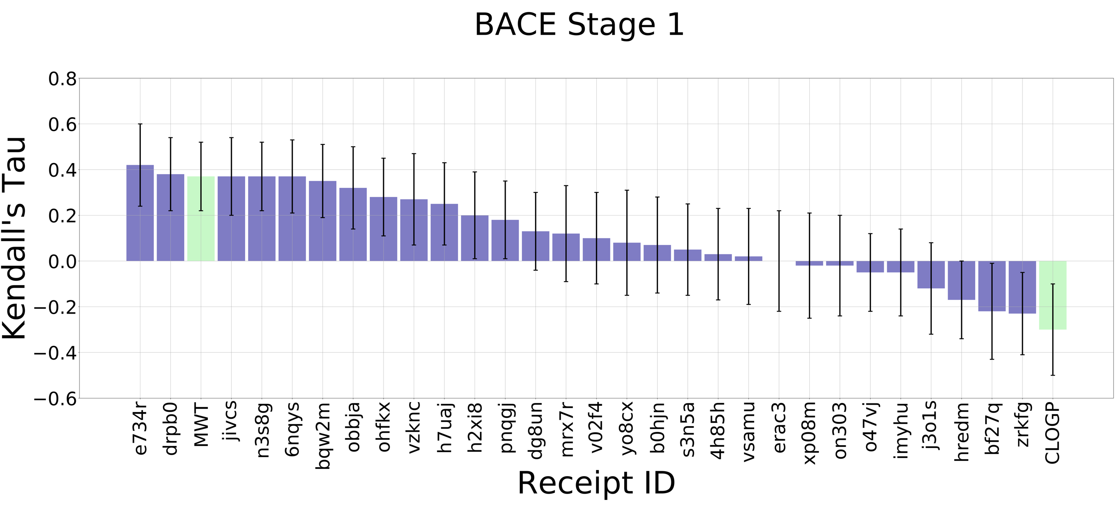
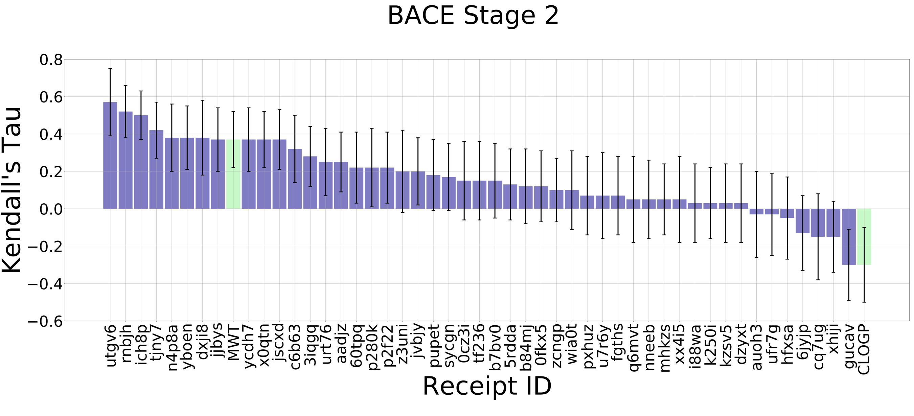
Does knowledge of co-structure improve affinity ranking?
All 154 BACE1 ligands
Subset of 16 BACE1 ligands with co-crystal structures released at the end of Stage 1

Slide 14
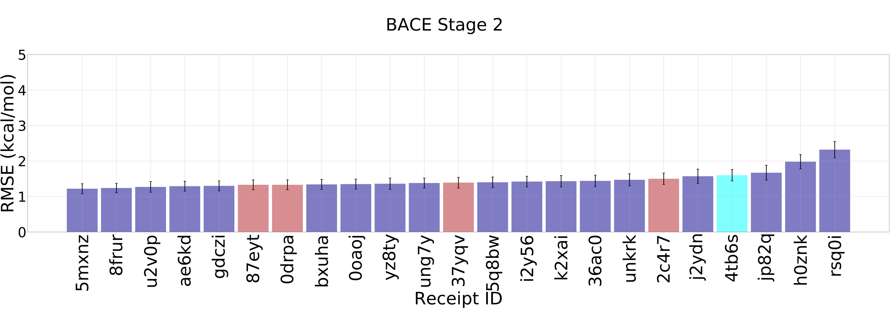
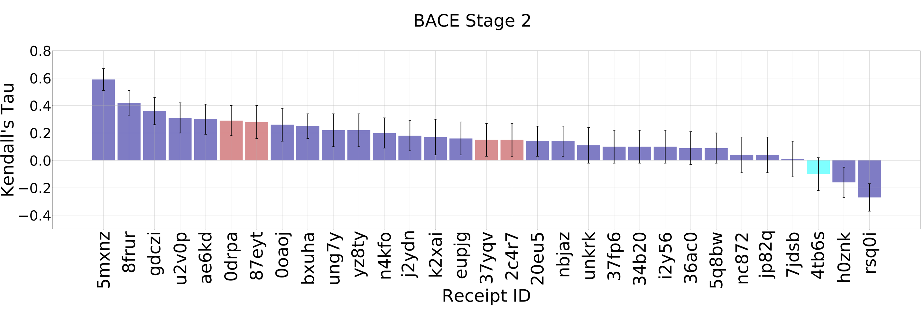
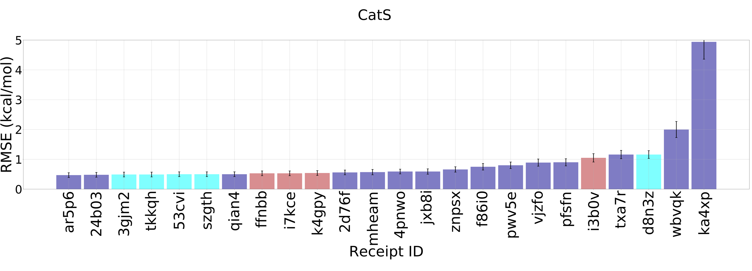
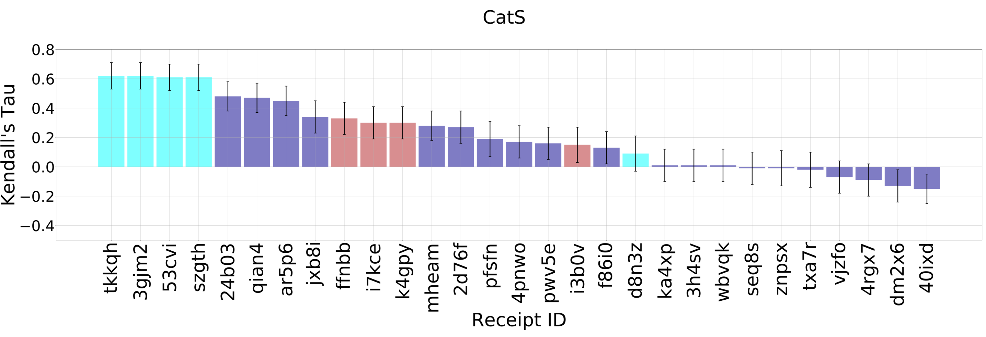
Explicit solvent free energy methods show advantage for CatS, not for BACE1
Not a consistent presence of explicit solvent free energy methods in the grand challenges:
3(GC2015), 30 (GC2), 1 (GC3)

Slide 15
Affinity ranking & prediction: Observations and best practices
Meaningful ranking can be achieved
Almost all of the submitted rankings correlate positively with the experimental rankings
Range of max Kendall’s Tau: target, ligand property space, practitioner
Struggle with null models
Across the GC’s, there is not enough differentiation to say much in general about accuracy of structure-based vs ligand-based, impact of machine-learning approaches, explicit solvent free energy methods
Test your affinity predictions frequently and try different approaches early on
Drug discovery is a multi-disciplinary and iterative effort
We have a lot to learn and need to invest in teaching

Slide 16
What you heard ....
..... was a personal perspective on the results and analyses from GC4
Thank you to those who gathered and analyzed all the submissions:
Zied Gaieb
Conor Parks
Mike Chiu
Mike Gilson
Rommie Amaro
Pat Walters
And thank you to all the participants !
Notes:
Conor D. Parks^{1⊥}, Zied Gaieb^{1⊥}, Michael Chiu¹, Huanwang Yang², Chenghua Shao², W. Patrick Walters³, Johanna M. Jansen⁴, Georgia McGaughey⁵, Richard A. Lewis⁶, Scott D. Bembenek⁷, Michael K. Ameriks⁷, Tara Mirzadegan⁷, Stephen K. Burley², Rommie E. Amaro^{1*}, Michael K. Gilson^{1*}

