Slide 1
A SAMPL journey: From 2 over 5 to 6 and 6.II, and back to square one
Outline
Molecular solvation thermodynamics
by 3D RISM / EC-RISM theory
Progress along challenges
SAMPL2: tautomers
SAMPL5: log D (cyclohexane/water)
SAMPL6 / 6.II: pK_{a} / log P (octanol/water)
Retrospective analysis
SAMPL5 and SAMPL2
Summary and perspective

Slide 2
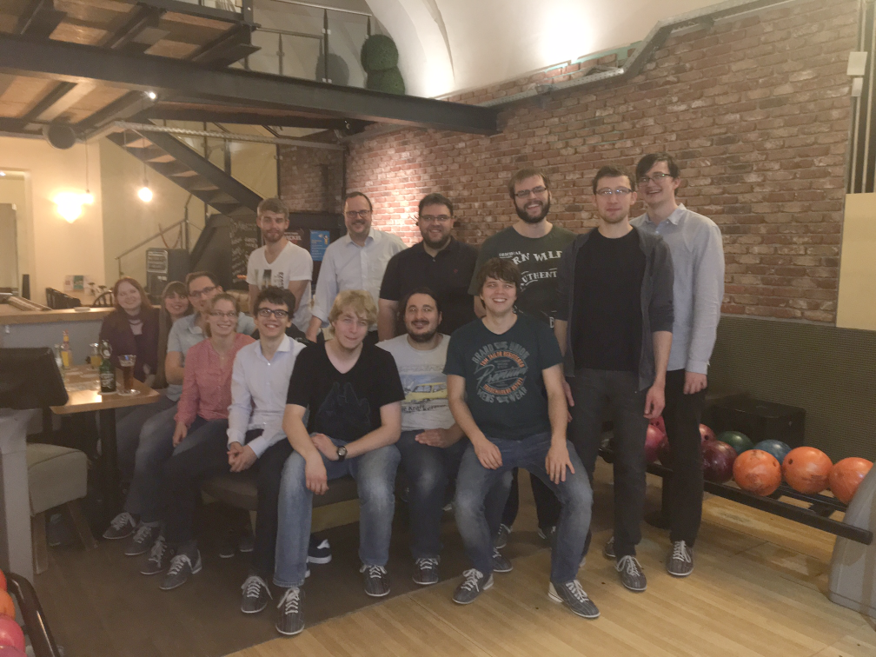
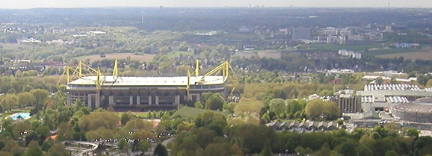

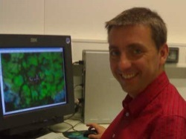
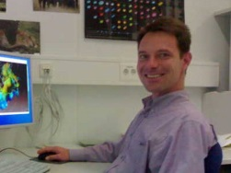
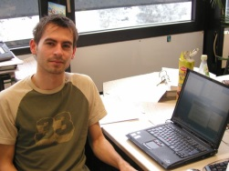
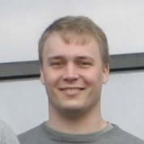

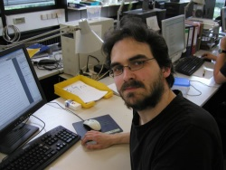
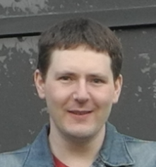
Without whom this would not be possible …
Coworkers
Nicolas Tielker
Lukas Eberlein
Christian Chodun
Thomas Kloss
Jochen Heil
Sebastian Ehrhart
Daniel Tomazic
Collaborators (this work)
Stefan Güssregen
K. Friedemann Schmidt
(Sanofi-Aventis Germany)

Slide 3
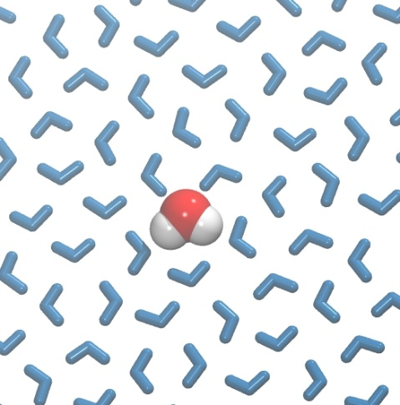
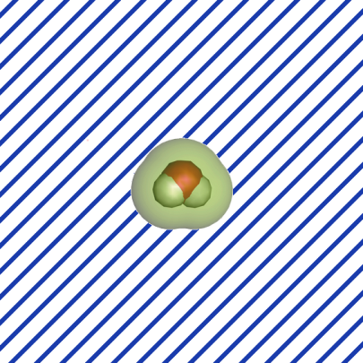
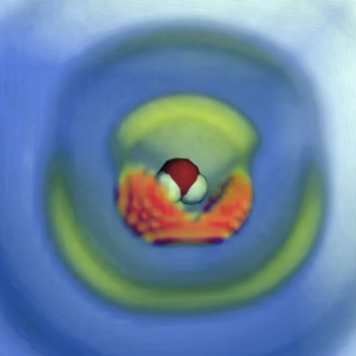
Thermodynamics in solution
Summary of methods
Direct (atomistic) simulation: histogram counting (g), thermodynamic (coupling parameter) integration (μ),
free energy perturbation, umbrella sampling, …
Continuum methods: Poisson-Boltzmann/surface-area (PB/SA), generalized Born (GB/SA), …
Integral equation theory (Ornstein-Zernike/RISM/closure): g, μ
Classical density functional theory (cDFT)
explicit
continuum
Solute description is usually granular/particulate
Fixed point charges (AMBER, CHARMM, …) + repulsion/dispersion
Classical polarizable force field (AMOEBA, hpCADD, …)
Quantum-chemical electronically polarizable models
(PCM, COSMO(-RS), EC-RISM, …)
3D RISM

Slide 4
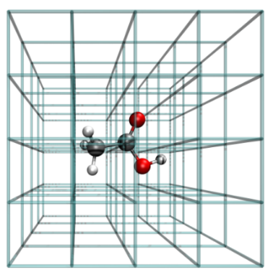
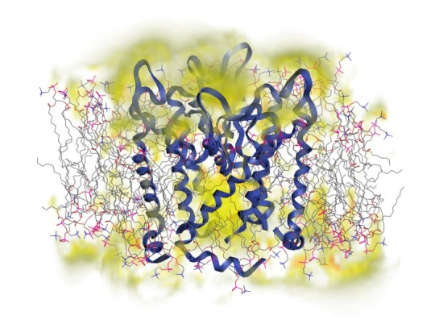
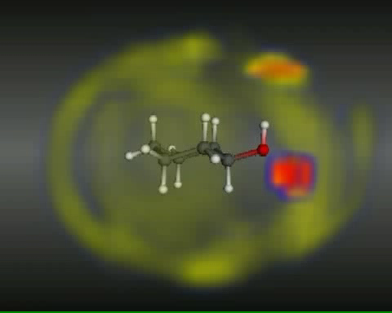
Beyond continuum solvation: 3D RISM
Workflow
Solute-molecule/solvent-atom (γ) interaction on grid
Coupled nonlinear integral equation/closure
(Imai / Beglov, Roux / Kovalenko, Hirata / Kast)
bridge
χ (solvent site susceptibility)
precomputed, 1D RISM
HNC, MD-parametrized, self-consistent
SPC/E, electrolytes, nonaq. models, …
p, T, x
Distribution functions
Potent. of mean force
Partial molar volume
Chemical potential
(Fedorov / Borgis / Kast)

Slide 5
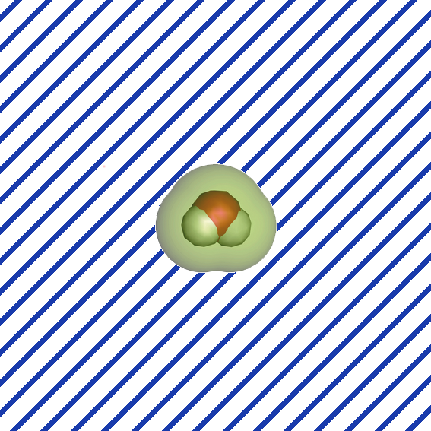

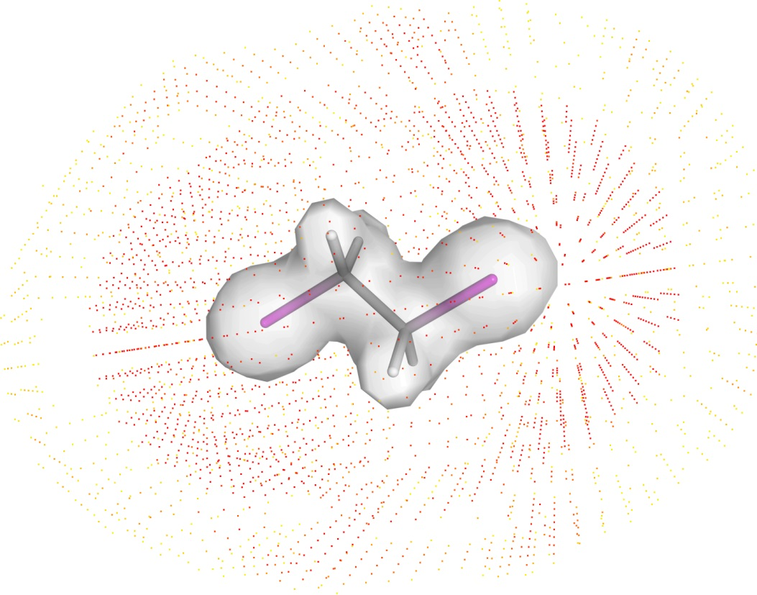
Beyond continuum solvation: EC-RISM
Self-consistent treatment of electronic and solvent polarization: EC-RISM(-QM)
start: ψ_{vac}
construct cluster of
embedding point charges
q(r_{i}), compute ψ_{tot}
(Gaussian/Turbomole/ORCA/EMPIRE)
fit q _{u} /
exact u^{C}
chemistry
converged?
no
3D RISM:
compute g(r), μ ^{ex}
yes
stop: ψ _{tot} ≈ ψ _{solv}
spectroscopy
structure
T. Kloss, J. Heil, S. M. Kast, J. Phys. Chem. B 112, 4337 (2008)
N. Tielker, D. Tomazic, J. Heil, T. Kloss, S. Ehrhart, S. Güssregen, J. Comput.-Aided Mol. Des. 30, 1035 (2016)

Slide 6
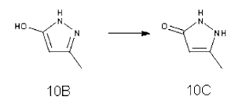
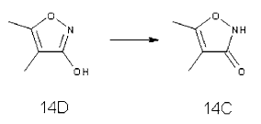
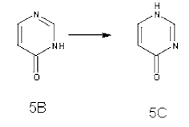
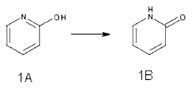
SAMPL2 (2009): Tautomers
Workflow
Exhaustive conformer / OH rotamer search
Geometry optimization: B3LYP/6-311++G(d,p)/PCM
Testing production level on explanatory compounds
→ MP2/aug-cc-pVDZ/EC-RISM/PSE-3(mSPC/E), no thermal corrections, single geometry, ChelpG charges, GAFF
Prediction for obscure compounds
explanatory
obscure
M. T. Geballe, A. G. Skillman, A. Nicholls, J. P. Guthrie, P. J. Taylor, J. Comput.-Aided Mol. Des. 24, 259 (2010)
S. M. Kast, J. Heil, S. Güssregen, K. F. Schmidt, J. Comput.-Aided Mol. Des. 24, 343 (2010)

Slide 7
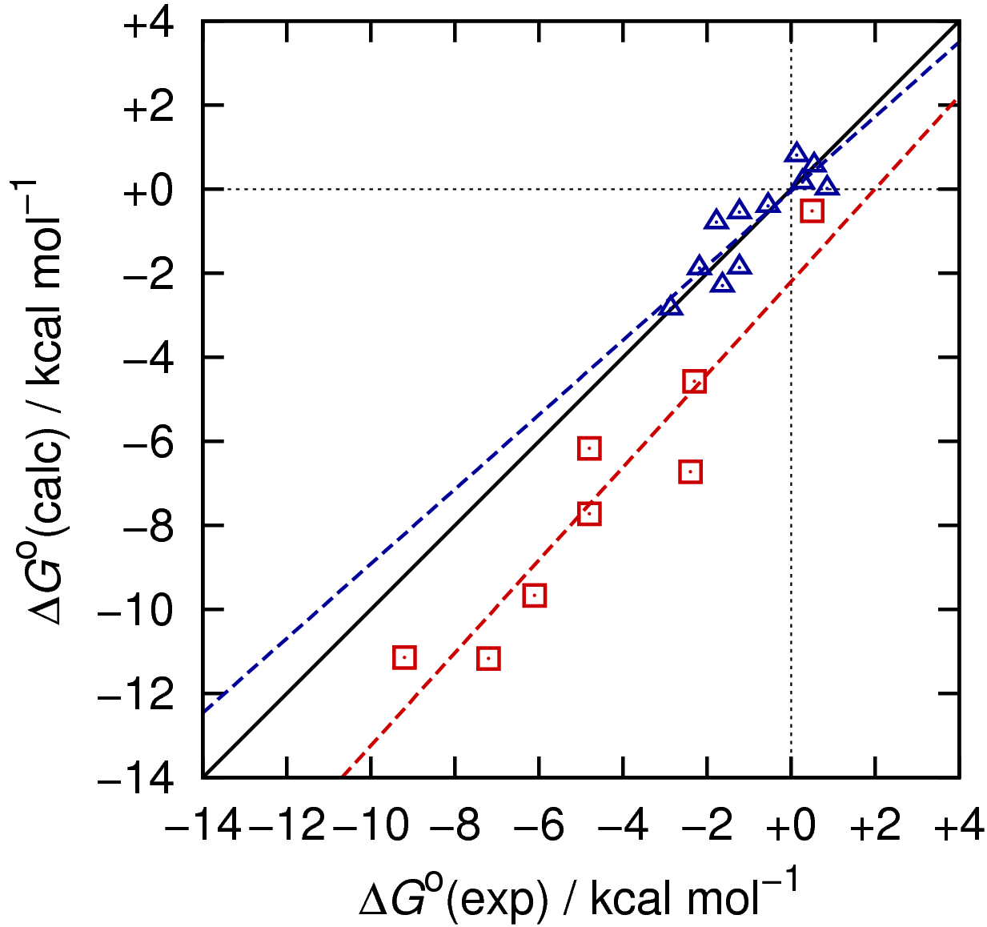
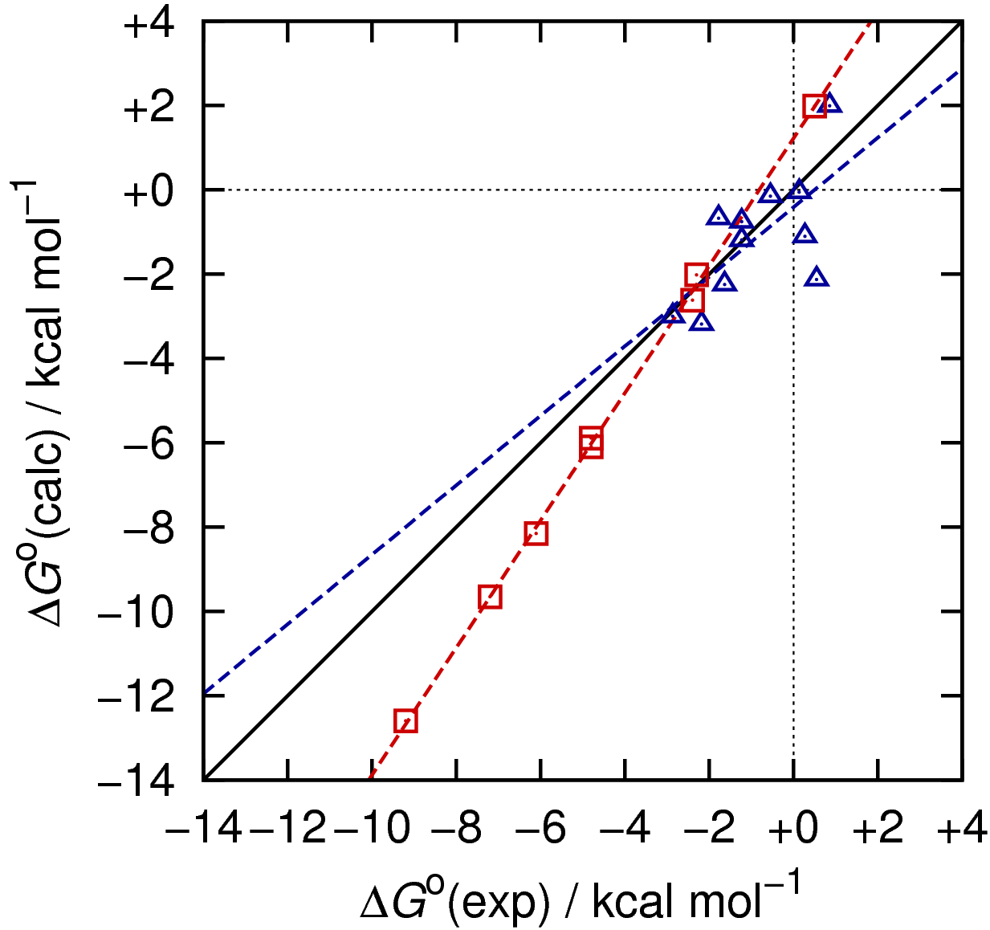
SAMPL2 (2009): Tautomers
Results – explanatory: 5-rings / obscure: 6-rings
MP2/aug-cc-pVDZ/EC-RISM/PSE-3//B3LYP/6-311++G(d,p)/PCM
EC-RISM
PCM
RMSE 0.57
RMSE 1.10
RMSE 2.91
RMSE 1.84
M. T. Geballe, A. G. Skillman, A. Nicholls, J. P. Guthrie, P. J. Taylor, J. Comput.-Aided Mol. Des. 24, 259 (2010)
S. M. Kast, J. Heil, S. Güssregen, K. F. Schmidt, J. Comput.-Aided Mol. Des. 24, 343 (2010)

Slide 8
SAMPL5 (2015): log D_{7.4} (water/cyclohexane)
Workflow
Neutral tautomer determination at pH 7.4 (MoKa/Corina)
Conformational sampling (RDKit/Amber/GAFF/AM1-BCC/ALPB)
Filtered set (5 kcal/mol): geometry optimization B3LYP/6-311+G(d,p)/PCM(w/c), selection of global optimum
pK_{a}-guided ionization in water, neutral forms in cyclohexane assumed
Calibration of solvation free energies (w/c) on MNSOL dataset
Production: MP2/6-311+G(d,p)/EC-RISM/PSE-2(mSPC/E,uacyc), no thermal corrections, single geometry, ChelpG charges, GAFF
Submission: MoKa pK_{a} (batch 0)
Post-submission: EC-RISM pK_{a} (trained EC-RISM model, Klicić dataset, batches 0+1)
C. C. Bannan, K. H. Burley, M. Chiu, M. R. Shirts, M. K. Gilson, D. L. Mobley, J. Comput.-Aided Mol. Des. 30, 927 (2016)
N. Tielker, D. Tomazic, J. Heil, T. Kloss, S. Ehrhart, S. Güssregen, K. F. Schmidt, S. M. Kast, J. Comput.-Aided Molec. Des. 30, 1035 (2016)
C. P. Kelly, C. J. Cramer, D.G. Truhlar, J. Chem. Theory Comput. 1, 1133 (2005)
D. Palmer, A. Frolov, E. Ratkova, M. V. Fedorov, J. Phys. Cond. Matter. 22, 492101 (2010)
J. J. Klicić, R. A. Friesner, S. Y. Liu, W. C. Guida, J. Phys. Chem. A 106, 1327 (2002)

Slide 9
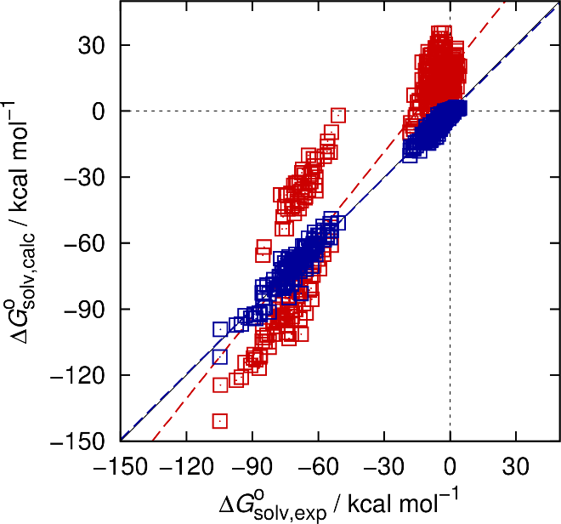
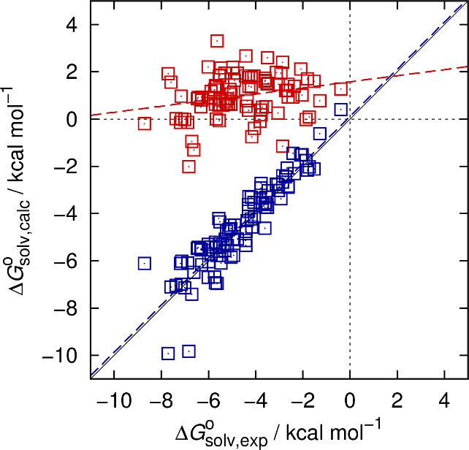
SAMPL5 (2015): log D_{7.4} (water/cyclohexane)
Results – Δ_{solv}G optimization
Submission phase: Δ_{solv}G optimization only, MoKa pK_{a}
Water
Cyclohexane
RMSE 20.84
RMSE 5.90
RMSE 2.43
RMSE 0.76
C. C. Bannan, K. H. Burley, M. Chiu, M. R. Shirts, M. K. Gilson, D. L. Mobley, J. Comput.-Aided Mol. Des. 30, 927 (2016)
N. Tielker, D. Tomazic, J. Heil, T. Kloss, S. Ehrhart, S. Güssregen, K. F. Schmidt, S. M. Kast, J. Comput.-Aided Molec. Des. 30, 1035 (2016)
C. P. Kelly, C. J. Cramer, D.G. Truhlar, J. Chem. Theory Comput. 1, 1133 (2005)
D. Palmer, A. Frolov, E. Ratkova, M. V. Fedorov, J. Phys. Cond. Matter. 22, 492101 (2010)
J. J. Klicić, R. A. Friesner, S. Y. Liu, W. C. Guida, J. Phys. Chem. A 106, 1327 (2002)

Slide 10
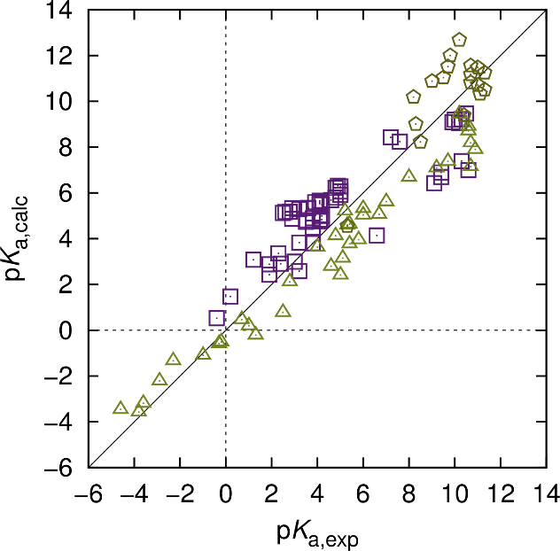
SAMPL5 (2015): log D_{7.4} (water/cyclohexane)
Results – pK_{a} optimization
Post-submission phase: Δ_{solv}G optimization and EC-RISM-optimized pK_{a}
RMSE 1.52
C. C. Bannan, K. H. Burley, M. Chiu, M. R. Shirts, M. K. Gilson, D. L. Mobley, J. Comput.-Aided Mol. Des. 30, 927 (2016)
N. Tielker, D. Tomazic, J. Heil, T. Kloss, S. Ehrhart, S. Güssregen, K. F. Schmidt, S. M. Kast, J. Comput.-Aided Molec. Des. 30, 1035 (2016)
C. P. Kelly, C. J. Cramer, D.G. Truhlar, J. Chem. Theory Comput. 1, 1133 (2005)
D. Palmer, A. Frolov, E. Ratkova, M. V. Fedorov, J. Phys. Cond. Matter. 22, 492101 (2010)
J. J. Klicić, R. A. Friesner, S. Y. Liu, W. C. Guida, J. Phys. Chem. A 106, 1327 (2002)

Slide 11
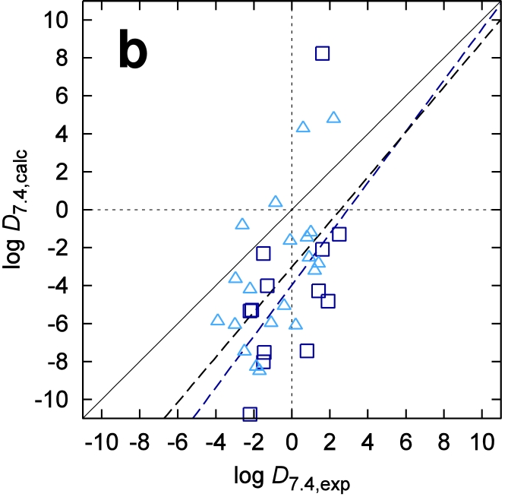
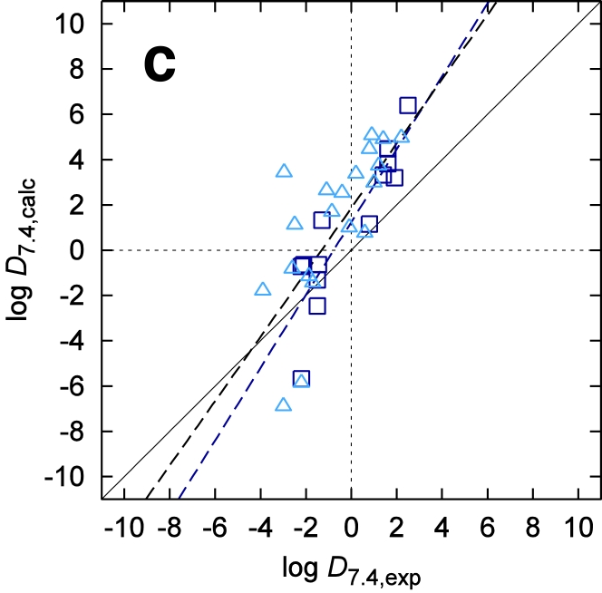
SAMPL5 (2015): log D_{7.4} (water/cyclohexane)
Results – batches 0+1
Submission setup
Δ_{solv}G optimization, MoKa pK_{a}
Post-submission setup
Δ_{solv}G optimization, EC-RISM pK_{a}
RMSE 4.61
RMSE 2.76
C. C. Bannan, K. H. Burley, M. Chiu, M. R. Shirts, M. K. Gilson, D. L. Mobley, J. Comput.-Aided Mol. Des. 30, 927 (2016)
N. Tielker, D. Tomazic, J. Heil, T. Kloss, S. Ehrhart, S. Güssregen, K. F. Schmidt, S. M. Kast, J. Comput.-Aided Molec. Des. 30, 1035 (2016)

Slide 12
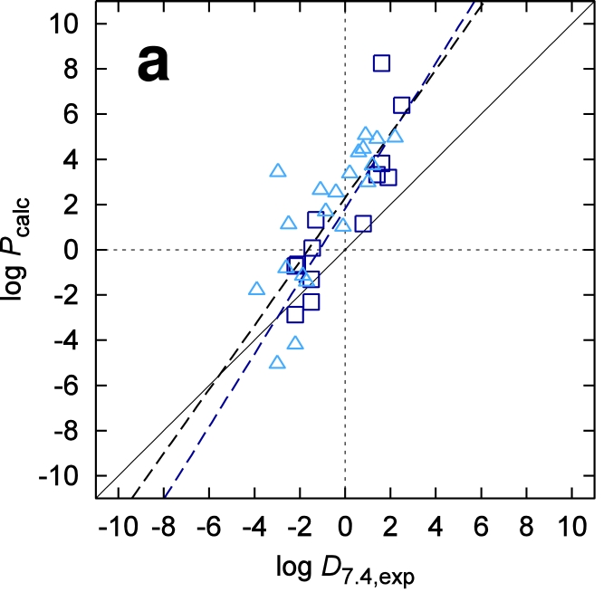
SAMPL5 (2015): log D_{7.4} (water/cyclohexane)
Results – batches 0+1
Submission setup
Δ_{solv}G optimization, log P only
Post-submission setup
Δ_{solv}G optimization, EC-RISM pK_{a}
RMSE 2.86
RMSE 2.76
C. C. Bannan, K. H. Burley, M. Chiu, M. R. Shirts, M. K. Gilson, D. L. Mobley, J. Comput.-Aided Mol. Des. 30, 927 (2016)
N. Tielker, D. Tomazic, J. Heil, T. Kloss, S. Ehrhart, S. Güssregen, K. F. Schmidt, S. M. Kast, J. Comput.-Aided Molec. Des. 30, 1035 (2016)

Slide 13
SAMPL6 (2017): pK_{a}
Workflow
All tautomers (microstates) taken as provided (partition function)
Conformational sampling (Macromodel/OPLS3)
Filtered set (5 kcal/mol): geometry optimization B3LYP/6-311+G(d,p)/PCM, selection of global optimum (submission: force field, post-submission: re-ranked QM)
Calibration of solvation free energies on MNSOL dataset (2-par water)
EC-RISM pK_{a} (trained on Klicić et al. dataset with 2-par water)
Production: MP2/6-311+G(d,p)/EC-RISM/PSE-2, no thermal corrections, 1 and 2 geometries, exact electrostatics, GAFF
Submission: Not accounting for aperiodic wave function potential
Post-submission: MNSOL/Klicić-retrained models with periodicity correction
M. Işik, …, D. L. Mobley, T. Rhodes, J. D. Chodera, J. Comput.-Aided Mol. Des. 32, 1117 (2018)
N. Tielker, L. Eberlein, S. Güssregen, S. M. Kast, J. Comput.-Aided Mol. Des. 32, 1151 (2018)
C. P. Kelly, C. J. Cramer, D.G. Truhlar, J. Chem. Theory Comput. 1, 1133 (2005)
D. Palmer, A. Frolov, E. Ratkova, M. V. Fedorov, J. Phys. Cond. Matter. 22, 492101 (2010)
J. J. Klicić, R. A. Friesner, S. Y. Liu, W. C. Guida, J. Phys. Chem. A 106, 1327 (2002)

Slide 14
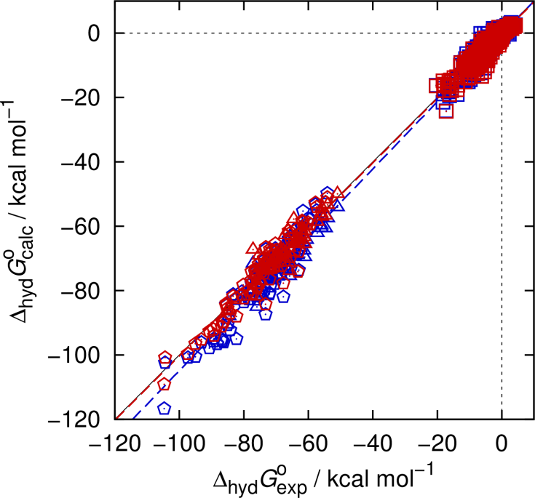
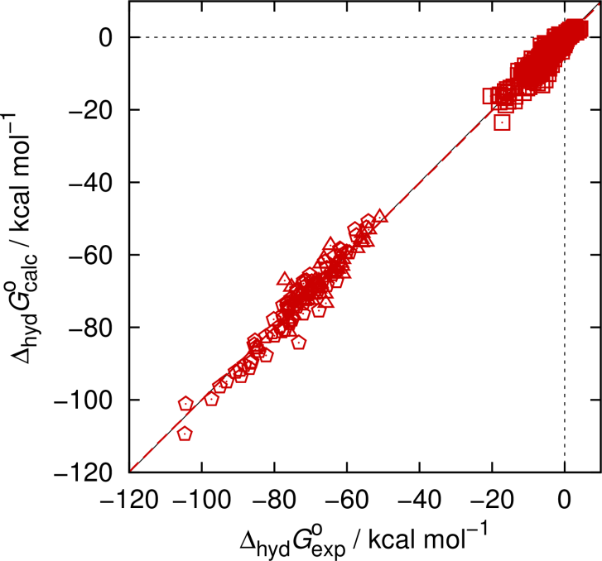
SAMPL6 (2017): pK_{a}
Results – Δ_{hyd}G optimization
Submission setup
uncorrected electrostatics
Post-submission setup
periodicity-corrected electrostatics
RMSE 2.98 (q)
RMSE 2.20
RMSE 2.04
M. Işik, …, D. L. Mobley, T. Rhodes, J. D. Chodera, J. Comput.-Aided Mol. Des. 32, 1117 (2018)
N. Tielker, L. Eberlein, S. Güssregen, S. M. Kast, J. Comput.-Aided Mol. Des. 32, 1151 (2018)
C. P. Kelly, C. J. Cramer, D.G. Truhlar, J. Chem. Theory Comput. 1, 1133 (2005)
D. Palmer, A. Frolov, E. Ratkova, M. V. Fedorov, J. Phys. Cond. Matter. 22, 492101 (2010)
J. J. Klicić, R. A. Friesner, S. Y. Liu, W. C. Guida, J. Phys. Chem. A 106, 1327 (2002)

Slide 15
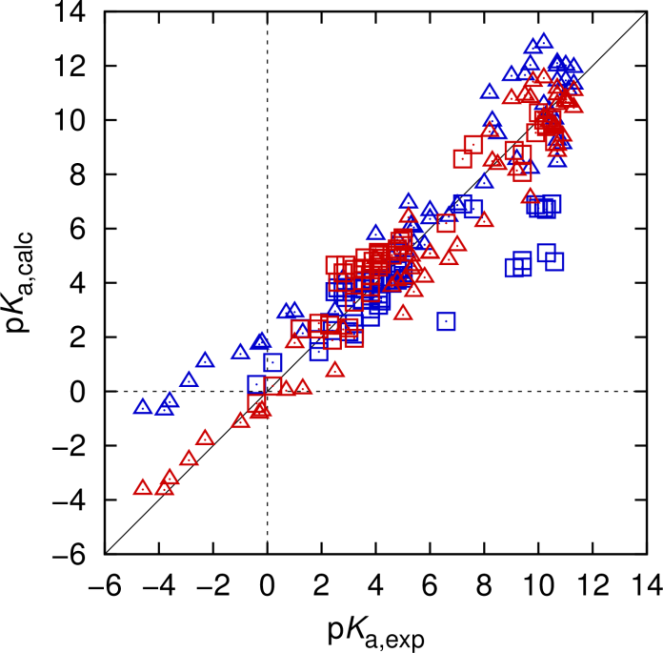
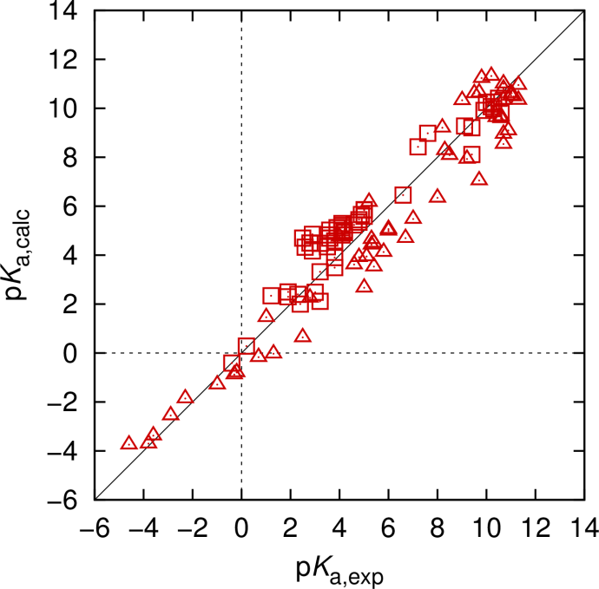
SAMPL6 (2017): pK_{a}
Results – pK_{a} optimization
Submission setup
uncorrected electrostatics
Post-submission setup
periodicity-corrected electrostatics
RMSE 1.88 (q)
RMSE 1.00
RMSE 1.04
M. Işik, …, D. L. Mobley, T. Rhodes, J. D. Chodera, J. Comput.-Aided Mol. Des. 32, 1117 (2018)
N. Tielker, L. Eberlein, S. Güssregen, S. M. Kast, J. Comput.-Aided Mol. Des. 32, 1151 (2018)
C. P. Kelly, C. J. Cramer, D.G. Truhlar, J. Chem. Theory Comput. 1, 1133 (2005)
D. Palmer, A. Frolov, E. Ratkova, M. V. Fedorov, J. Phys. Cond. Matter. 22, 492101 (2010)
J. J. Klicić, R. A. Friesner, S. Y. Liu, W. C. Guida, J. Phys. Chem. A 106, 1327 (2002)

Slide 16
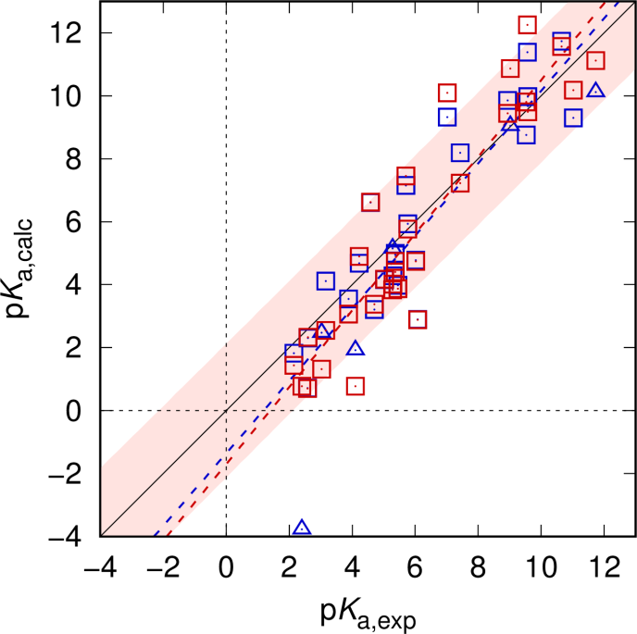
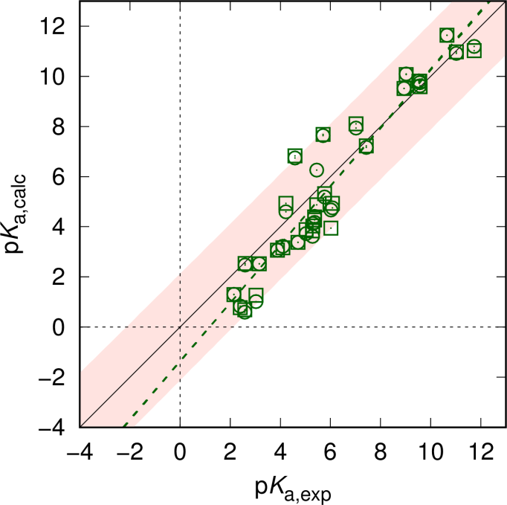
SAMPL6 (2017): pK_{a}
Results – SAMPL6 dataset
Submission/post-submission setup
original structures
Post-submission setup
re-ranked structures
RMSE 1.70
RMSE 1.15/1.13
RMSE 1.54
M. Işik, …, D. L. Mobley, T. Rhodes, J. D. Chodera, J. Comput.-Aided Mol. Des. 32, 1117 (2018)
N. Tielker, L. Eberlein, S. Güssregen, S. M. Kast, J. Comput.-Aided Mol. Des. 32, 1151 (2018)

Slide 17
SAMPL6.II (2019): log P (water/octanol)
Workflow
Take post-submission optimized neutral structures from SAMPL6
Geometry optimization B3LYP/6-311+G(d,p)/PCM(oct)
Use water model as in SAMPL6
Calibration of octanol solvation free energies on MNSOL dataset (2-par)
Production as in optimized SAMPL6 workflow:
MP2/6-311+G(d,p)/EC-RISM/PSE-2, no thermal corrections, partition function (all < 5 kcal/mol), exact electrostatics, GAFF
Dry and wet octanol models (ua, experimental densities and mole fractions,
1D RISM/HNC)
N. Tielker, L. Eberlein, S. Güssregen, S. M. Kast, J. Comput.-Aided Mol. Des. 32, 1151 (2018)
C. P. Kelly, C. J. Cramer, D. G. Truhlar, J. Chem. Theory Comput. 1, 1133 (2005)
W. L. Jorgensen, J. Phys. Chem. 90, 1276 (1986)

Slide 18
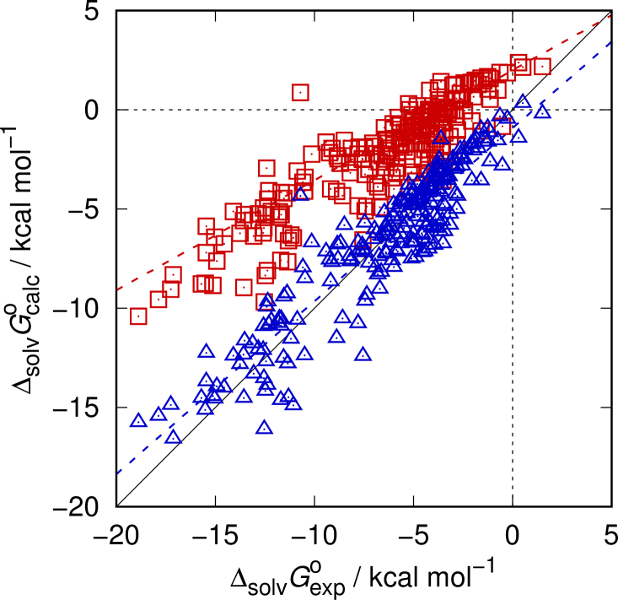
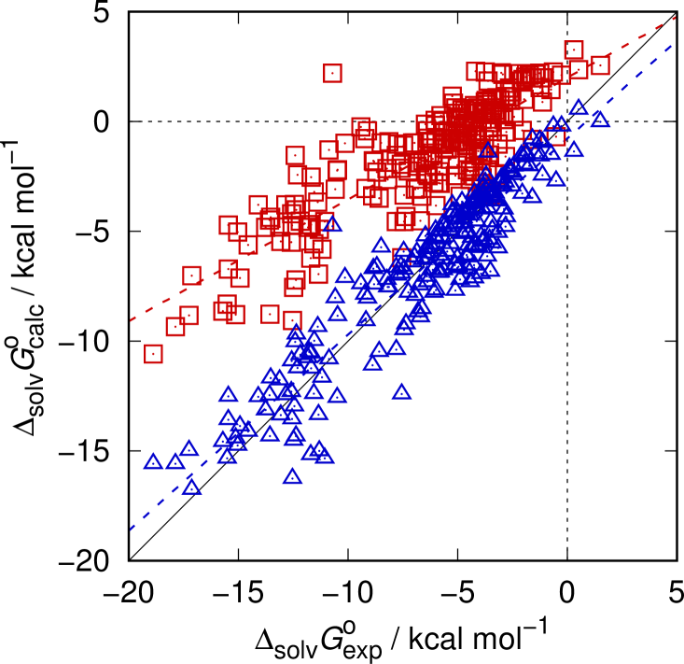
SAMPL6.II (2019): log P (water/octanol)
Results – Δ_{solv}G optimization (MNSOL, 2-par)
Wet octanol
Dry octanol
RMSE 5.40
RMSE 4.74
RMSE 1.51
RMSE 1.48
(RMSE log P wet/dry 0.89 / 0.98)
N. Tielker, L. Eberlein, S. Güssregen, S. M. Kast, J. Comput.-Aided Mol. Des. 32, 1151 (2018)
C. P. Kelly, C. J. Cramer, D. G. Truhlar, J. Chem. Theory Comput. 1, 1133 (2005)
W. L. Jorgensen, J. Phys. Chem. 90, 1276 (1986)

Slide 19
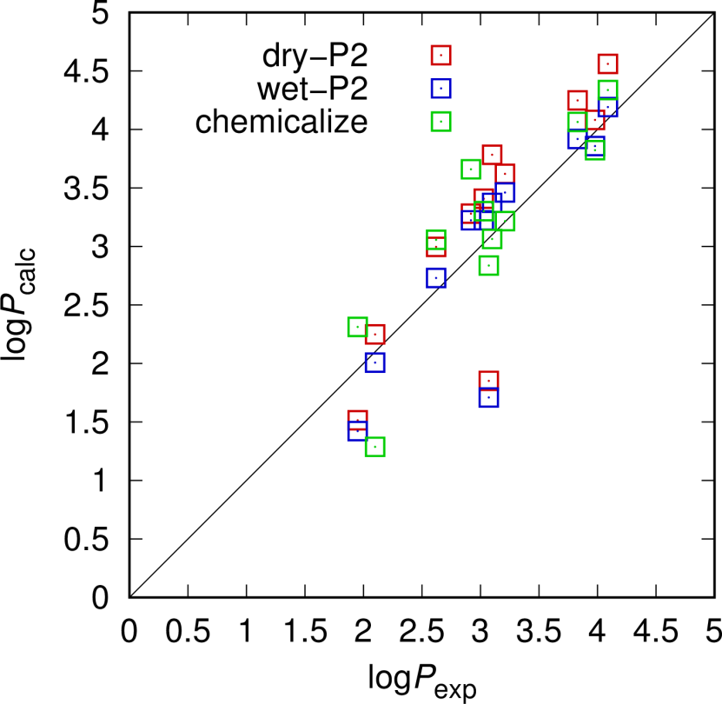
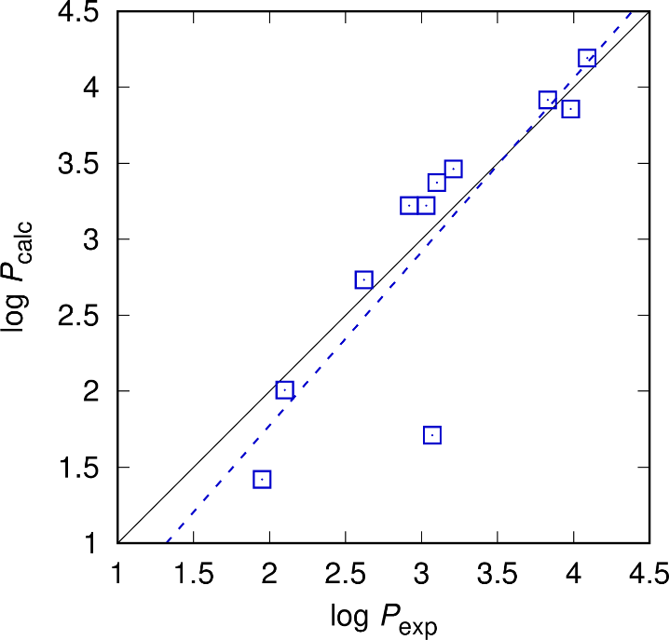
SAMPL6.II (2019): log P (water/octanol)
Results – log P
j8nwc (wet)
RMSE 0.54
RMSE 0.40
RMSE 0.47
N. Tielker, L. Eberlein, S. Güssregen, S. M. Kast, J. Comput.-Aided Mol. Des. 32, 1151 (2018)
W. L. Jorgensen, J. Phys. Chem. 90, 1276 (1986)

Slide 20
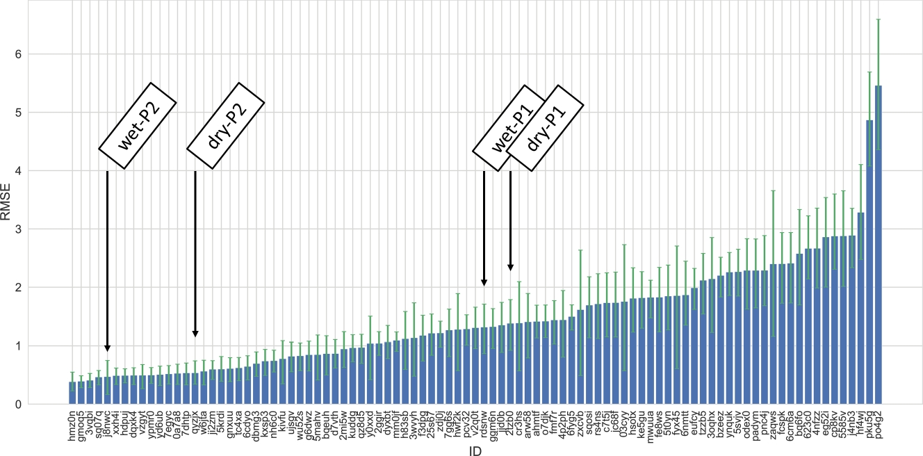
SAMPL6.II (2019): log P (water/octanol)
Results – log P

Slide 21
SAMPL6.II (2019): log P (water/octanol)
Results – log P
Wet octanol performs best, as expected
One single outlier distorts results
j8nwc (wet)
SM15
SM14
N. Tielker, L. Eberlein, S. Güssregen, S. M. Kast, J. Comput.-Aided Mol. Des. 32, 1151 (2018)
W. L. Jorgensen, J. Phys. Chem. 90, 1276 (1986)

Slide 22
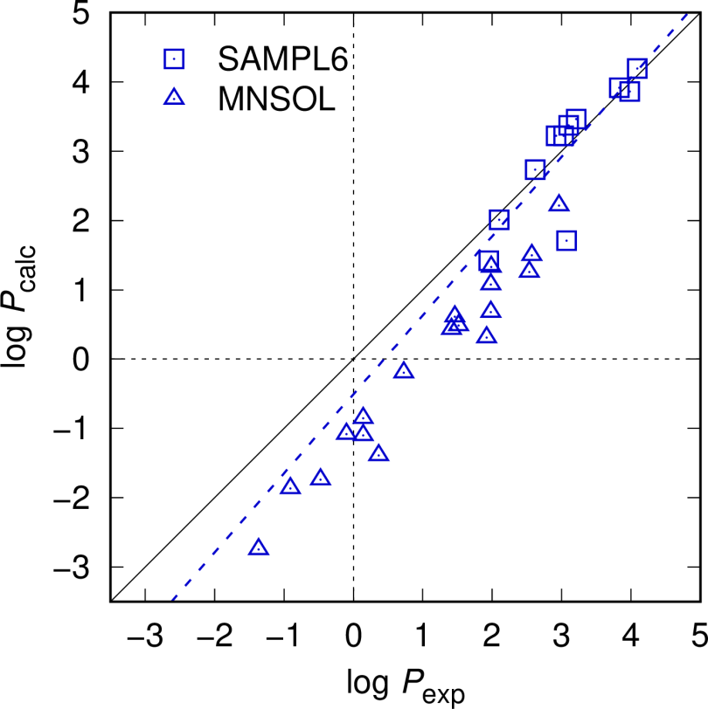
SAMPL6.II (2019): log P (water/octanol)
Results – log P
Outlier: alcohol
Other MNSOL alcohols also show systematic deviation: GAFF problem
j8nwc (wet)
MNSOL alcohols
N. Tielker, L. Eberlein, S. Güssregen, S. M. Kast, J. Comput.-Aided Mol. Des. 32, 1151 (2018)
C. P. Kelly, C. J. Cramer, D. G. Truhlar, J. Chem. Theory Comput. 1, 1133 (2005)
W. L. Jorgensen, J. Phys. Chem. 90, 1276 (1986)

Slide 23
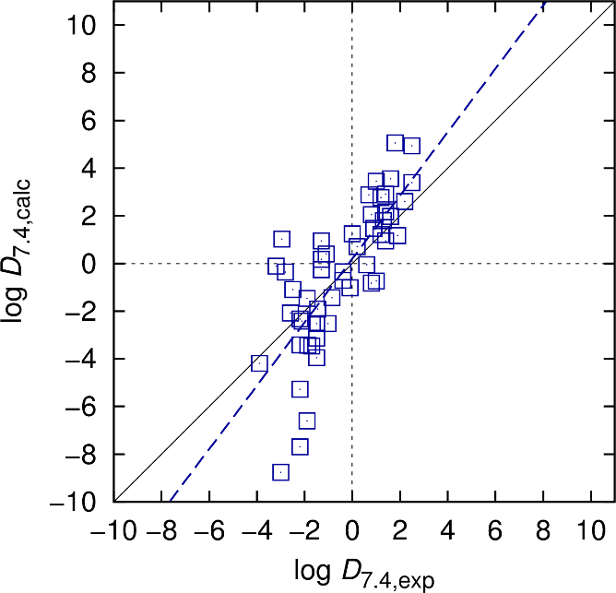
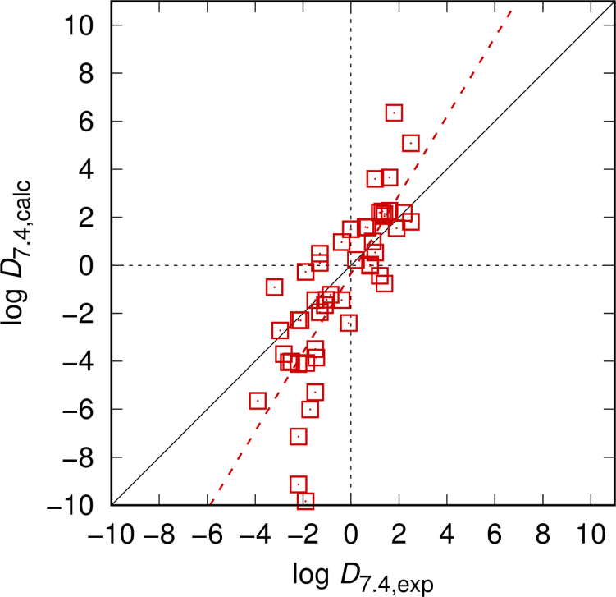
SAMPL5 with SAMPL6 setup
Results – log D_{7.4}(water/cyclohexane), batches 0+1+2
SAMPL5 setup
point charges, 3-par water,
single conformation
SAMPL6 setup
exact periodicity-corrected electrostatics, 2-par water, partition function < 5 kcal/mol
RMSE 2.02
RMSE 2.53
N. Tielker, L. Eberlein, S. Güssregen, S. M. Kast, J. Comput.-Aided Mol. Des. 32, 1151 (2018)
A. Klamt, F. Eckert, J. Reinisch, K. Wichmann, J. Comput.-Aided Mol. Des. 30, 959 (2016)
N. Tielker, D. Tomazic, J. Heil, T. Kloss, S. Ehrhart, S. Güssregen, K. F. Schmidt, S. M. Kast, J. Comput.-Aided Molec. Des. 30, 1035 (2016)

Slide 24

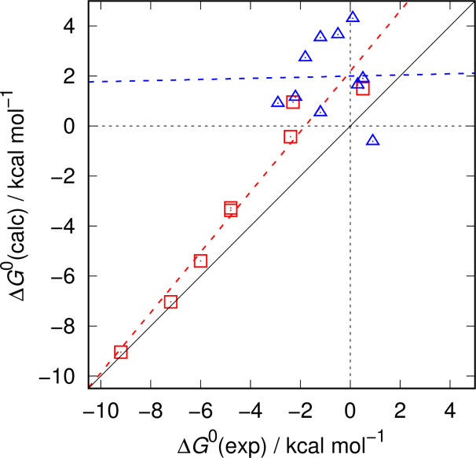
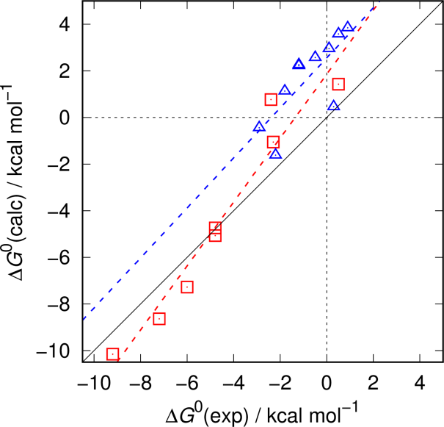
SAMPL2 with SAMPL6 setup (and beyond)
Results – Tautomers (explanatory: 5-rings / obscure: 6-rings)
SAMPL6 setup
exact periodicity-corrected electrostatics, 2-par water
explicit gas phase CCSD(T)/cc-pVQZ/thermal
SAMPL2 setup
point charges,
no PMV correction
SAMPL6 setup
exact periodicity-corrected electrostatics, 2-par water
RMSE 0.57
RMSE 3.36
RMSE 2.72
RMSE 2.91
RMSE 1.59
RMSE 1.46
N. Tielker, L. Eberlein, S. Güssregen, S. M. Kast, J. Comput.-Aided Mol. Des. 32, 1151 (2018)
S. M. Kast, J. Heil, S. Güssregen, K. F. Schmidt, J. Comput.-Aided Mol. Des. 24, 343 (2010)

Slide 25
A SAMPL journey: From 2 over 5 to 6 and 6.II, and back to square one
Timeline summary in RMSE (kcal/mol|pK) units
2008 – PSE closures, EC-RISM
2009 – SAMPL2: Δ_{hyd}G ≈ 20.8 (training)
Δ_{taut}G ≈ 2.0
2015 – SAMPL5: Δ_{hyd}G ≈ 2.4 (training)
+PMV correction log D ≈ 4.6 (MoKa), 2.0
pK_{a} ≈ 1.5 (training)
Can we challenge experiments?
No, but some open experimental questions persist
For us: Re-optimize LJ parameters,
add few explicit waters
Extend experimental data base
2017 – SAMPL6: Δ_{hyd}G ≈ 2.2, 2.0
+ex. electrostatics pK_{a} ≈ 1.0 (training); 1.7, 1.1
2019 – SAMPL6.II: log P ≈ 0.5
+SAMPL6-style log D ≈ 2.5 (SAMPL5)
+CCSD(T) extension Δ_{taut}G ≈ 2.5, 2.0 (SAMPL2)

Slide 26



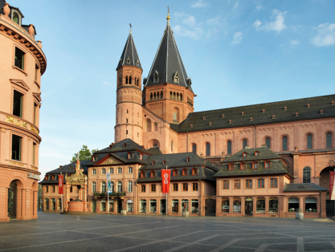
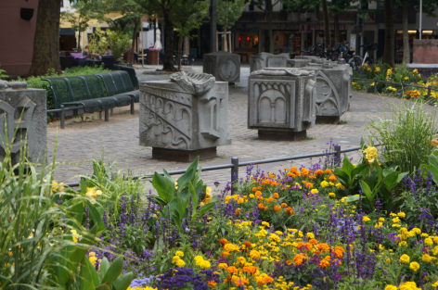
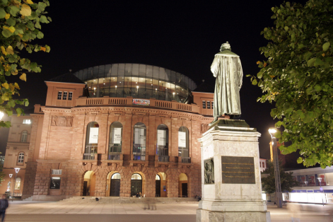
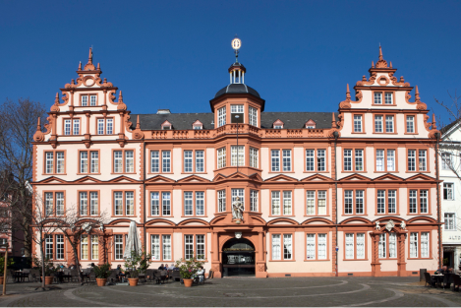
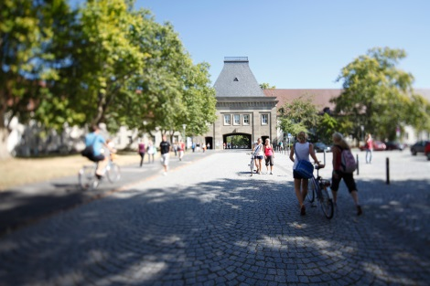
GCC 2019
Registration is still open
15th GERMAN CONFERENCE ON
CHEMINFORMATICS
November 3-5, 2019
in Mainz / Germany
https://www.gdch.de/gcc2019
Computers in Chemistry (CIC)
subdivision of the GDCh

Slide 27
GCC 2019
Keynote speakers
Michael Beck, Bayer/DE
John Chodera, MSKCC/US
Kate Holloway, GfreeBio/US
Nicole Jung, KIT/DE
Esther Kellenberger, University of Strasbourg/FR
Alpha Lee, University of Cambridge/UK
Stefan Raunser, MPI Dortmund/DE
Horst Weiss, BASF/DE

Slide 28


GCC 2020/EuroSAMPL
Save the date
16th GERMAN CONFERENCE ON
CHEMINFORMATICS
and EuroSAMPL satellite workshop
November 1-5, 2020
in Mainz / Germany

Slide 30
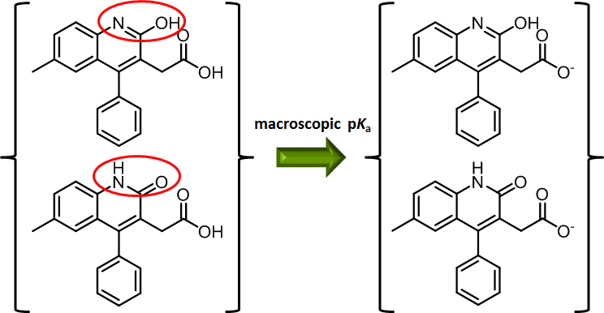
A side remark: pK_{a} calculations for multistate species
Microstate transition and partition function equivalence for m = 1 only
N. Tielker, L. Eberlein, C. Chodun, S. Güssregen, S. M. Kast, J. Mol. Model. 25, 139 (2019)

Slide 31

A side remark: pK_{a} calculations for multistate species
Microstate transition and partition function equivalence for m = 1 only
N. Tielker, L. Eberlein, C. Chodun, S. Güssregen, S. M. Kast, J. Mol. Model. 25, 139 (2019)

