Slide 1
Protein-Ligand affinity prediction via Artificial Intelligence &
Quantum Chemistry
Thomas Evangelidis
www.linkedin.com/in/thomasevangelidis
@tevangelidis
github.com/tevang
tevang3@gmail.com

Slide 2
Agenda
deepScaffOpt algorithm for affinity ranking.
SQM/COSMO scoring for affinity and pose ranking.

Slide 3
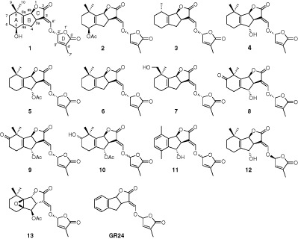
The Lead Optimization problem
… x 1000
I can synthesize all these analogues of hit compound (1), but I have time and resources to make only few. Which ones do you suggest ???

Slide 4
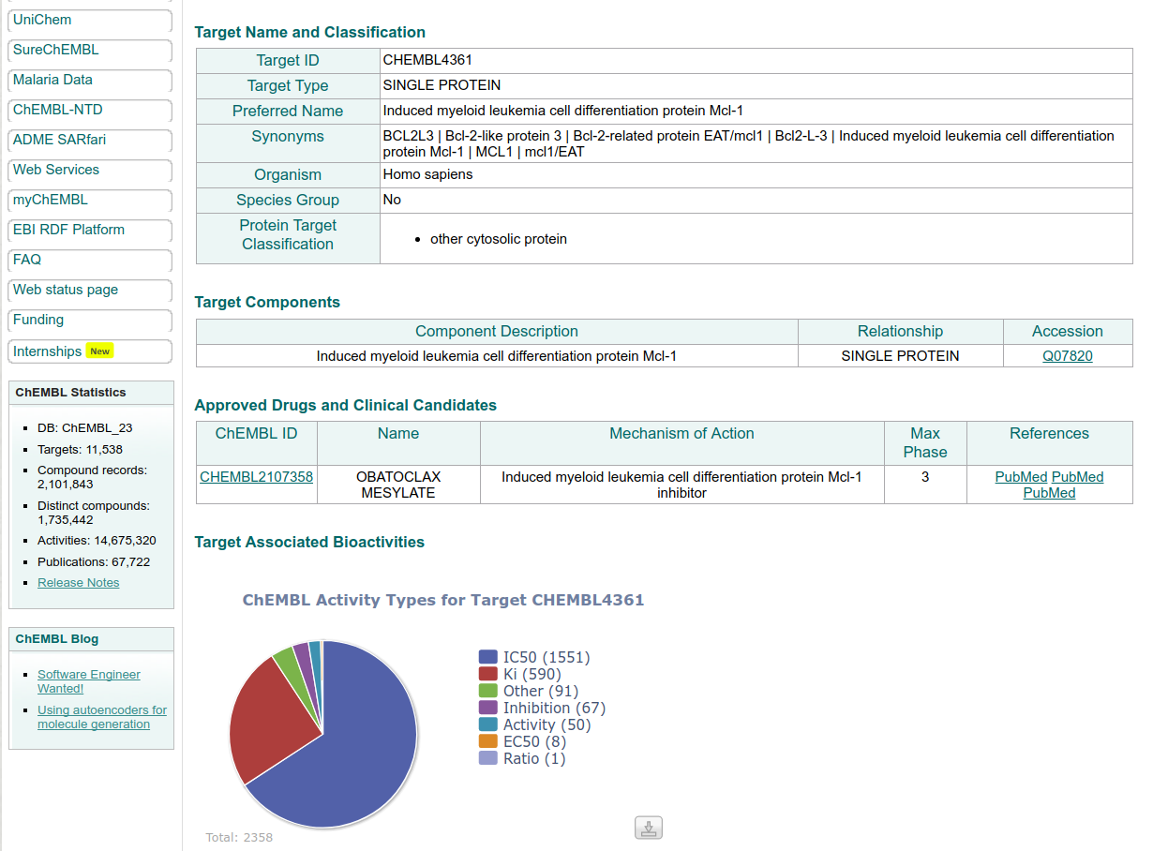
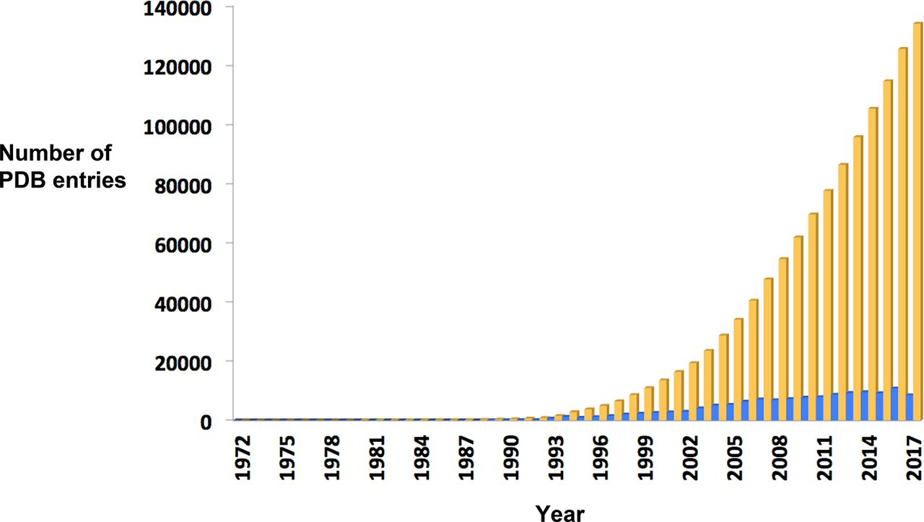
Big Data Era

Slide 5
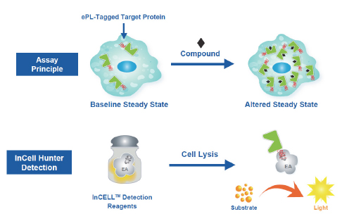
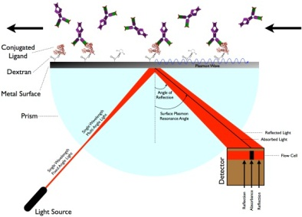
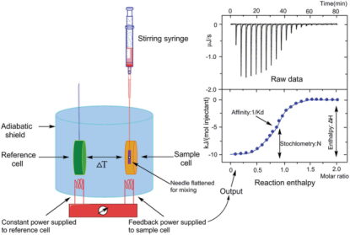
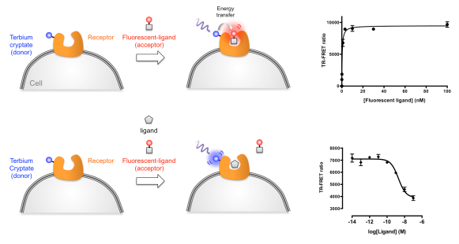
Loss Function
Binding affinities from different experiments are not comparable
SPR
Cell-based Assays
ITC
Cell-free Assays
FRET
Different treatment for each:
type of measurement (K_{d}, K_{i}, IC50, EC50, T_{m}, % Inhibition, % Activity, etc.)
cell-free, cell-based
binding, functional (biological effect)
Notes:
BINDING: data measuring the binding of a compound to a molecular target, e.g. Ki, IC50, Kd.
FUNCTIONAL: data measuring the biological effect of a compound, e.g. % cell death in a cell line, rat weight.

Slide 6
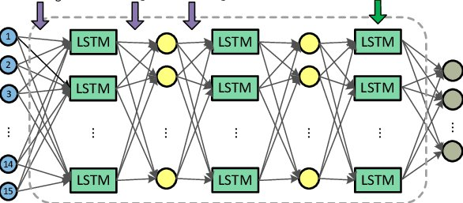
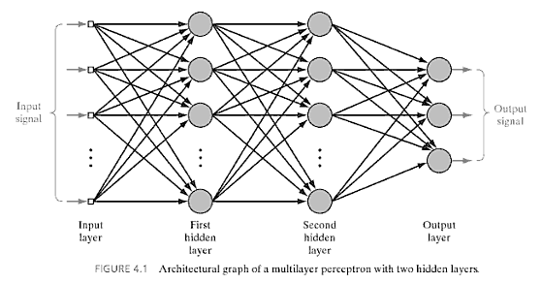
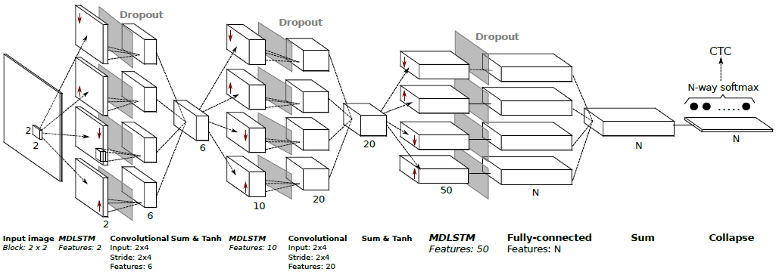
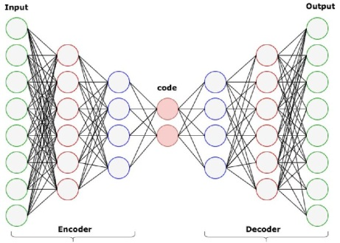
Feed-Forward layers are the common component in all types of networks.
Deep network with 3 Long Short Term Memory (LSTM) layers and 2 feed-forward layers. [Zhu et al., 2016]
Feed-forward network (Multi-layer Perceptron).
Multidirectional LSTM net with Convolutional layers.
[Pham et al., 2013]
Typical sequential Convolutional Neural Network (CNN).
[Baldominos et al., 2018]
Autoencoder network.

Slide 7
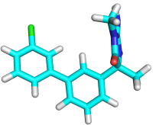
The deepScaffOpt architecture
Arbitrary number of feature vector types
MLP: multi-layer perceptron regressor; RF: random forest regressor;
Default settings: N > 200, k ϵ [10, 50]
New
molecule
Feature
vectors
Predicted
Binding Affinity
[-0.13, 0.14, -0.37, -0.11, -0.57, -0.6, 0.5, -0.99] [-21.4, 93.94, 98.91, 18.36, 79.22, 44.13, 5.99, 77.71] [1, 1, 0, 0, 1, 1, 1, 1] [34, 12, 12, 4, 10, 27, 19, 27]

Slide 8
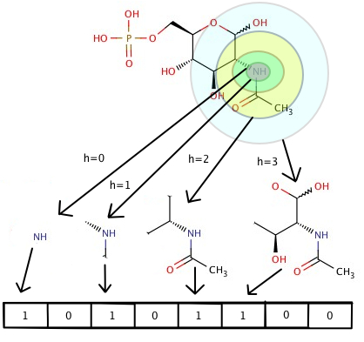
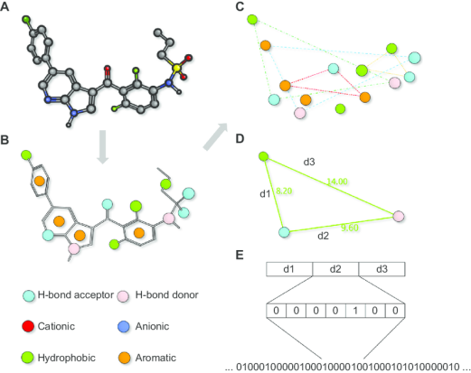
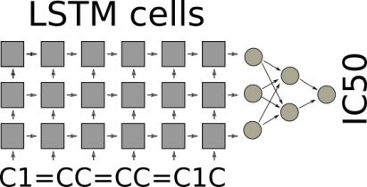
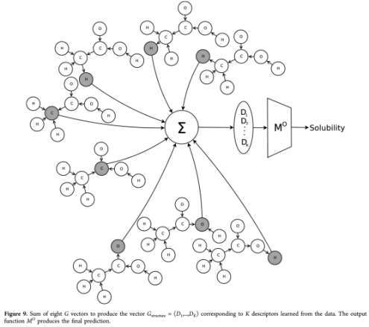
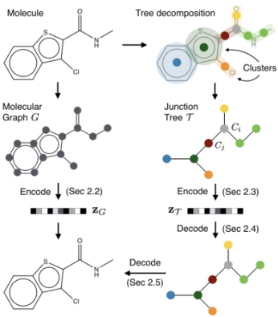
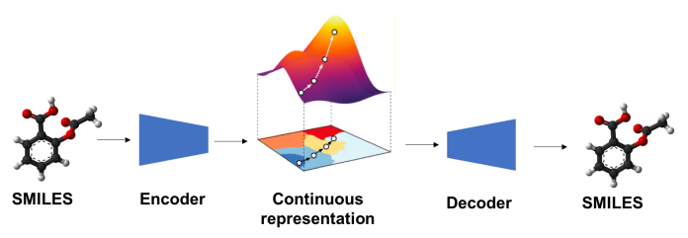
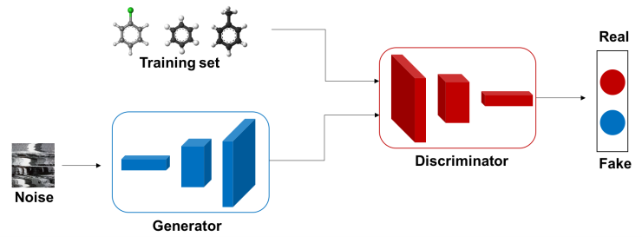
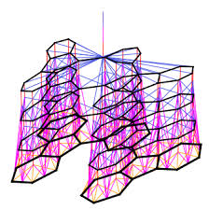
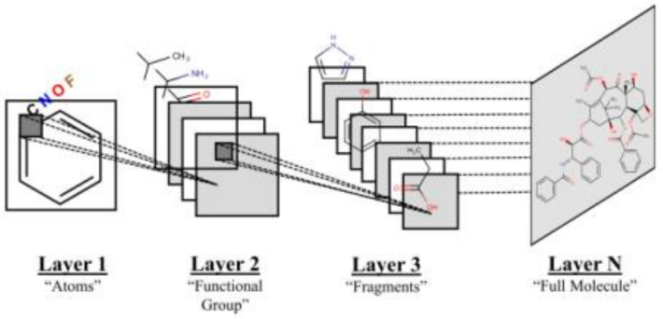
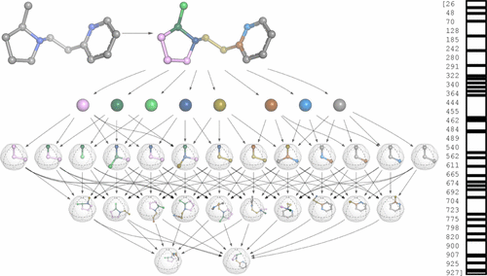
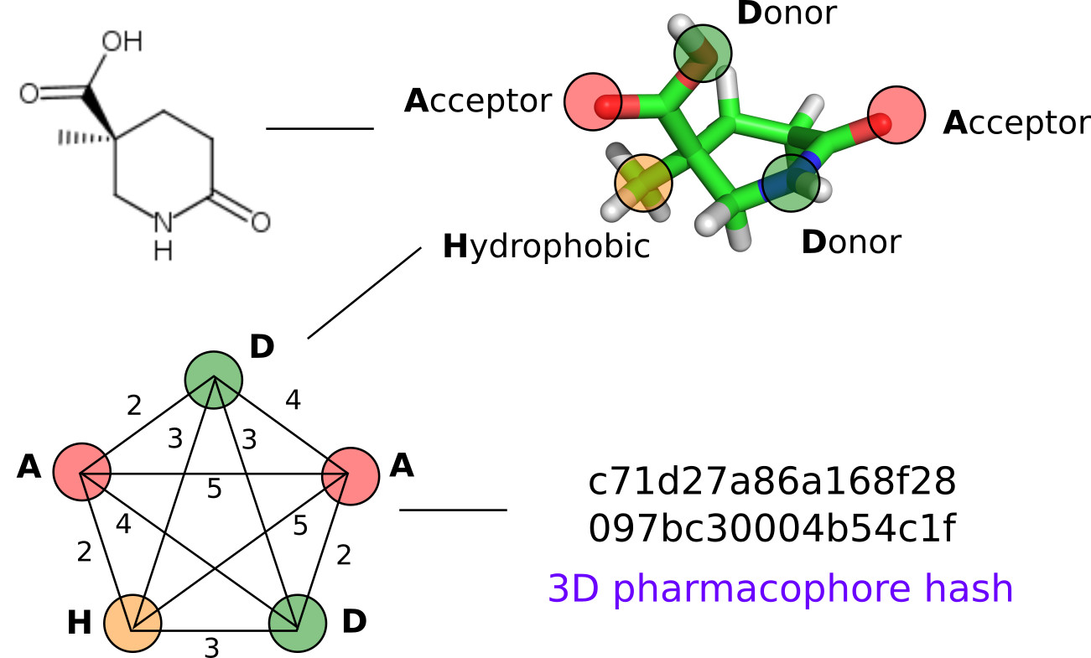
Uncharted Territory
2D Circular Fingerprints
2D Pharmacophore Fingerprints
Undirected Graph – Recursive Network
deepScaffOpt
Variational AutoEncoder
Generative Adversarial Network
Junction Tree
Variation AutoEncoder
Uncharted Territory
2D Convolutional Networks
Molecular Neural Graphs
3D Extended Connectivity Fingerprints
Alignment-independent
3D-Pharmacophores
Notes:
2D Circular & 2D Pharmacophore Fingerprints were the main work force for deepScaffOpt.
They both encode which substructures are present in a molecule in a way that is invariant to atom-relabeling.

Slide 9
Feature Vectors currently used by deepScaffOpt
Topological:
ECFP: rdkit.Chem.AllChem.GetMorganFingerprintAsBitVect
FCFP: rdkit.Chem.AllChem.GetMorganFingerprintAsBitVect(useFeatures=True)
RDK5: rdkit.Chem.RDKFingerprint
Mol2Vec: https://github.com/samoturk/mol2vec
2D Pharmacophore:
2Dpp: rdkit.Chem.Pharm2D.Generate.Gen2DFingerprint​
ErgFP: rdkit.Chem.rdReducedGraphs.GetErGFingerprint
3D Pharmacophore (only in old version, “ScaffOpt”):
3Dpp (MD averaged): rdkit.Chem.Pharm2D.Generate.Gen2DFingerprint​
Notes:
Mol2vec learns vector representations of molecular substructures that point in similar directions for chemically related substructures. Compounds can finally be encoded as vectors by summing the vectors of the individual substructures and, for instance, be fed into supervised machine learning approaches to predict compound properties. The underlying substructure vector embeddings are obtained by training an unsupervised machine learning approach on a so-called corpus of compounds that consists of all available chemical matter. The resulting Mol2vec model is pretrained once, yields dense vector representations, and overcomes drawbacks of common compound feature representations such as sparseness and bit collisions.

Slide 10
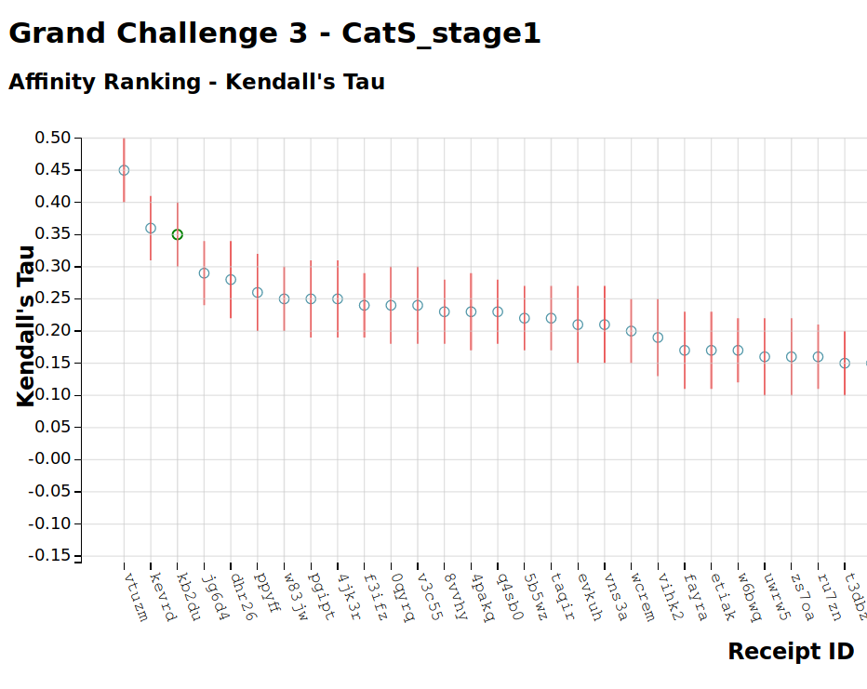
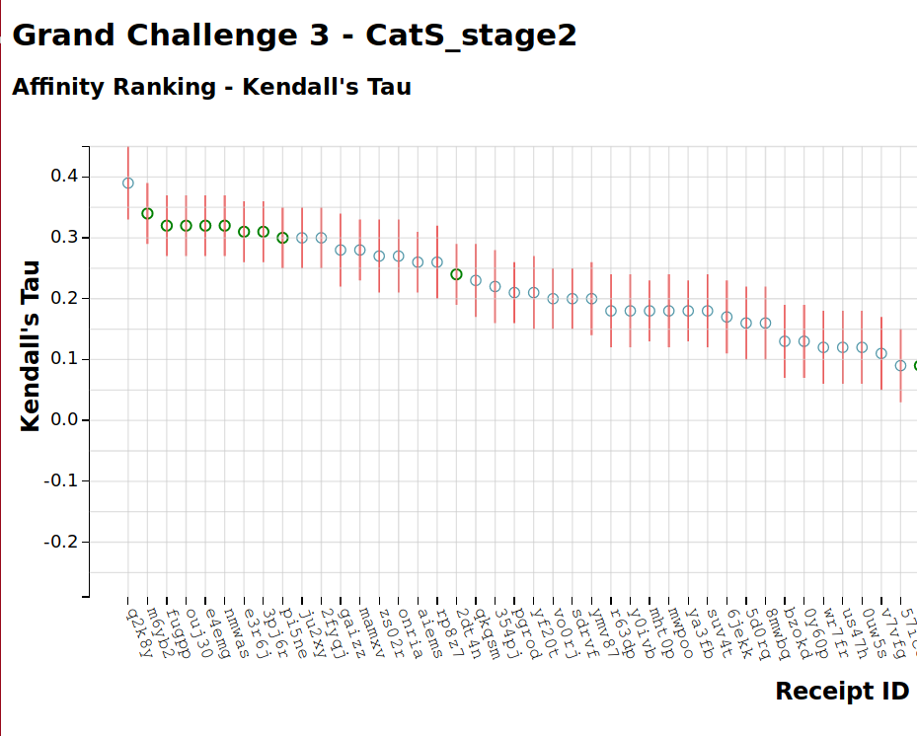
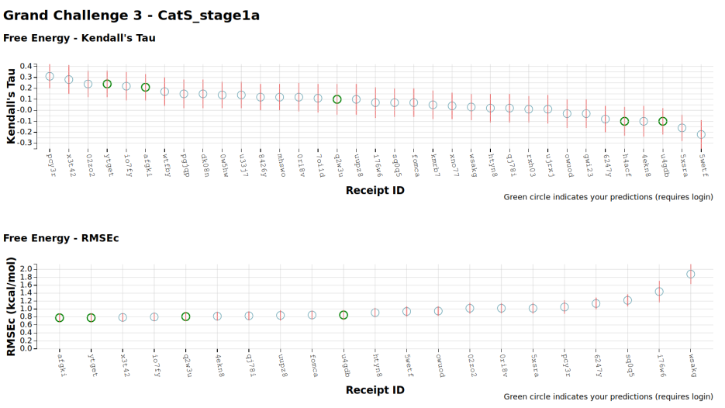
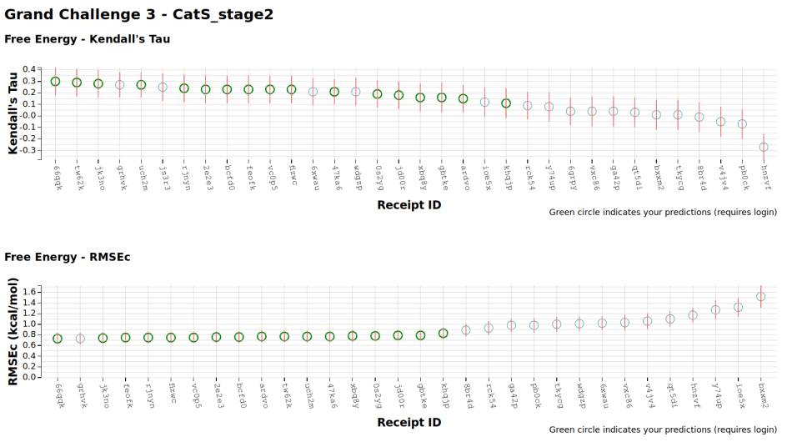
D3R Grand Challenge 2017
27 participants, 303 submissions
Official
Participation

Slide 11
D3R Grand Challenge 3 2017
Retrospective
Evaluation
CatS dataset
(136 test compounds , 2223 training compounds)
1st position
1st position
P38-α dataset
(31 test compounds , 4855 training compounds)
Notes:
CatSstg2, 2223 training compounds, 136 test compounds, FCFP

Slide 12
D3R Grand Challenge 3 2017
Retrospective
Evaluation
VEGFR2 dataset
(43 test compounds , 8260training compounds)
1st position
Notes:
CatSstg2, 2223 training compounds, 136 test compounds, FCFP

Slide 13
D3R Grand Challenge 2 2016
Retrospective
Evaluation
FXR dataset
(102 test compounds , 502 training compounds)
1st position
Notes:
FXR, 502 training compounds, 102 test compounds, featvec ?

Slide 14
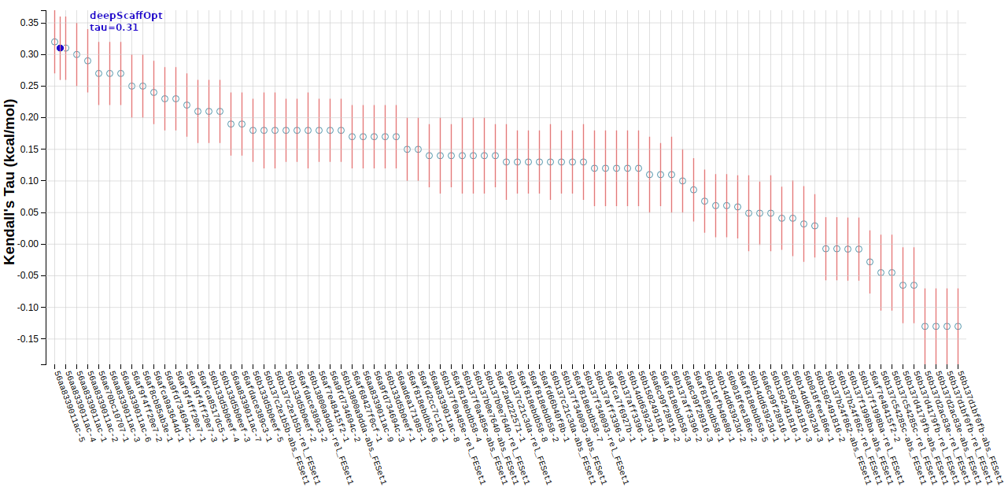
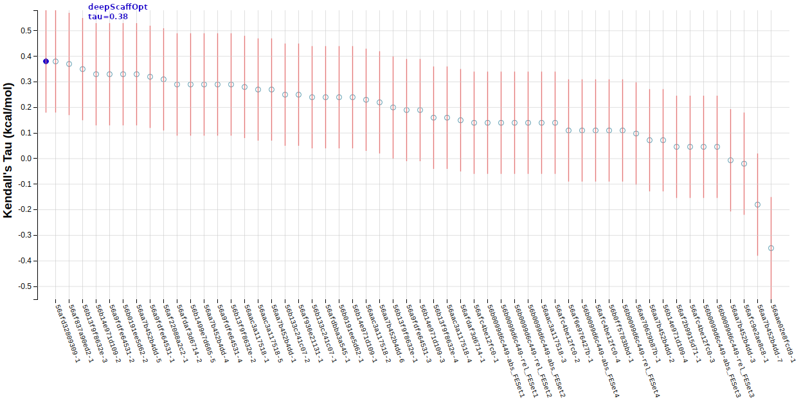
D3R Grand Challenge 1 2015
Retrospective
Evaluation
HSP90 dataset
(180 test compounds , 709 training compounds)
2nd position
MAP4K4
(18 test compounds , 160 training compound)
1st position
Notes:
HSP90, 709 training compounds, 180 test compounds, 2Dpp
MAP4K4, 2Dpp

Slide 15
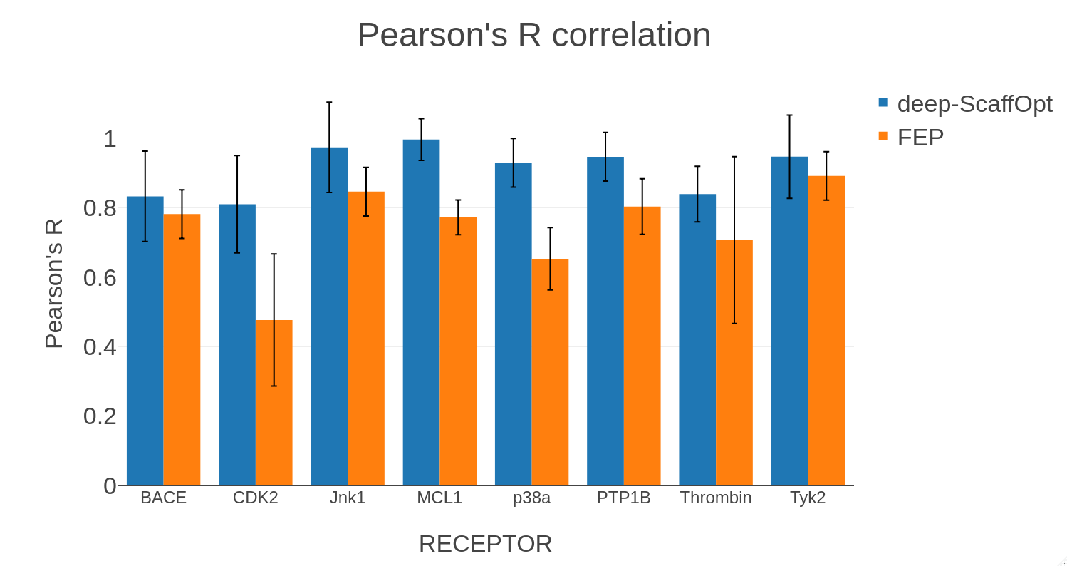
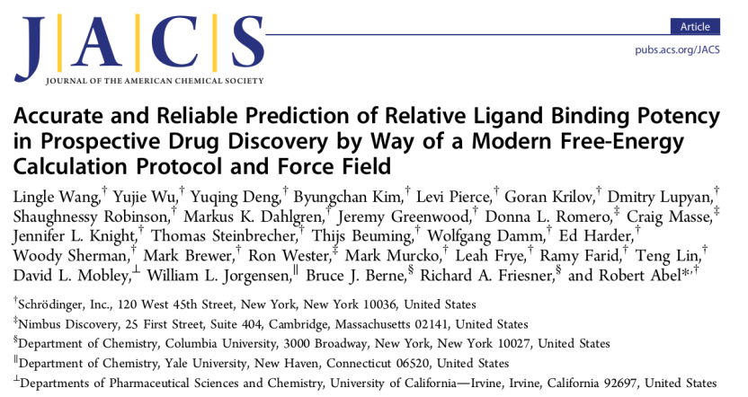
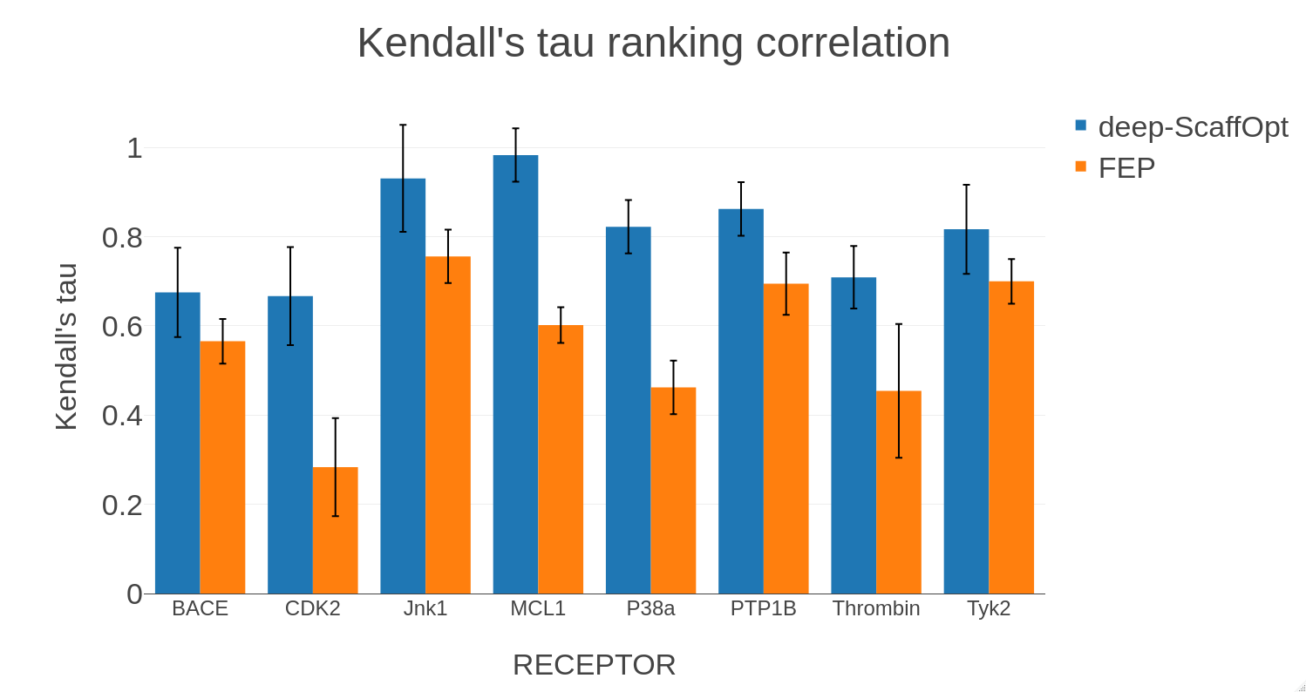
deepScaffOpt validation: correlations between Experimental and Predicted DeltaG for Schrodinger‘s datasets
+23% improvement
FEP+ (50,000-110,000 $/year)
11-42 ligands per dataset.
Only 1 chemical series per dataset.
+43% improvement

Slide 16
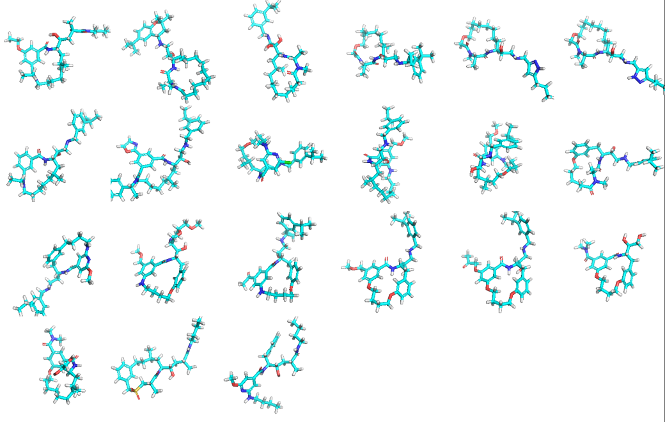
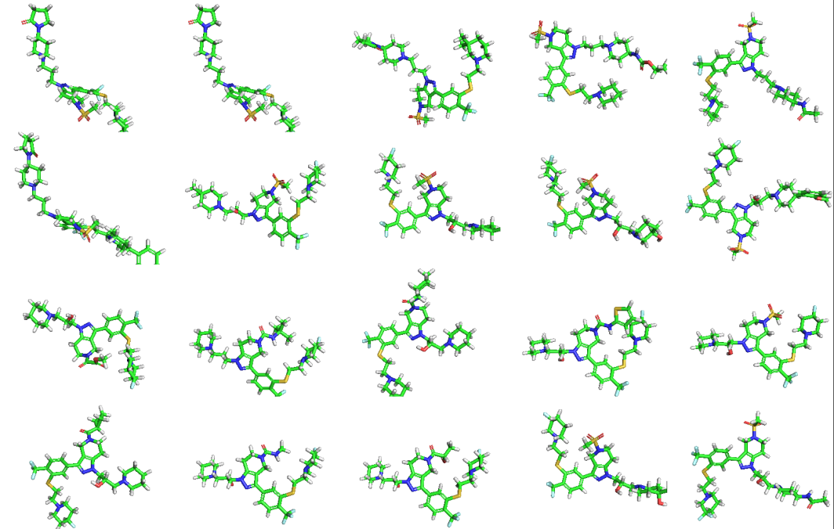
D3R Grand Challenge 2018
55 participants, 385 submissions
Set 1 BACE
154 compounds ( macrocycles! )
Set 2 CatS
459 compounds
min max mean stdev
Rings 1 6 3.4 1.0
RotatableBonds 4 22 10.8 2.56
HeavyAtoms 25 48 38.37 3.49
min max mean stdev
Rings 4 8 5.76 0.66
RotatableBonds 6 18 11.44 2.17
HeavyAtoms 39 56 46.64 3.19

Slide 17
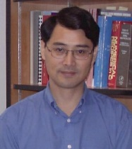
Set 1 BACE
154 compounds
Official
Participation
deepScaffOpt
13th position
tau=0.21
1st position
tau=0.54
Set 2 CatS
459 compounds
B3
Winner
Prof. Guowei Wei
deepScaffOpt

Slide 18
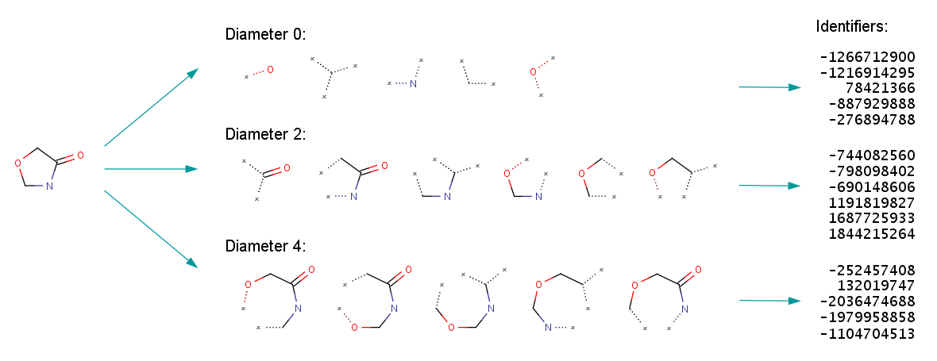
2D structure similarity fingerprint
Notes:
Oxazoline
The fingerprint generation process is as follows:
Initial assignment of atom identifiers The ECFP generation process begins with the assignment of an initial integer identifier to each non-hydrogen atom of the input molecule. This identifier captures some local information about the corresponding atom in such a way that various atom properties (e.g., atomic number, connection count, etc.) are packed into a single integer value using a hash function. The set of considered atom properties is an important configuration parameter of ECFPs, which can be fully customized (see later).
Iterative updating of identifiers After that, a number of iterations are performed to combine the initial atom identifiers with identifiers of neighboring atoms until a specified diameter is reached. Each iteration captures larger and larger circular neighborhoods around each atom, which are then encoded into single integer values using a suitable hashing method and these identifiers are collected into a list.
If the identifier counts should be kept, then this step is modified to store each integer identifier as many times as the corresponding substructural feature occurs in the molecule. The final step of the generation process is the removal of multiple identifier representations of equivalent atom neighborhoods. Two neighborhoods are considered to be equivalent if they contain exactly the same set of bonds or their hashed integer identifiers are the same.
Duplication removal
If the identifier counts should be kept, then this step is modified to store each integer identifier as many times as the corresponding substructural feature occurs in the molecule. The final step of the generation process is the removal of multiple identifier representations of equivalent atom neighborhoods. Two neighborhoods are considered to be equivalent if they contain exactly the same set of bonds or their hashed integer identifiers are the same.
The following figures illustrate the whole ECFP generation process, including the derivation of the fixed length bit string from the identifier list representation.

Slide 19
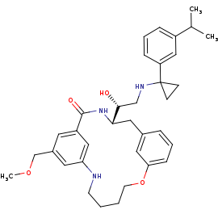
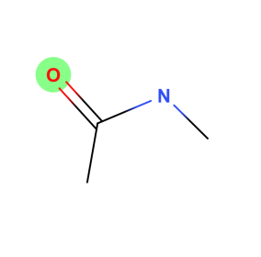
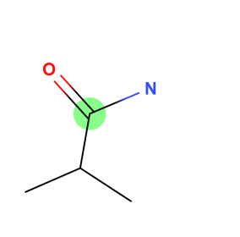
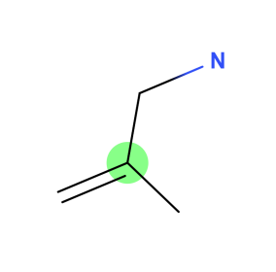
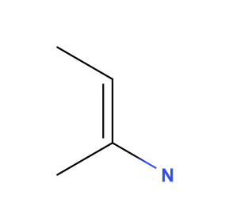
2D structure similarity fingerprint of a macrocycle
Cannot describing well atom properties within the macrocyclic environment!
Macrocycle
Diameter 4:
Notes:
Methyl-acetamide fragments.
The fingerprint generation process is as follows:
Initial assignment of atom identifiers The ECFP generation process begins with the assignment of an initial integer identifier to each non-hydrogen atom of the input molecule. This identifier captures some local information about the corresponding atom in such a way that various atom properties (e.g., atomic number, connection count, etc.) are packed into a single integer value using a hash function. The set of considered atom properties is an important configuration parameter of ECFPs, which can be fully customized (see later).
Iterative updating of identifiers After that, a number of iterations are performed to combine the initial atom identifiers with identifiers of neighboring atoms until a specified diameter is reached. Each iteration captures larger and larger circular neighborhoods around each atom, which are then encoded into single integer values using a suitable hashing method and these identifiers are collected into a list.
If the identifier counts should be kept, then this step is modified to store each integer identifier as many times as the corresponding substructural feature occurs in the molecule. The final step of the generation process is the removal of multiple identifier representations of equivalent atom neighborhoods. Two neighborhoods are considered to be equivalent if they contain exactly the same set of bonds or their hashed integer identifiers are the same.
Duplication removal
If the identifier counts should be kept, then this step is modified to store each integer identifier as many times as the corresponding substructural feature occurs in the molecule. The final step of the generation process is the removal of multiple identifier representations of equivalent atom neighborhoods. Two neighborhoods are considered to be equivalent if they contain exactly the same set of bonds or their hashed integer identifiers are the same.
The following figures illustrate the whole ECFP generation process, including the derivation of the fixed length bit string from the identifier list representation.

Slide 20
Set 1 BACE
154 compounds
Retrospective
Evaluation
deepScaffOpt
Neural Graph Fingerprint
3rd position (tau=0.34)
deepScaffOpt
Available on GitHub:
https://github.com/tevang/keras-neural-graph-fingerprint
Duvenaud, David Kristjanson et al. “Convolutional Networks on Graphs for Learning Molecular Fingerprints.” ArXiv abs/1509.09292 (2015)
Notes:
NGF is a differentiable neural network whose input is a graph representing the original molecule. In this graph, nodes represent individual atoms and edges represent bonds. The lower layers of this network are 2D convolutional in the sense that the same local filter is applied to each atom and its neighborhood. After several such layers, a global pooling step combines features from all the atoms in the molecule.
WHY IT WORKS BETTER THAN STANDARD FINGERPRINTS WITH MACROCYCLES:
Standard fingerprints encode each possible fragment completely distinctly, with no notion of similarity between fragments. In contrast, each feature of a NGF can be activated by similar but distinct molecular fragments, making the feature representation more meaningful.

Slide 21
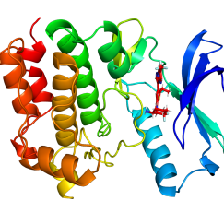
Conclusions
deepScaffOpt
Receptor or ligand 3D structures not necessary.
Fully automated, minor human input.
Screening compounds can span multiple chemical series.
Extremely fast: 1 sec/molecule !!
Needs training samples.
Receptor-specific executable
Future Work
Upgrade deepScaffOpt to utilize structure information.
New version for Classification (“binders” , “non-binders”) and virtual screening (deepHitMiner algorithm).

Slide 22
Agenda
deepScaffOpt algorithm for affinity ranking.
SQM/COSMO scoring for binding pose prediction and hit identification.

Slide 23
SQM/COSMO SCORING
Protein & ligand desolvation .
Protein & ligand deformation to match each other.
Complex formation.
Complex is solvation.
Conformational
Rotational
Translational
Vibrational
Protein Deformation
Ligand Deformation
Binding Entropy
Score = ΔE_{int} + ΔΔG_{solv}(L) + ΔG_{conf}^{w}(P)_{SQM/MM} + ΔG_{conf}^{w}(L)_{SQM/MM} - TΔS_{int}
Semiempirical Quantum Mechanical(SQM) / Implicit Solvent (COSMO) Scoring
SQM Methods: PM6-D3H4X, DFTB3-D3H4X
Lepšík, M. et al., Chempluschem, 78, 921–931 (2013).
Řezáč, J., J. Comput. Chem., 37, 1230–1237 (2016).
Notes:
A leap back to the old school.
What are the D3H4X corrections? Corrections for dispersion, hydrogen- and halogen-bonding.

Slide 24
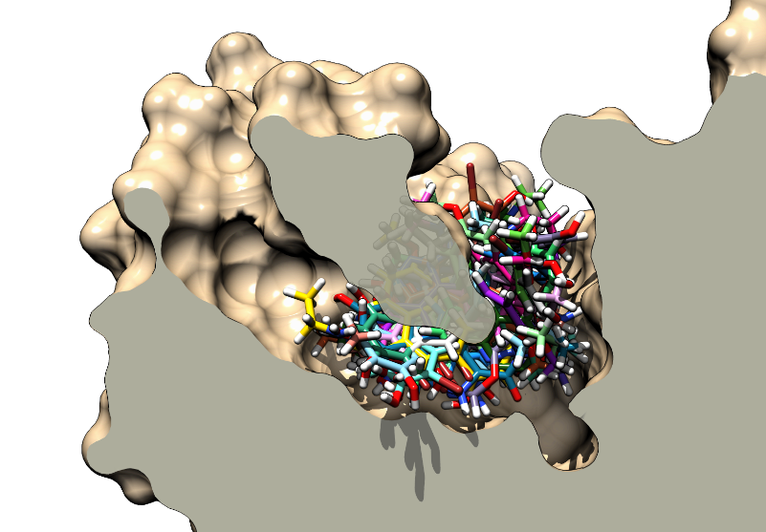
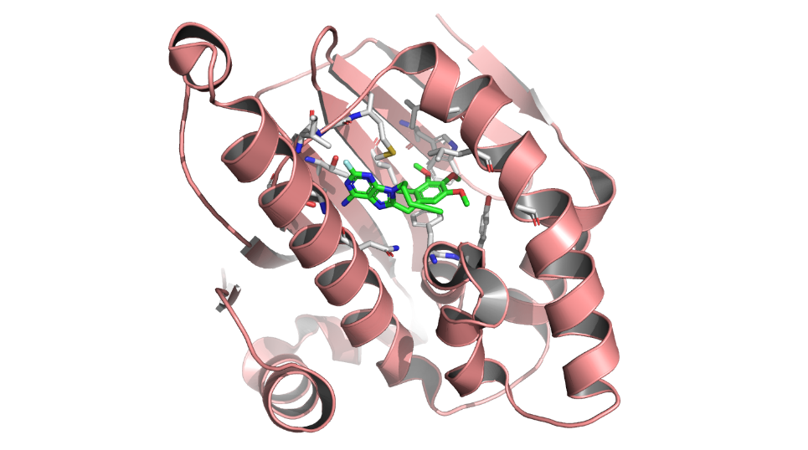
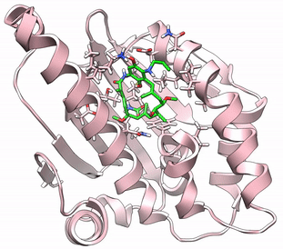
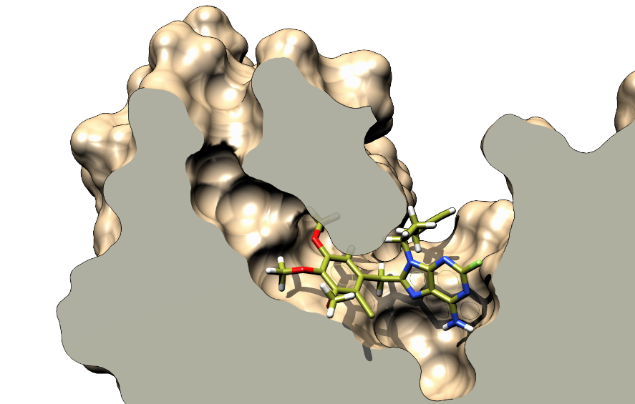
SQM/COSMO Scoring Protocol
Crystal Structure
Docking
SQM/COSMO Scoring
Energy Minimization

Slide 25
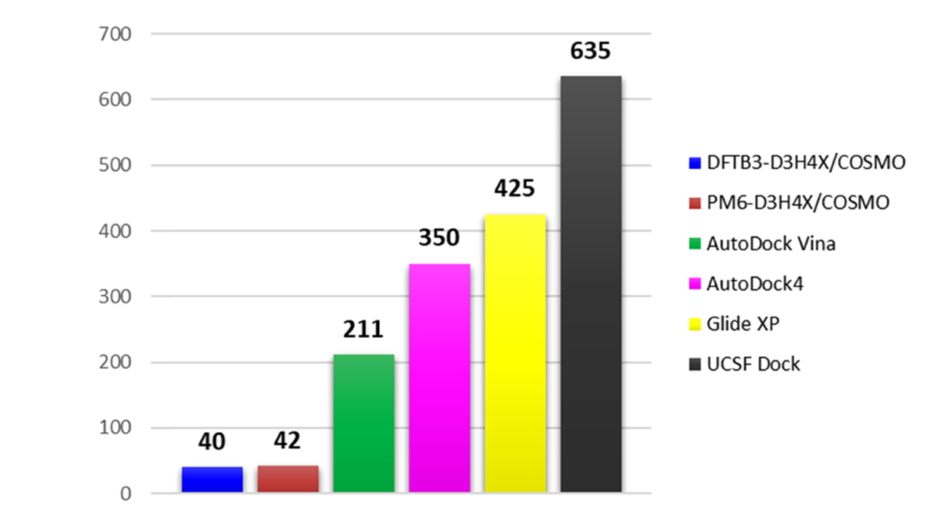
SQM/COSMO for native pose recognition
Ajani, H. et al., ACS Omega, 2, 4022–4029 (2017).
Number of False Positives
Neutral Charged
Number of min. Energy poses with RMSD>2 Å across 17 receptors from PDBbind.
Total Number of False Positives
Total number of min. Energy poses with RMSD>2 Å per scoring function.
Notes:
→ Which software they used for docking before scoring with SQM/COSMO?

Slide 26
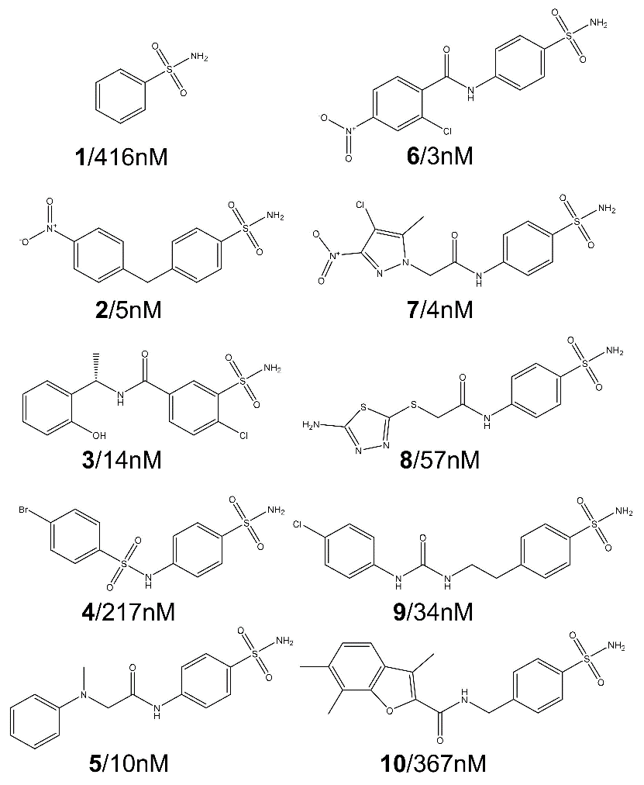
RANKING POWER
Carbonic anhydrase II: Zinc metalloprotein
SQM/COSMO
Method | R²
SQM/COSMO | 0.69
Vina | 0.39
DOCK 6 | 0.38
AMBER^{HF}/COSMO | 0.31
Autodock 4 | 0.19
Gold ASP | 0.15
GoldPLP | 0.12
AMBER^{HF}/GB | 0.09
AMBER^{AM1}/GB | 0.05
AMBER^{HF}/PB | 0.02
GoldScore | 0.01
Chemscore | 0.01
DOCK 6
Vina
Pecina, A. et al., ChemPhysChem, 19, 873–879 (2018).
Notes:
Change the title to a more descriptive one.
Accurate evaluation of metal-ligand interactions by docking or MD simulations is hampered by the complicated coordination geometries and MM ff inaccuracies.

Slide 27
Current study: Heat Shock Protein 90
Color scale: -10 eV to +10 eV
➔ Burried, neutral pocket
76 actives, 3897 decoys
Mean Net Charge: ligands=0.1, decoys=0.1
Small molecules, few rotatable bonds
Docking
9 software (VINA, SMINA, AD4, ASP, PLP, ChemScore, GoldScore, GlideSP, GlideXP)
~700-900 poses per compound
Energy Minimization
MM/GBSA scoring
Reduction of Poses (~5 to 50 per compound)
PM6/COSMO Scoring
Enrichment

Slide 28
General AMBER Force Field 2 Inaccuracies
Corrected value from PM6 optimization
GAFF2 minimized
PM6
minimized
Notes:
2-carboxybenzene-1-sulfonamide

Slide 29
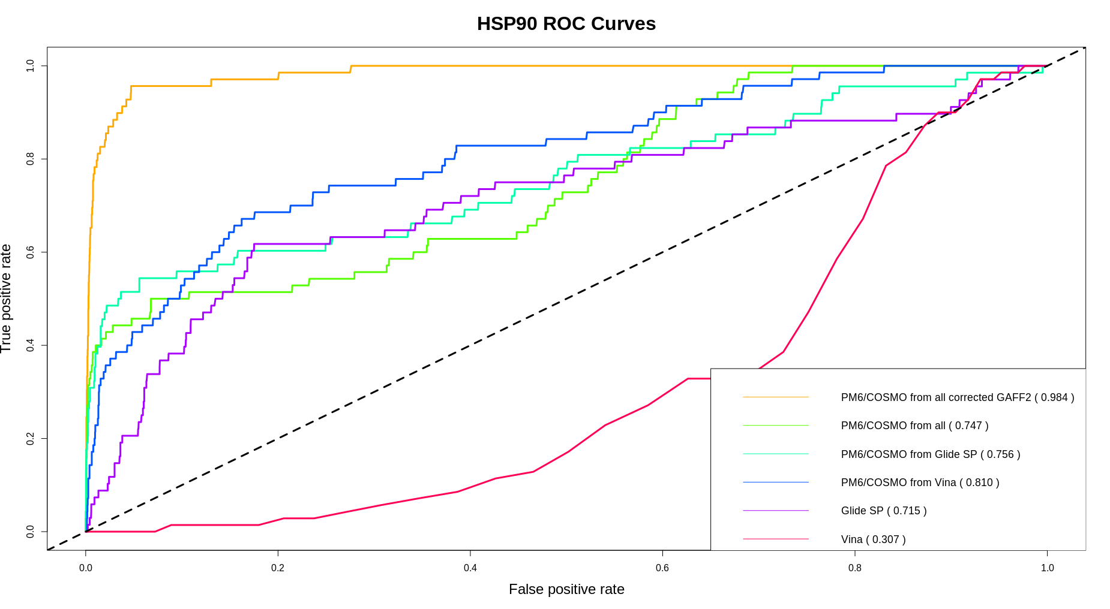
Perfect Enrichment upon force field corrections!!
Notes:
ROC curve (ideally animated).

Slide 30
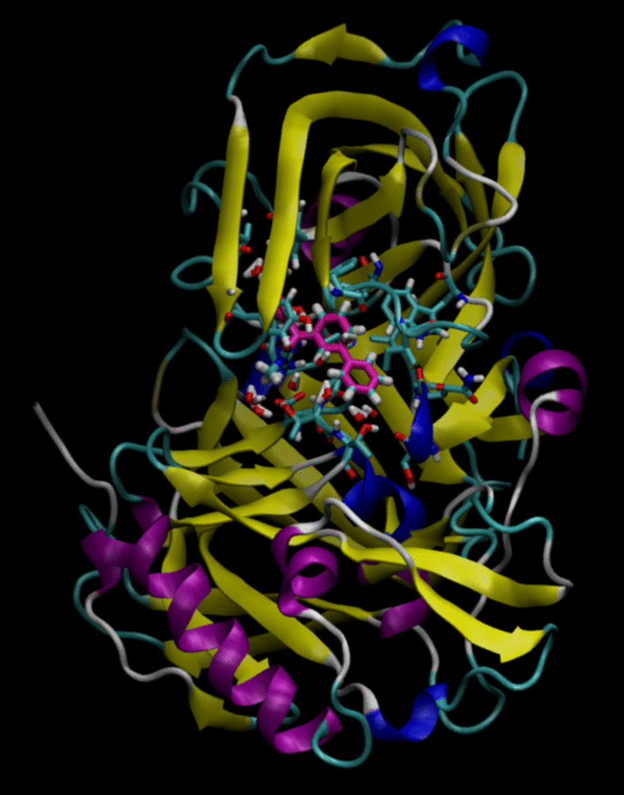
Experimental
SQM/COSMO Scoring Protocol
Crystal Structure
Docking
SQM/COSMO Scoring
MD equilibration

Slide 31
Low sequence identity structure may share similar active sites
D3R Grand Challenge 2017
D3RKN_5
3FZR superposed to the JAK2 homology model from 3FZR and 4DS1. Both contain the 3FZR crystal ligand.
3FZR crystal ligand
The JAK2 homology model with compound D3RKN_5.
4D1S: JAK2 from homo sapiens.
3FZR: proline-rich tyrosine kinase 2 (PYK2) from homo sapiens, 35% sequence identity to JAK2.
Notes:
When multiple crystal ligands are available, ScaffOpt is able to select the ideal reference ligand for each compound by 2D similarity and coverage of the scaffold atoms by the MCS.

Slide 32
HomoLigAlign algorithm
Inspired by:
Dalton & Jackson. J Mol Biol. 2010 Jun 18;399(4):645-61

Slide 33
D3R Grand Challenge 2018
55 participants, 385 submissions
BACE binding pocket electrostatic potential
CatS binding pocket electrostatic potential
Buried, negatively charged pocket.
Exposed, neutral pocket.
Color scale: -10 eV to +10 eV

Slide 34
FESet 1 BACE
34 compounds
deepScaffOpt
PM6/COSMO
ΔG
ΔG
ΔG
6th position
12th position
deepScaffOpt
ΔG
6th position

Slide 35
FESet 2 CatS
39 compounds
deepScaffOpt
PM6/COSMO
ΔG
9th position
ΔG
ΔG
ΔG
21st position
deepScaffOpt
ΔG
ΔG
ΔG
8th position

Slide 36
Rescoring best submissions with PM6/COSMO
Bogdan Iorga
PM6/COSMO
(tau=0.15)
deepScaffOpt
BACE
Polo Lam, Max Totrov
deepScaffOpt
CatS
PM6/COSMO
(tau=0.02)

Slide 37
In Progress: introducing receptor flexibility & Entropy into the score.
Higher enrichment
PM6/COSMO scoring
Correct binding poses
Lowest Energy
all receptor structures!
deepScaffOpt
Notes:
This is the big picture.

Slide 38
Acknowledgements
deepScaffOpt
Dr. Takayuki Serizawa
Receptor-specific executable
SQM/COSMO
Prof. Pavel Hobza
Dr. Kostas Tripsianes
Prof. Jan Rezac
Saltuk Eyrilmez
Cemal Köprülüoğlu
4D NMR
Dr. Kostas Tripsianes

Slide 39
4D-CHAINS/autoNOE-Rosetta at a glance
Applied successfully to 13 unique protein folds since last year!
NMR data recording: 8-12 days
Peak picking: 1 day
4D-CHAINS: 30-90 minutes
autoNOE-ROSETTA: 8-12 hours
Structure: 3-4 weeks
iteration
Notes:
That’s a great leap forward compared with the traditional 3D NMR.

Slide 40
MD Refinement
100 ps MD simulation.
Software: AMBER or OpenMM.
Binding pocket residues flexible, the rest restrained. Explicit waters in binding pocket.
1000 steps minimization, 50 ps NVT equilibration, 50 ps production MD (NVT).
Force fields: Protein AMBER14SB, ligand GAFF2, water TP3P.
Long-range interactions treated with Reaction Field method and cutoff 18 Å.
Structural properties (3Dpp, MM/GBSA, SiFt, USRCAT moments) calculated from last 50 ps.

Slide 41
Pose Prediction Results
(20 BACE ligands)
HomoLigAlign

