Slide 1
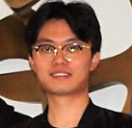
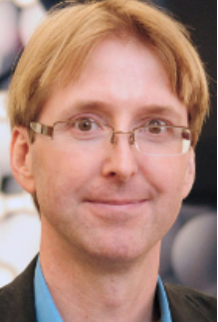
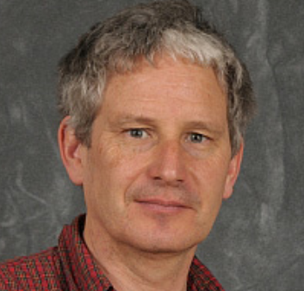
Progress in Alchemical Free Energy Calculations
Drug Design Data Resource (D3R)
Aug 23rd 2019
Junjie Zou
Stony Brook University
Chuan Tian
Carlos Simmerling
Daniel Raleigh
Notes:
I am a phd student from stony brook university.
My partner Chuan Tian and I….
I have 2 advisors. Prof. simmerling who is a member of Amber developers. Prof. Raleigh who is an experimentalist studying protein biophysics
We are not drug design oriented groups but I had many success using free energy calculations in study mutation effect on protein stability and protein-protein binding affinity.
I think maybe I should try something more challenging so that is why I joined blinded prediction

Slide 2
Outline
Blind binding affinity prediction using AMBER TI
The challenges free energy calculations are facing
The layout, protocol and results
What we have learned
Progress in alchemical free energy calculations
Time to break the stereotype
Broader spectrum of chemistry
More efficient sampling in λ space
Dynamic chemical states and accelerated water/ion partitioning
Training on alchemical free energy calculations
Notes:
I will start with briefly talking about what I did in the predictions
and what I think will make good free energy calculations.
You can find more details on JCAMD
Progress in afec.
I believe one of the biggest barriers for people to use afec is the stereotype.
I will talk about those significant improvements in MM afec
I wish I can convince people that afec is not what it used to be
In the end, I’d like to make some suggestions to fec workflow from a user-perspective

Slide 3
Three major methods for computing binding free energies
$$∆G\left(A→B\right)=\int_{0}^{1}{\frac{∂G\left(λ\right)}{∂λ}dλ}=−\int_{0}^{1}{\frac{k_{B}T}{Q}\frac{∂Q}{∂λ}dλ}$$
$$=\int_{0}^{1}{\frac{k_{B}T}{Q}\sum_{X,λ}{\frac{1}{k_{B}T}e^{−\frac{U\left(λ,X\right)}{k_{B}T}}}\frac{∂U\left(λ,X\right)}{∂λ}dλ}$$
$$=\int_{0}^{1}{{<\frac{∂U\left(λ,X\right)}{∂λ}>}_{λ}dλ}$$
$=\int_{0}^{1}{{<U_{B}\left(λ,X\right)−U_{A}\left(λ,X\right)>}_{λ}dλ}$
Free energy perturbation (FEP)
Thermodynamic integration (TI)
Bennett acceptance ratio (BAR)
Physics-based
Do not require existing affinity data
Transferable between different systems
X: coordinates of protein and ligand
U: potential energy functions
<….>: ensemble averaging obtained from MD simulations
Notes:
There are three major methods for ddG.
On the right side, an example showing how we derive TI using statistical mechanics.
All three physics base which means no little prior knowledge of affinity data is required
Highly transferrable which is the biggest advantage over ML and statistics based methods

Slide 4
Relative binding free energy calculation
Relative binding free energy between 2 ligands
∆∆G = ∆G₁ - ∆G₂ = 2.303RT∆pK_{d}
slow
It seems all we need to do is to solve the following equations, so what are the challenges here?
Calculated ∆G₁
Calculated ∆G₂
$∆G\left(A→B\right)=\int_{0}^{1}{{<U_{B}\left(λ,X\right)−U_{A}\left(λ,X\right)>}_{λ}dλ}$
slow

Slide 5
What challenges are free energy calculations facing?
$∆G\left(A→B\right)=\int_{0}^{1}{{<U_{B}\left(λ,X\right)−U_{A}\left(λ,X\right)>}_{λ}dλ}$
Short and neat transition pathways
Protein and ligand structure need to be
stable during the simulations
The quality of general atom force fields
Sufficient sampling (accessible and inexpensive computers)
Notes:
Mention the coupling between enough sampling and protein-ligand stability

Slide 6
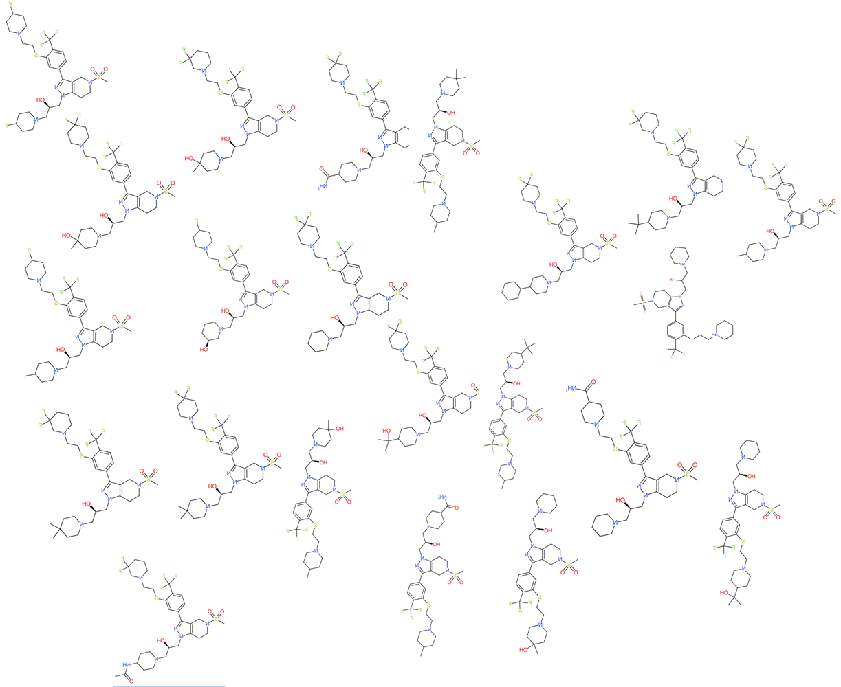
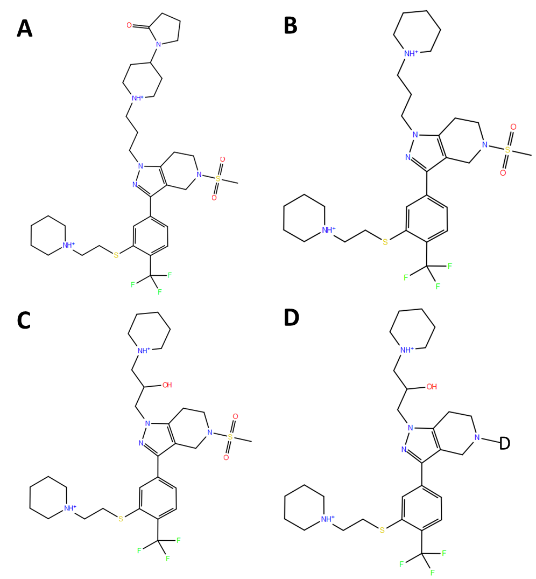
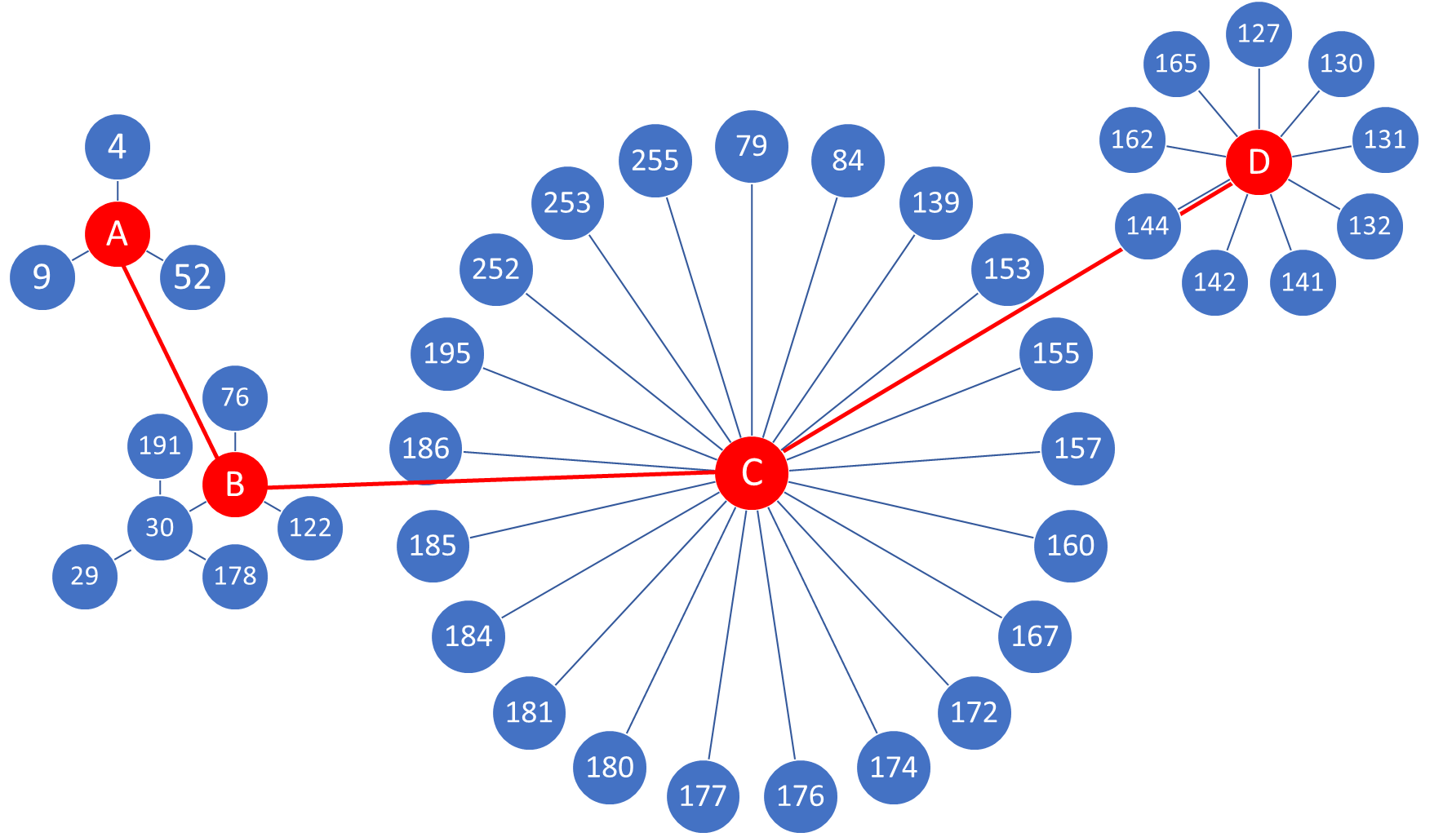
Implementations of TI/FEP/BAR in the software
TI/FEP/BAR and MD simulation protocol
Less intermediates
Less transition steps
More parallel
Less intermediates
To maximize the accuracy and precision, layout of the transitions should be coherent with the TI/FEP/BAR protocol and how they are implemented in the software.

Slide 7
The layout: transition map designed for the 39 ligands in CatS data set and the intermediates
Parallel transition map: minimize the “distance” between ligand pairs
Intermediates: help organize the transitions
Notes:
A transition map which links all 39 ligands together
The red circles are intermediates designed to organize the transitions and make things more parallel
Intermediates are not included in the data set
Single topo is more restrictive for designing this map. Dual-topo is more flexible, but no matter what approach is used.
The results benefit from a more parallel transition map

Slide 8
Protocols
Ligand and protein preparation:
Charges assigned using AM1-BCC
GAFF2 with mod on F and S
ff14SB + TIP3P
TI and MD simulation protocol:
Regular MD simulations (timestep=2fs)
4ns each λ window for both the complex and the free states
Linear scaling/single topology approach (non-softcore)
λ values: 0.00922, 0.04794, 0.11505, 0.20634, 0.31608, 0.43738, 0.56262, 0.68392, 0.79366 0.88495, 0.95206, 0.99078, 0.995 and 0.999.
a simple protocol you can find in the tutorial
Boulanger E, etal. JCTC, 2018, 14(6):3121-3131.
Maier JA, et al. JCTC, 2015, 11(8):3696-3713.
Notes:
Protocol for MD simulation is just tutorial
0.995 0.999
Even it doesn’t use things like softcore and dual-topology, it still get the job done.
So as I said afec has changed a lot.

Slide 9
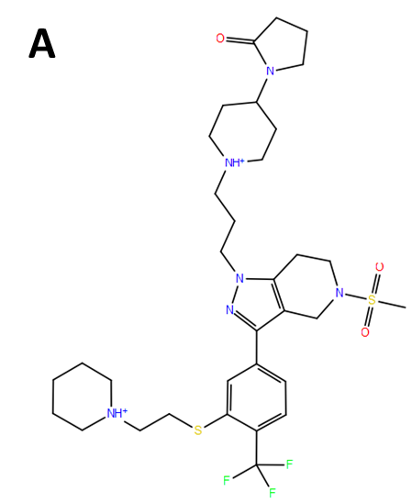
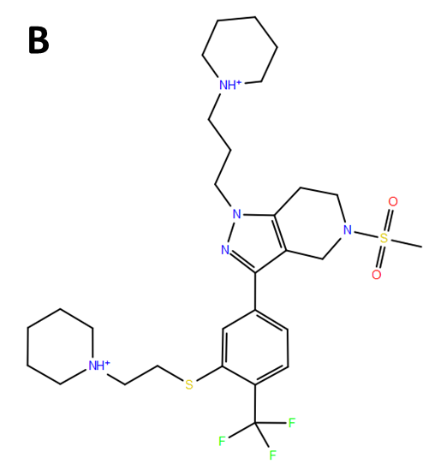
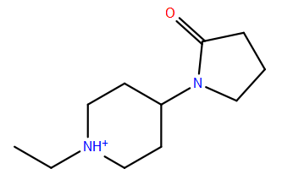
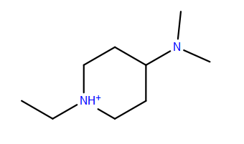
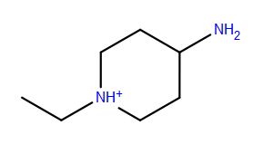
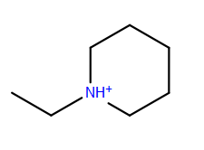
Each transition use multiple sub-intermediate states to minimize the perturbations in linear scaling potential
14 λs
14 λs
14 λs
Notes:
Because I used linear scaling which can only take a small perturbations at a time, so I divide a big perturbation into several small ones.
For example, to remove this 2-oxo-pyrolydine group, we split it to 3 and remove several heavy atoms a time.
Even if you use softcore potential, it doesn’t mean you can do whatever perturbation you want. The size of perturbation still need to be set reasonably.

Slide 10
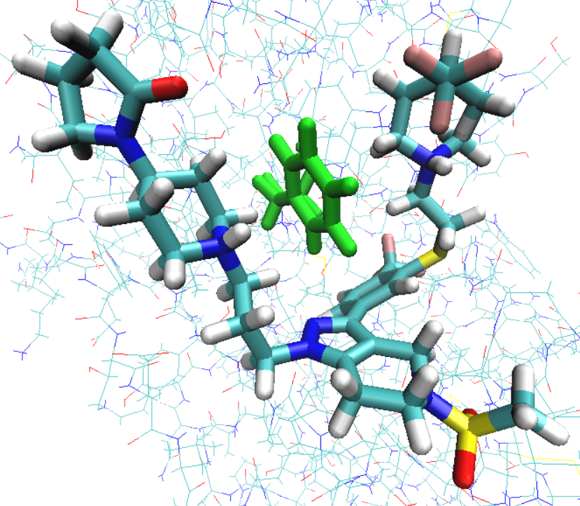
Phe 70
This structure was used as the scaffold.
Modified functional groups were manually adjusted to avoid steric clashes.
Other X-ray structures were also used to deduce the conformations of the added atoms.
PDB ID 5qc6
Chain B
2 Pi-cation interactions are formed in this binding pose
Binding pose in chain B binds tighter
Notes:
From a user perspective, Free energy calculations have very little error-forgiveness

Slide 11
With empirical adjustment on F
Kendall’s τ = 0.62; Spearman’s ρ = 0.80; Pearson’s R = 0.82; cRMSD = 0.49 kcal/mol

Slide 12
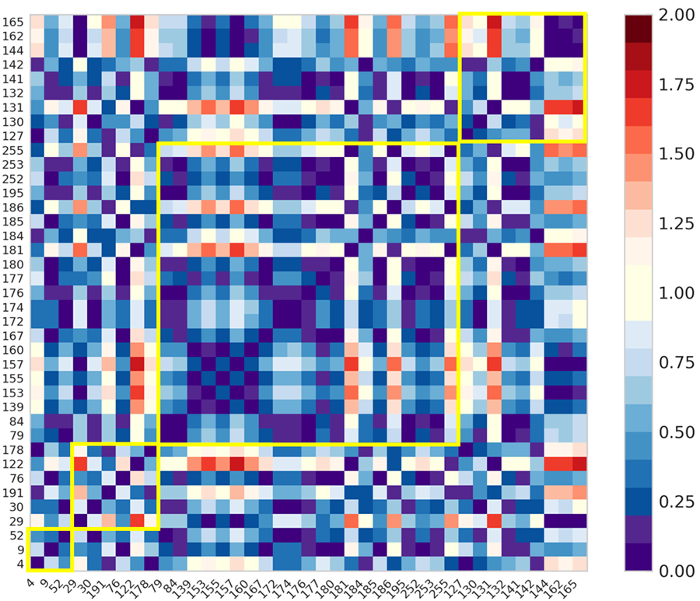
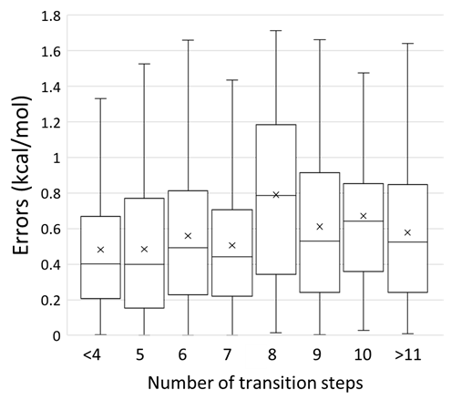
Does the number of intermediates affect accuracy?
Errors of pairwise ∆∆G
Errors in each group are relatively similar.
Number of transition steps doesn’t affect accuracy too much
Notes:
Some people asked me, you are using so many intermediates and so many transition steps, do you worry about the errors accumulated at each transition steps.
Maybe I am wrong, but I think it doesn’t matter that much if the intermediates are on the optimal transition pathway
It is just like adding more lambda window in TI.

Slide 13
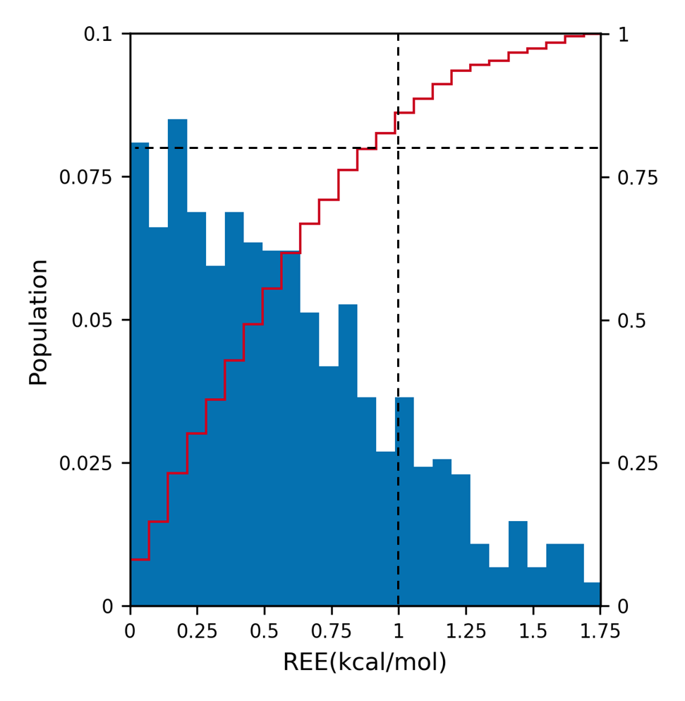
Histogram of pairwise ∆∆G errors
(39X38/2 pairs)
100% < 2 kcal/mol
84% < 1 kcal/mol

Slide 14
Standard deviations of ∆∆G values
∆∆G values were referenced to first ligand (004).
Standard deviations are mostly within 0.2 kcal/mol except ligands with larger differences (e.g. 6 heavy atoms).
Fraction of pairs
STD (kcal/mol) of 3 independent runs

Slide 15
A few thoughts
Longer simulations do not necessary help when doing free energy calculations
4-5 ns per λ window is usually used
Enough for relaxation of amino-acid side chains
Protein may “deform” in longer simulations due to inaccuracy in force fields.
Consider using local sampling enhancement technique (e.g. REST)
Notes:
Since we do afec to avoid direct modelling of binding and unbinding, there is no reason to run long simulations unless we have a flexible binding site.
What I found by reading publications
If there are slow dynamics important for binding like the notorious val111 in lysozyme

Slide 16
A few thoughts
TI saves more storage space compared to BAR/FEP
BAR & FEP
Require postprocessing of trajectories
Need to save enough frames if more λ windows are to be added
TI
Does NOT require postprocessing of trajectories
Only DV/Dλ needs to be collected
180 GB of data for 39 ligands using TI
25 TB (estimated) if using BAR & FEP
Imagine storage space needed for the full data set (459 ligands)

Slide 17
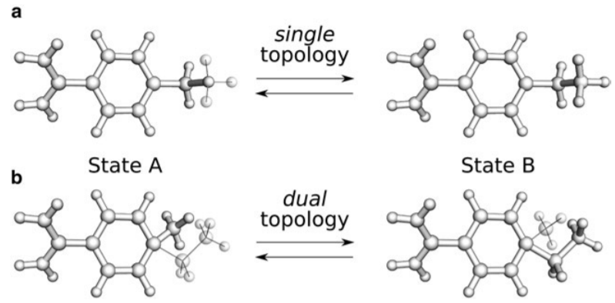
Linear scaling vs softcore potential Single topology vs dual topology
Softcore potential allows lager perturbation/changes in a transition
Dual-topology is easier to setup than single topology
Dual-topology is used predominantly nowadays and is usually used with softcore potential.
Softcore potential/dual-topology approach is more efficient than linear scaling potential/single-topology approach.
We used linear scaling/single topology because softcore potential/dual-topology approach in Amber TI is problematic
Gapsys V, Michielssens S, Peters JH, de Groot BL, & Leonov H (2015) Calculation of binding free energies. Methods Mol Biol 1215:173-209.
Notes:
You may heard terminologies like…. a lot when people talk about Afec
Softcore potential allows larger perturbations compared to linear scaling.
Some software package like Tinker only has softcore potential because softcore potential is by all means more superior to linear
Dual-topology is more user friendly.
Softcore dual is used predominantly by people.
But I still use linear scaling/single topology because…

Slide 18
Softcore potential/dual topology approach in Amber TI does not allow scaling of bond/angle/dihedral/1-4 interactions between the changing part and common part. (Amber developers are fixing this)
Not allowing scaling bond/angle/dihedral will be a problem for some transitions (e.g. a sp3 atom to a sp2 atom)
Linear scaling/single topology approach allows scaling of everything.
Notes:
Our D3R paper gave two examples at which I think Amber TI will fail if using the softcore/dual approach

Slide 19
It is possible to avoid this issue by scaling bond/angle/dihedral using linear scaling/single topology before using softcore potential/dual topology
A new approach emphasizing scalable bond/angle/dihedral interactions between the changing part and common part was newly implemented in NAMD.
It is important to understand how free energy calculation was implemented in the software.
Notes:
I am not the only one who think implementations of afec in major software package may be problematic.
The Take home message is be sure that you check how afec is implemented in the software

Slide 20
Time to break the stereotype
Alchemical free energy calculations were believed to be:
Expensive
Slow
Inaccurate
Not worth trying
Only for academia
“Explicit solvent free energy methods have not yet outperformed faster scoring methods in blinded protein-ligand affinity predictions.”
---D3R GC1&2
Notes:
As I said before. The one of biggest barriers is the stereotype. There is even this statement on D3R website.

Slide 21
Time to break the stereotype
$∆G\left(A→B\right)=\int_{0}^{1}{{<U_{B}\left(λ,X\right)−U_{A}\left(λ,X\right)>}_{λ}dλ}$
X: coordinates of protein and ligand
More stable structures
U: potential energy functions
More diversified atom type
<….>: ensemble averaging
More sufficient sampling
Notes:
I will try to prove it to you that things are on the right track

Slide 22
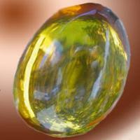
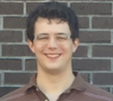
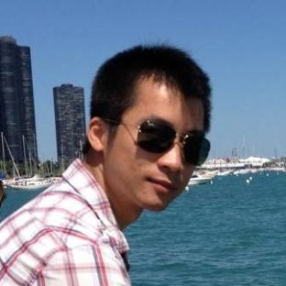
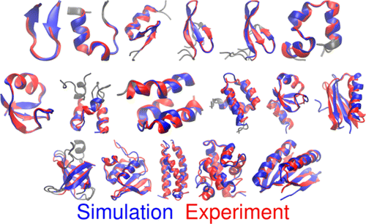
Time to break the stereotype
X: coordinates of proteins
Patching amino acids with specific side-chain torsion correction increase the structure stability of proteins in MD simulations significantly. (ff14sb vs ff99sb)
Patching on backbone torsions further increases the stability.
(ff19sb vs ff14sb)
Amber
James Maier
Hai Nguyen
Chuan Tian
Nguyen H, Maier J, Huang H, Perrone V, & Simmerling C (2014) Folding simulations for proteins with diverse topologies are accessible in days with a physics-based force field and implicit solvent. J Am Chem Soc 136(40):13959-13962.
Notes:
These structures are obtained by starting from extended conformations

Slide 23
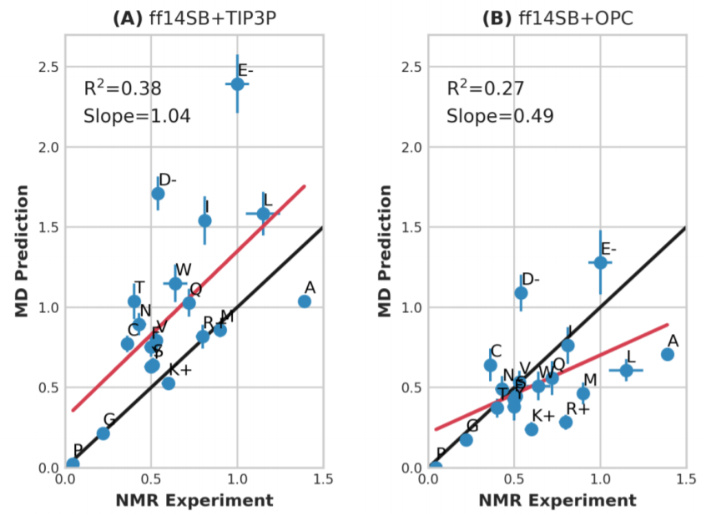
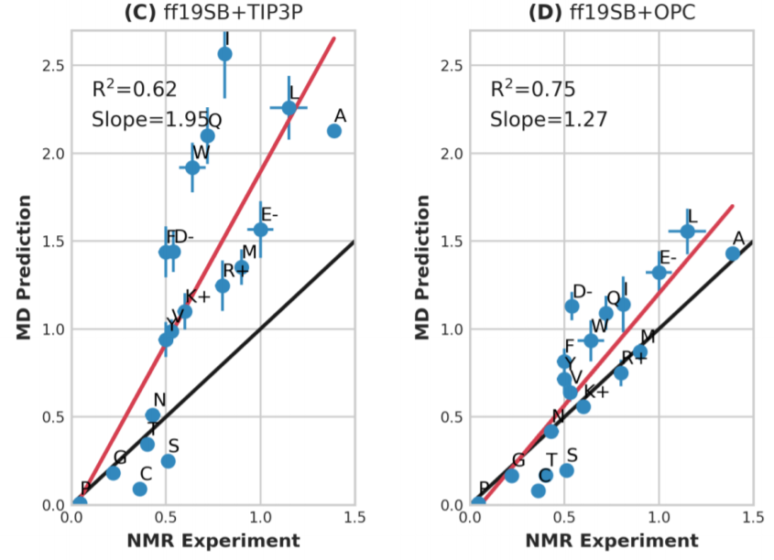
Time to break the stereotype
X: coordinates of proteins
Predicted vs NMR measured helical propensities
Amber
Chuan Tian
ff14SB/TIP3P
ff14SB/OPC
ff19SB/TIP3P
ff19SB/OPC
Neither ff19SB nor OPC water model were trained against helical propensity

Slide 24
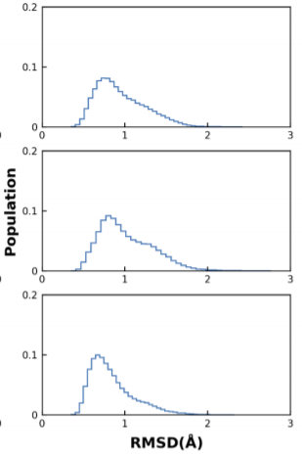
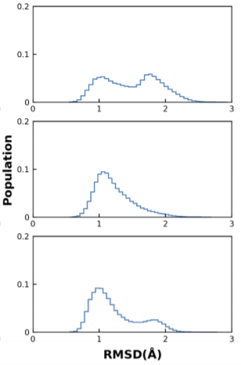
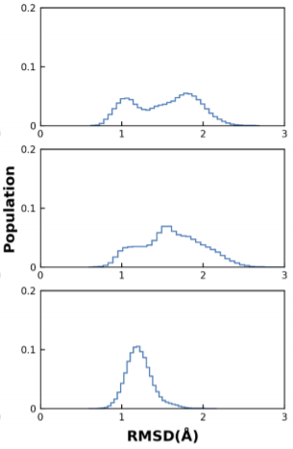
Time to break the stereotype
X: coordinates of proteins
ff19SB/OPC stabilizes proteins in experimental structures
Amber
Chuan Tian
ff14SB/TIP3P
ff14SB/OPC
ff19SB/OPC
GB3
Ubiquitin
Lysozyme
ff19SB was not trained against X-ray structures
Notes:
By training protein force fields against QM, we can get more stable structures during MD simulations.

Slide 25
Time to break the stereotype
U: potential energy functions
Atom types are more diversified in general atom force field.
GAFF2 vs GAFF
More thermodynamic properties are included in training
More specific Lennard-Jones and bond/angle/dihedral parameters for different chemistry.
Open Force Field: even more diversified chemistry
Machine learning trained on DFT

Slide 26
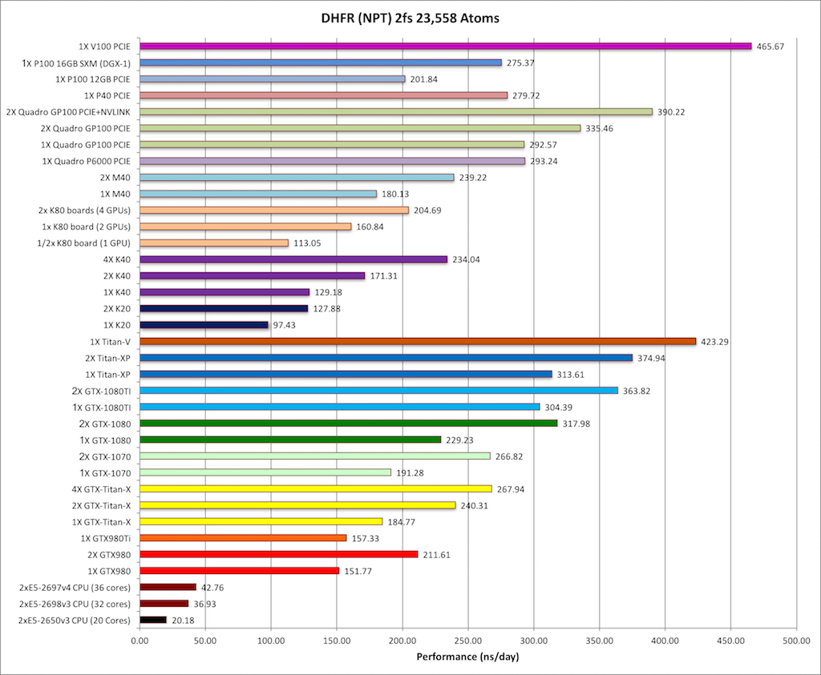
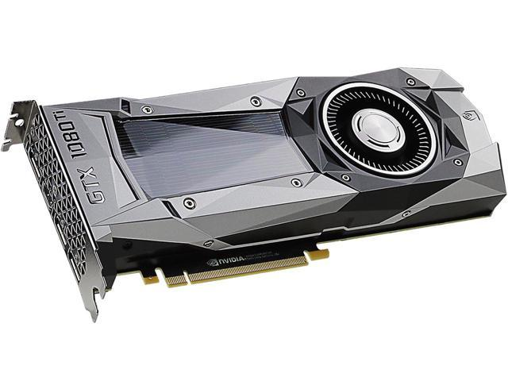
Time to break the stereotype
<….>: ensemble averaging
Amber pmemd benchmark

Slide 27
Time to break the stereotype
Time and financial costs
Cathepsin S protein
51kDa
21000 atoms including water
A pair of ligands using 16 GTX 1080 TI
1~1.5 hours (can be much shorter)
Cost for computing the relative binding affinity of 2 ligands
~$2 (unit price for leasing GTX 1080TI: ~$0.12/GPU hrs)
Including the hardware (CPU, hard disk, RAM etc. ), electricity and maintainance
These are the highest estimate.

Slide 28
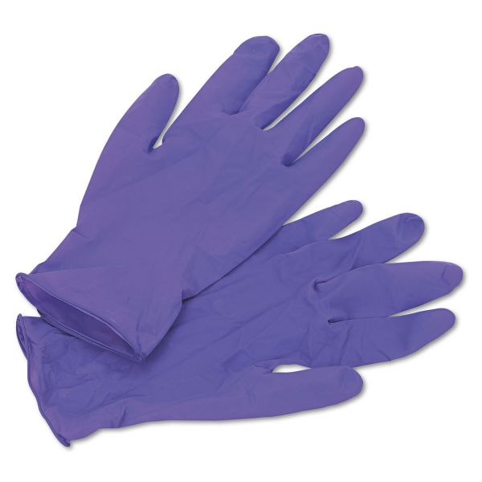
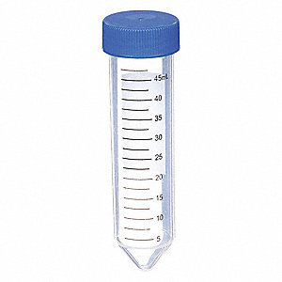
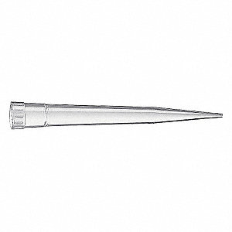
Time to break the stereotype
What $2 can buy in a wet lab:
5x
$0.34
5x
$0.87
20x
$0.22
20x
$0.54

Slide 29
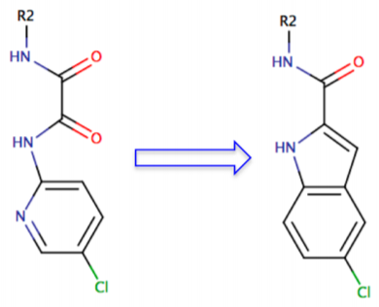
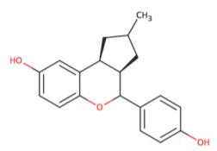
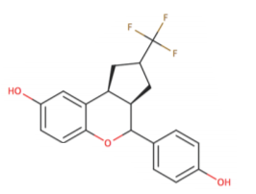
Broader spectrum of chemistry
R group modification vs core region modification (“scaffold hopping”)
R group modification
Core region modification
(scaffold hopping)
√
ꓫ
Wang L, et al. (2017) Accurate Modeling of Scaffold Hopping Transformations in Drug Discovery. J Chem Theory Comput 13(1):42-54.

Slide 30
Broader spectrum of chemistry
“Scaffold hopping” in core regions
Can explore additional chemistry spaces
Can lead to patentable drugs
Can avoid side-effects caused by the core regions
Can utilize entropic effects in addition to enthalpic effects
BUT are usually more difficult and costly to synthesize
Benefits from computational screenings more than R group modifications

Slide 31
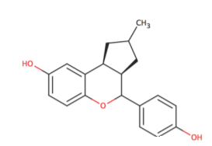
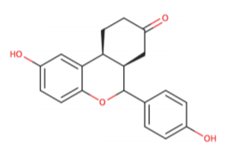
Broader spectrum of chemistry
Soft bond potential – a solution for scaffold hopping
Ring extension
Ring forming/breaking
Ring contraction/expansion
Wang L, et al. (2017) Accurate Modeling of Scaffold Hopping Transformations in Drug Discovery. J Chem Theory Comput 13(1):42-54.

Slide 32
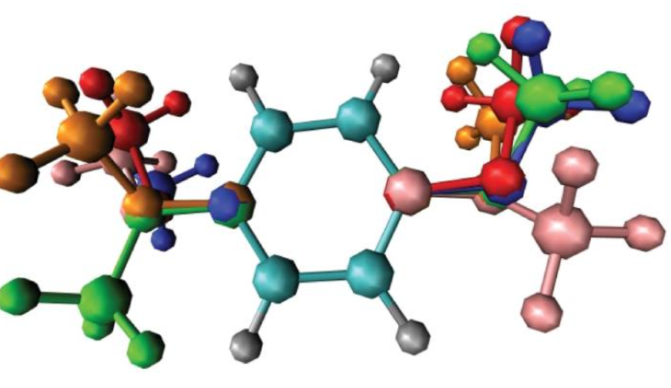
More efficient sampling in λ space
Replica exchange in λ space will be a norm
Minimal tradeoff on speed but huge gain in convergence rate
Multi-site and multi-state λ dynamics
Aggressive
Some tradeoff of accuracy
Huge gain in speed and convergence rate
Can be used for peptide/protein design
Knight JL & Brooks CL, 3rd (2011) Multi-Site lambda-dynamics for simulated Structure-Activity Relationship studies. J Chem Theory Comput 7(9):2728-2739.

Slide 33
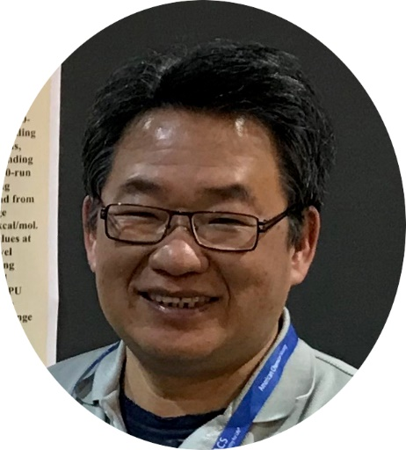
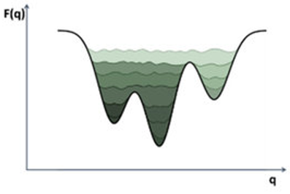
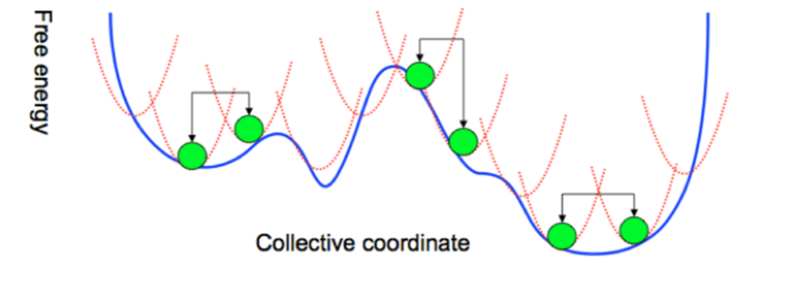
More efficient sampling in λ space
Self-adjusted mixture sampling (SAMS) – better placing of λ
Metadynamics
Slides adapted from Taisung Lee
Single free energy simulation instead multiple λ windows
More converged results
Provides 3-5 fold speed-up
Near-continuous λ coverage—maximize the overlap between windows

Slide 34
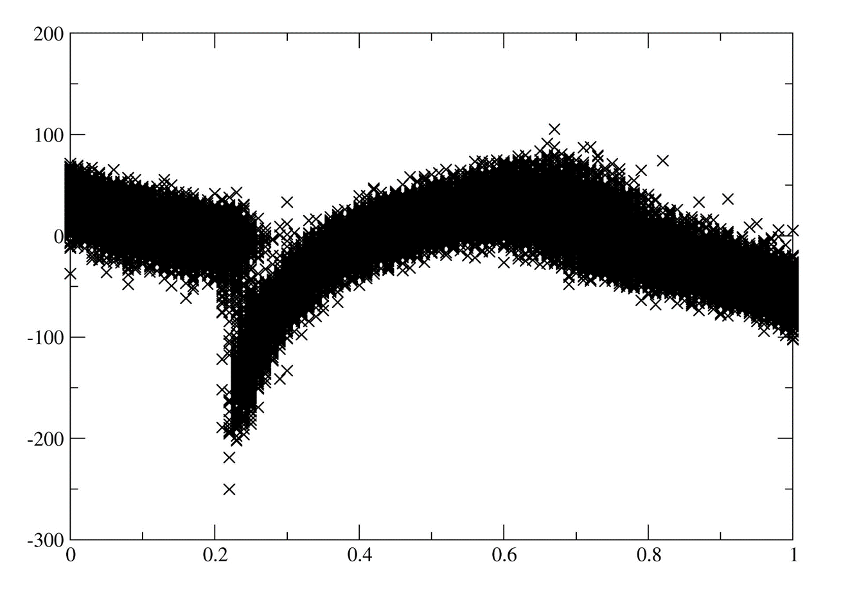
More efficient sampling in λ space
Self-adjusted mixture sampling (SAMS) – smarter placing of λ
Slides adapted from Taisung Lee
dU/dλ
Better coverage at where dU/dλ have steep changes
λ

Slide 35
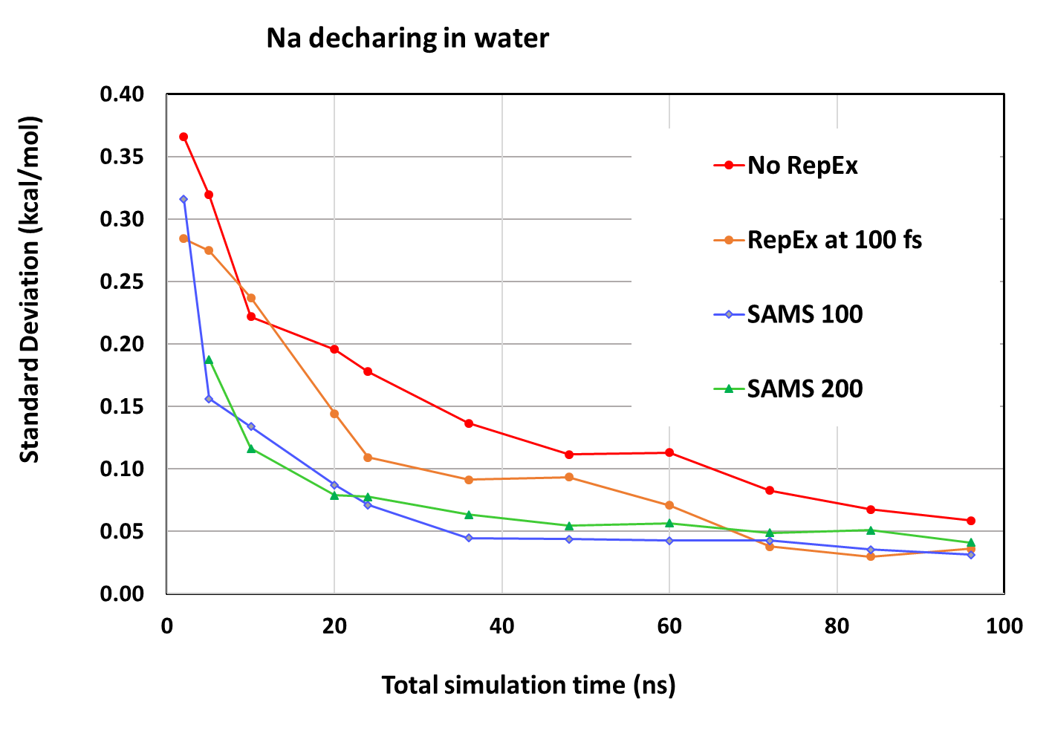
More efficient sampling in λ space
Self-adjusted mixture sampling (SAMS) – smarter placing of λ
Slides adapted from Taisung Lee
Will be implemented in Amber
Amber

Slide 36
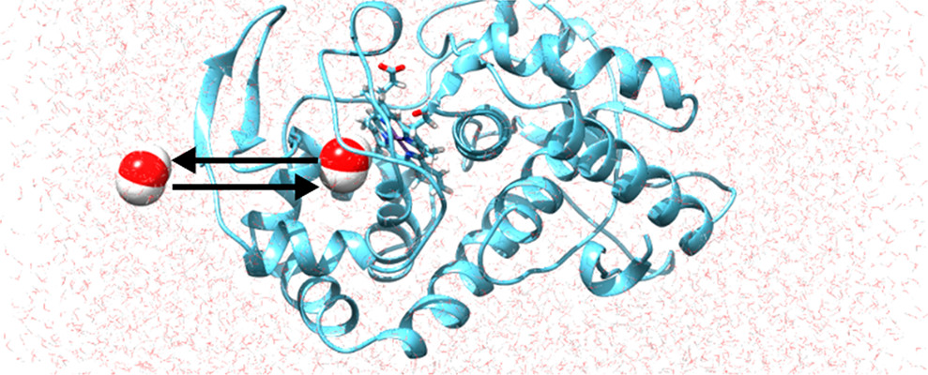
Dynamic chemical states and accelerated water/ion partitioning
Constant pH and constant redox potential MD simulations
Now implemented in many major software
Metropolis Monte Carlo based partitioning of water/ion
Facilitate the entrance of solvent into cavity
Will be implemented in Amber
Amber
Ben-Shalom IY, Lin C, Kurtzman T, Walker RC, & Gilson MK (2019) Simulating Water Exchange to Buried Binding Sites. J Chem Theory Comput 15(4):2684-2691.

Slide 37
Alchemical free energy calculations have very low error-forgiveness.
Tutorials and manuals about alchemical free energy calculations teach users how to get the ∆∆G, BUT do not educate users how to fail.
Users can learn the limitations of free energy calculations when they fail.

Slide 38
A python script for setting up parm7 used in Amber TI/FEP/BAR
AdvLigPrep
--Instructive and educative
https://github.com/birdking1989/AdvLigPrep.git
Parmed based
Goals:
Instruct beginners on basic concepts of alchemical free energy calculations.
Inspire user to apply advanced methods.
Encourage users to fully explore the potential of free energy calculations.
Still under-development

Slide 39
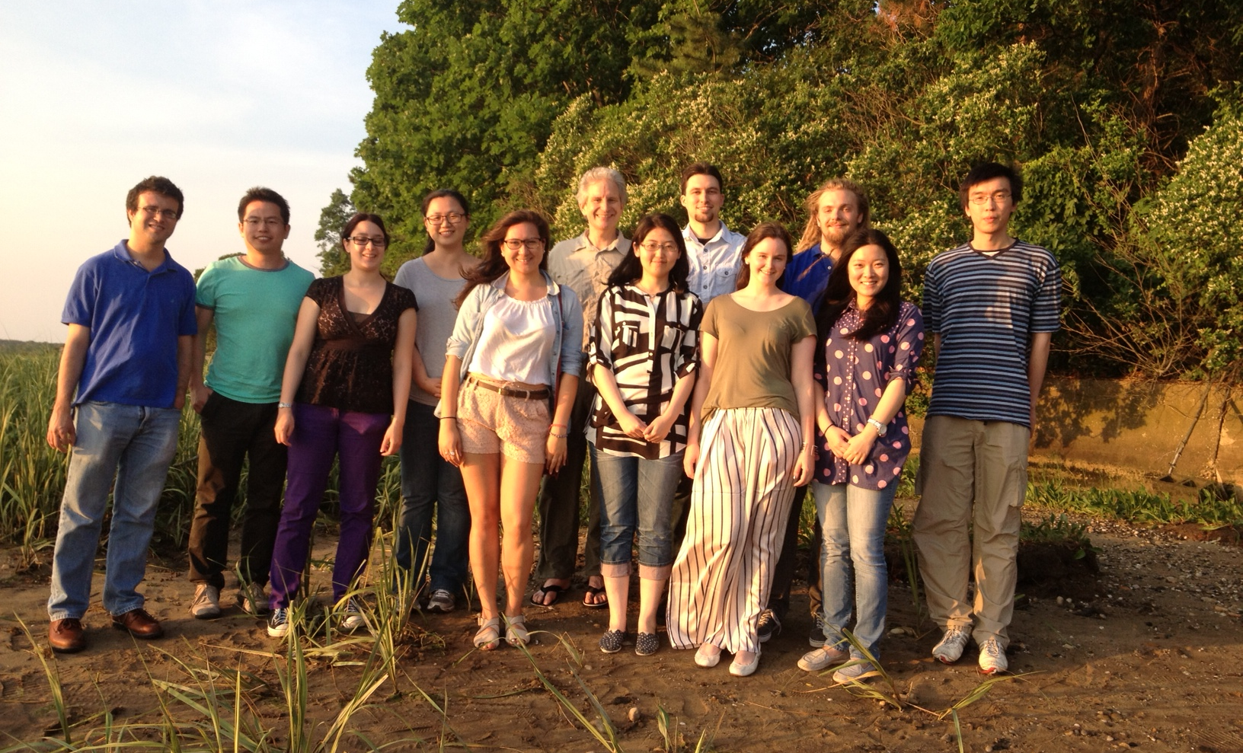
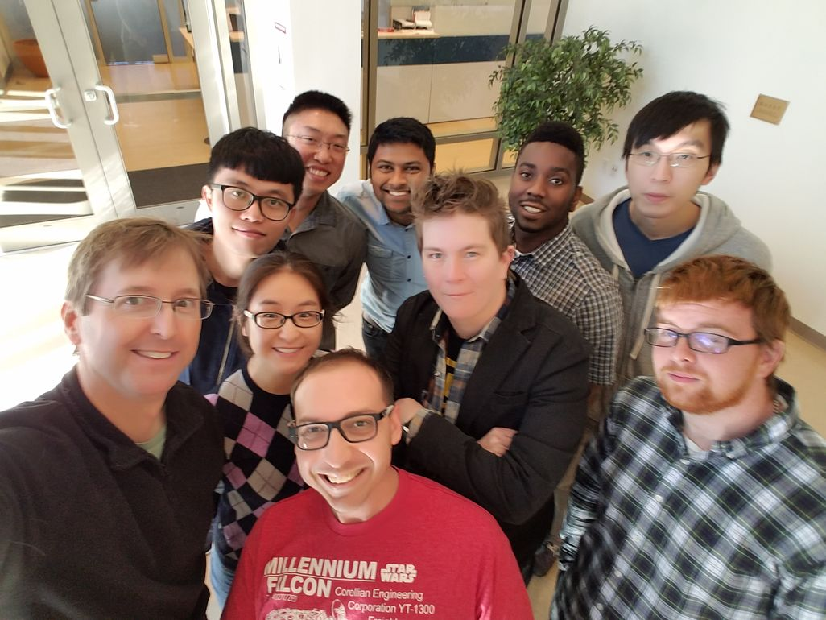
Acknowledgements
My partner: Chuan Tian
Prof. Carlos Simmerling
Prof. Daniel Raleigh
Current and former group members
NIH (GM078114), NIH (GM107104) and Laufer Center at SBU
Feng Zhang, Dr. James Maier & Koushik Kasavajhala

