Slide 1





Topological Maths and Deep Learning in CADD
Reducing the Mathphobicity and AIphobicity in Biology
Guo-Wei Wei
Mathematics
Michigan State University
http://www.math.msu.edu/~wei
Thank the D3R organizers
August 23, 2019
Grant support: NSF, NIH, Pfizer, BMS, and MSU

Slide 2

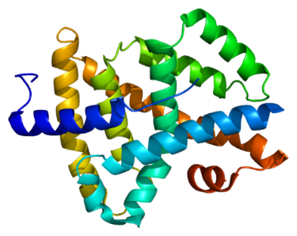

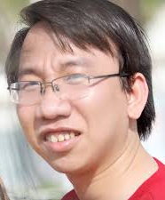
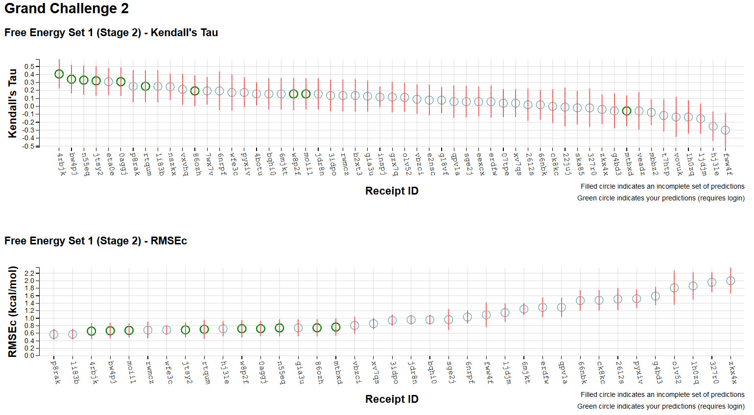
D3R Grand Challenge 2 (2016-2017)
Given: Farnesoid X receptor (FXR) and 102 ligands
Tasks: Dock 102 ligands to FXR, and predict their poses, binding free energies and energy ranking
Stage 1 Stage 2
Pose Predictions (partials) Scoring (partials)
Scoring (partials) Free Energy Set 1 (partials)
Free Energy Set 1 (partials) Free Energy Set 2 (partials)
Free Energy Set 2 (partials)
(Nguyen et al, JCAMD, 2018)
Dr D Nguyen
Our prediction

Slide 3

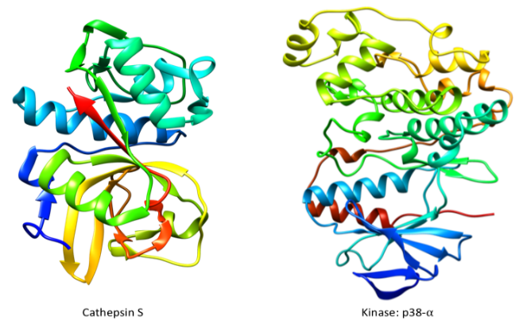

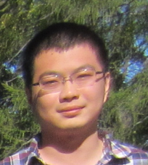
D3R Grand Challenge 3 (2017-2018)
Pose Prediction
Cathepsin Stage 1A Cathepsin Stage 1B
Pose Predictions (partials) Pose Prediction
Affinity Rankings excluding Kds > 10 µM
Cathepsin Stage 1 Cathepsin Stage 2
Scoring (partials) Scoring (partials)
Free Energy Set Free Energy Set
VEGFR2 JAK2 SC2 p38-α
Scoring (partials) Scoring (partials) Scoring
JAK2 SC3 TIE2 ABL1
Scoring Scoring Scoring (partials)
Free Energy Set Free Energy Set 2
Active / Inactive Classification
VEGFR2 JAK2 SC2 p38-α
Scoring (partials) Scoring (partials) Scoring (partials)
JAK2 SC3 TIE2 ABL1
Scoring Scoring (partials) Scoring (partials)
Free Energy Set Free Energy Set 1
Affinity Rankings for Cocrystalized Ligands
Cathepsin Stage 1 Cathepsin Stage 2
Scoring (partials) Scoring (partials)
Free Energy Set Free Energy Set
(Nguyen et al, JCAMD, 2018)
Zixuan Cang
Dr D Nguyen

Slide 4




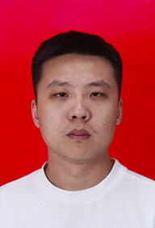
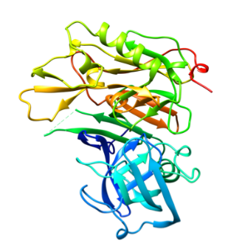
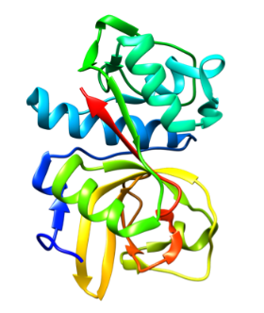
D3R Grand Challenge 4 (2018-2019)
Pose Predictions
BACE Stage 1A
Pose Predictions (Partials)
3/3
BACE Stage 1B
Pose Prediction (Partials)
2 /2
1/2
1/2
Affinity Predictions
Cathepsin Stage 1
Combined Ligand and Structure Based Scoring
Ligand Based Scoring (No participation)
Structure Based Scoring
Free Energy Set
2/5
2/3
2/4
Dr. Kaifu Gao
Dr. D Nguyen
2/4
3/3
3/3
1/7
1/7
3/5
BACE Stage 1
Combined Ligand and Structure (No participation)
Ligand Based Scoring (Partials) (No participation)
Structure Based Scoring (Partials)(No participation)
Free Energy Set (No participation)
BACE Stage 2
Combined Ligand and Structure
Ligand Based Scoring (No participation)
Structure Based Scoring (Partials)
Free Energy Set
3/4
1/4

Slide 5
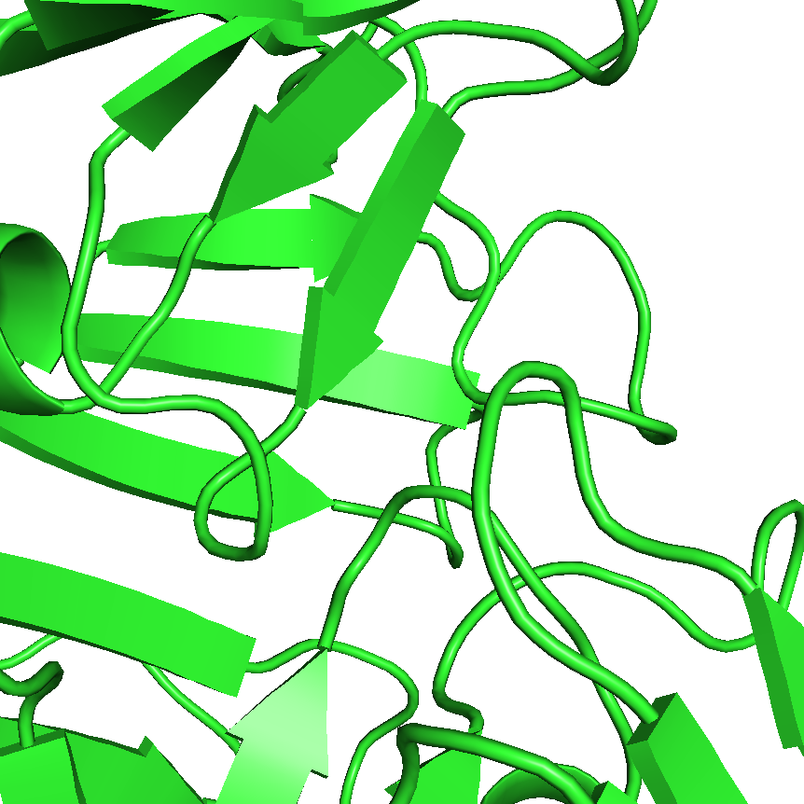
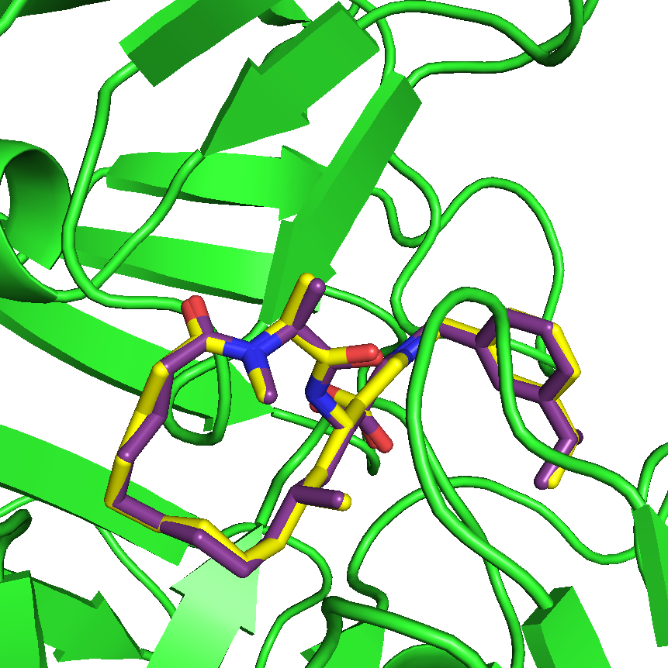
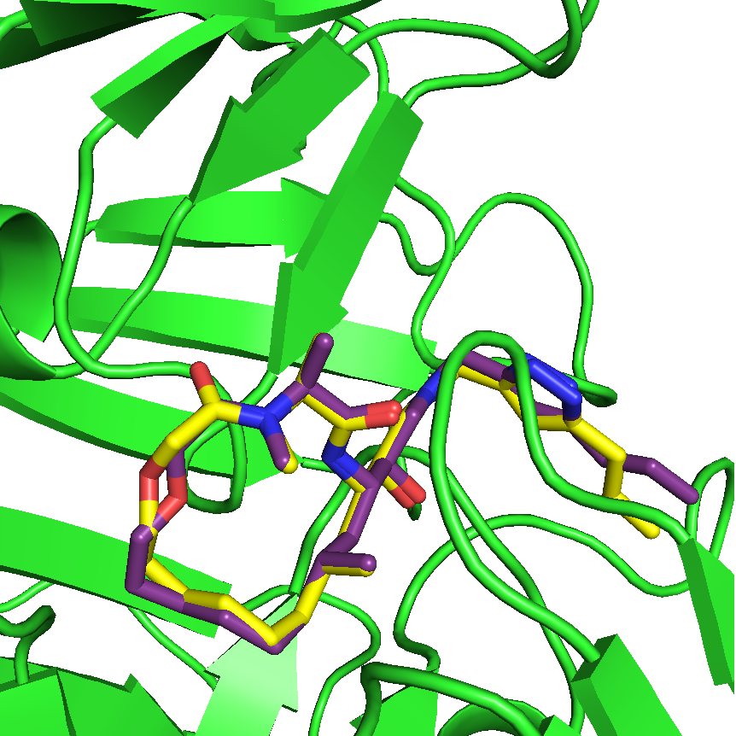
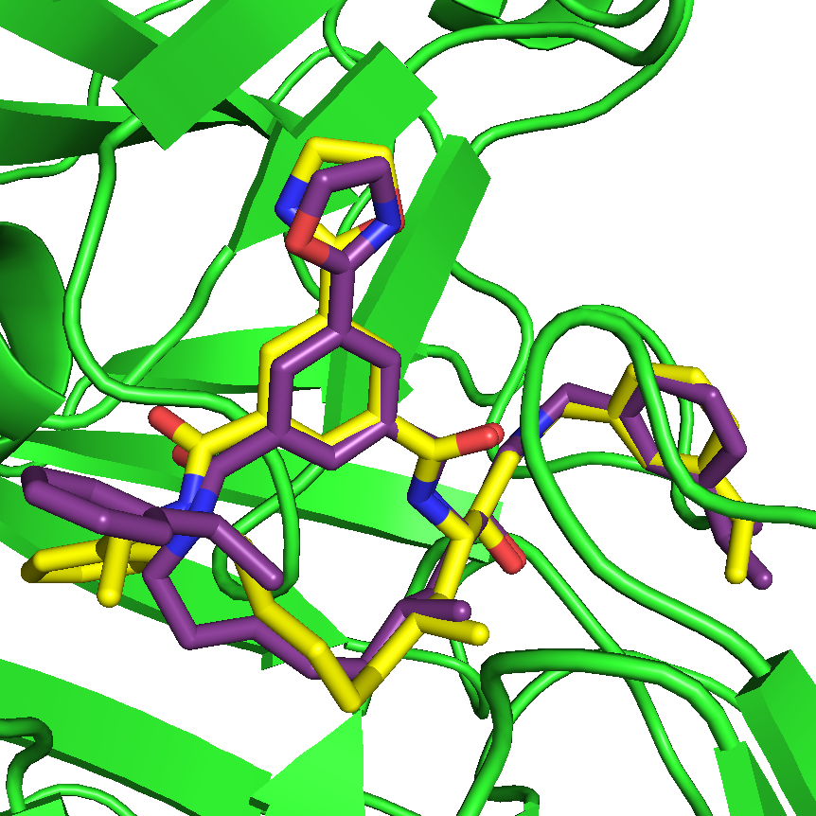
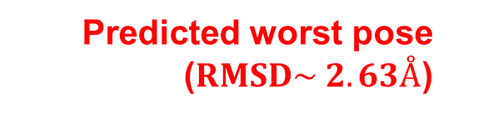
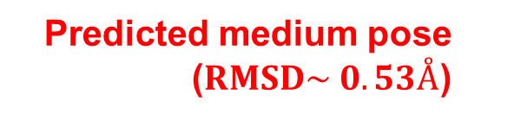
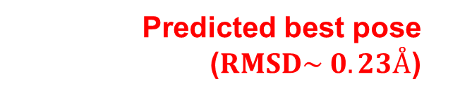
Pose prediction in D3R Grand Challenge 4 (2018-2019)
Predicted BACE binding site
Predicted best pose ($RMSD\sim 0.23Å$)
Predicted medium pose ($RMSD\sim 0.53Å$)
Predicted worst pose ($RMSD\sim 2.63Å$)

Slide 6
AI, Machine Learning, and Deep Learning
Artificial Intelligence (AI)
Machine Learning
Deep Learning

Slide 7

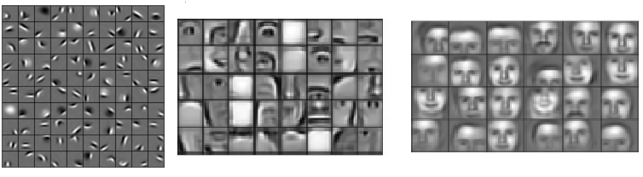
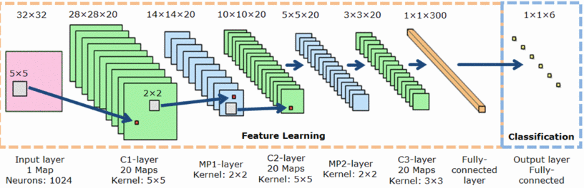
Artificial Intelligence & Deep learning
Bryson and Ho (Backpropagation 1969); Fukushima (Neo-Cognitron 1980); LeCun (CNN 1998); Hopfield (RNN 1982); Hochreiter and Schmidhuber (LSTM 1997); Goodfellow et al (GAN 2014); Autoencoder; Image translation, …

Slide 8
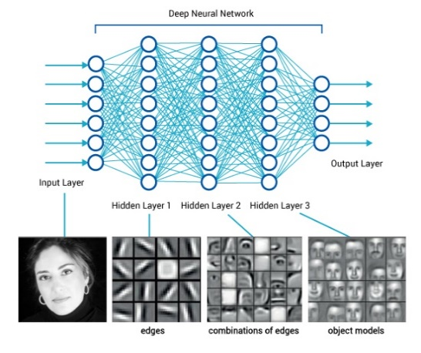
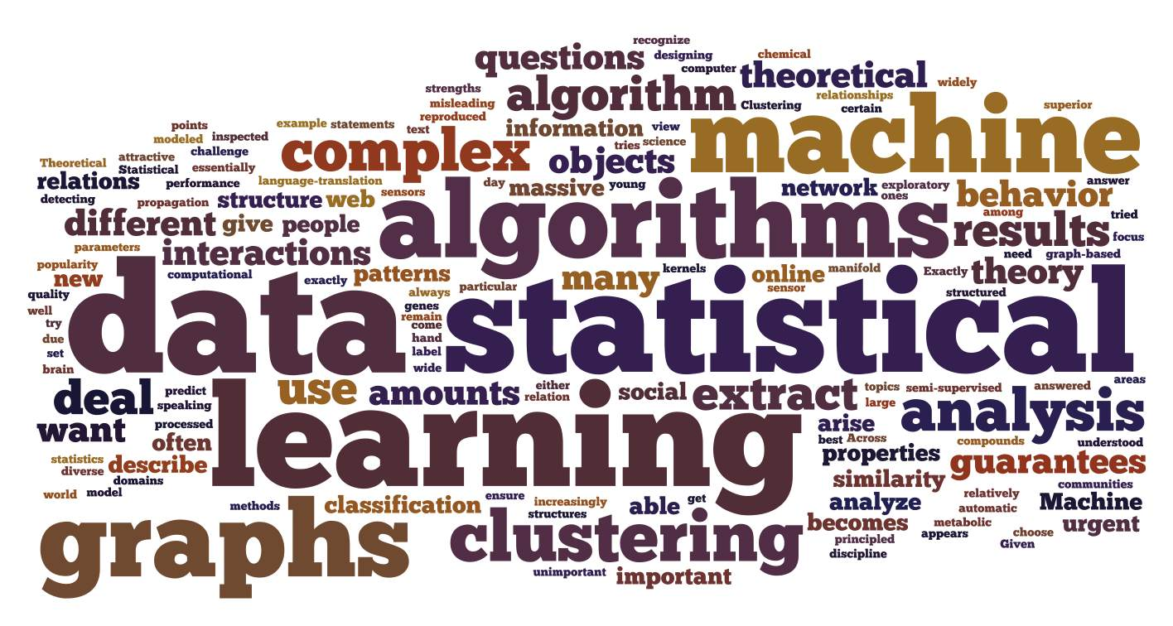
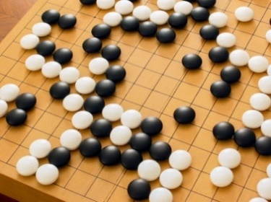
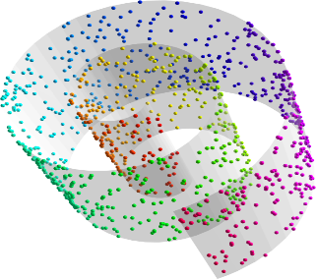


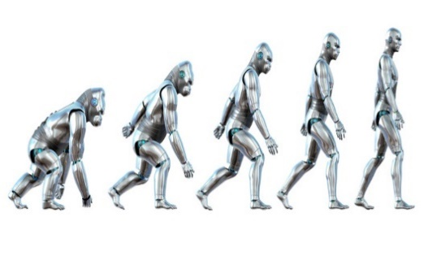

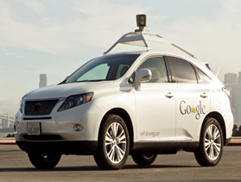

Artificial intelligence and machine learning
Turing Award 2019
Turing Award 2019
Geoffrey Hinton, Yann LeCun, and Yoshua Bengio
Geoffrey Hinton, Yann LeCun, and Yoshua Bengio

Slide 9
Face synthesis using generative adversarial network (GAN)
https://arxiv.org/pdf/1511.06434.pdf

Slide 10
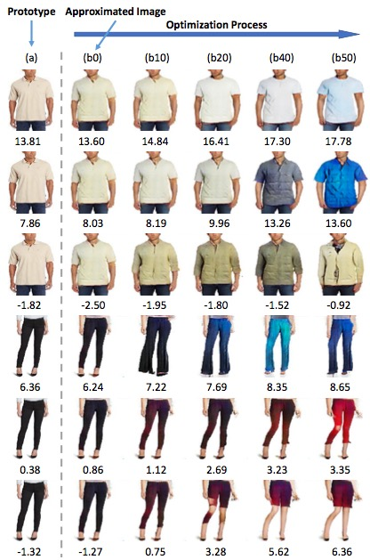
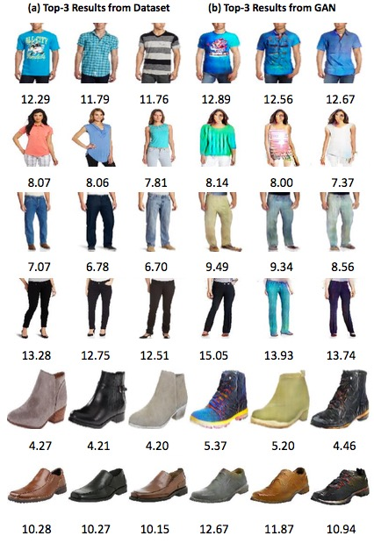
Visually-aware fashion recommendation and design with GANs (Kang et al., 2017)

Slide 11
Cycle GANs for image translation
(Zhu et al., 2017; arXiv:1703:10593v2 [cs.CV])

Slide 12
Cycle GANs for image translation
(Zhu et al., 2017; arXiv:1703:10593v2 [cs.CV])

Slide 13
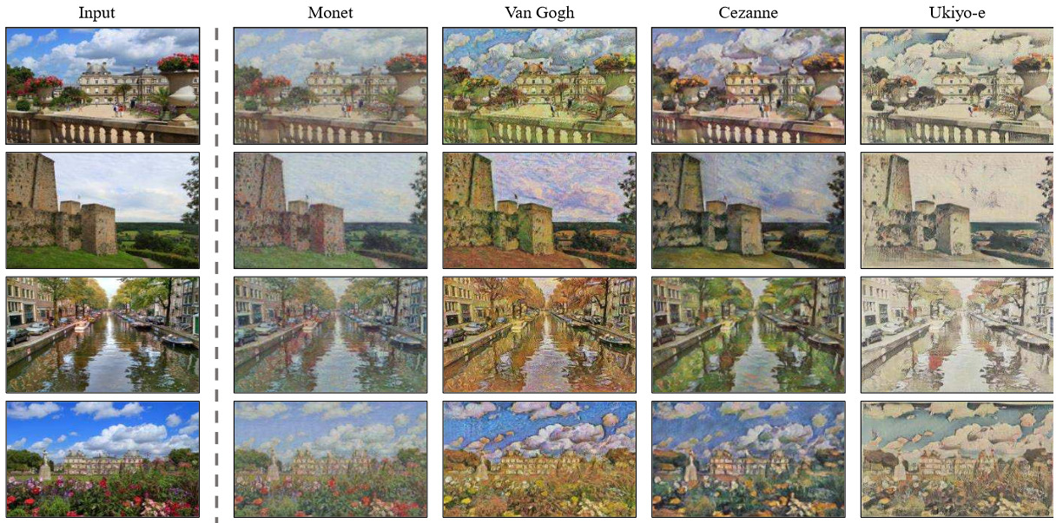
Paints in different styles
(Zhu et al., 2017; arXiv:1703:10593v2 [cs.CV])

Slide 14
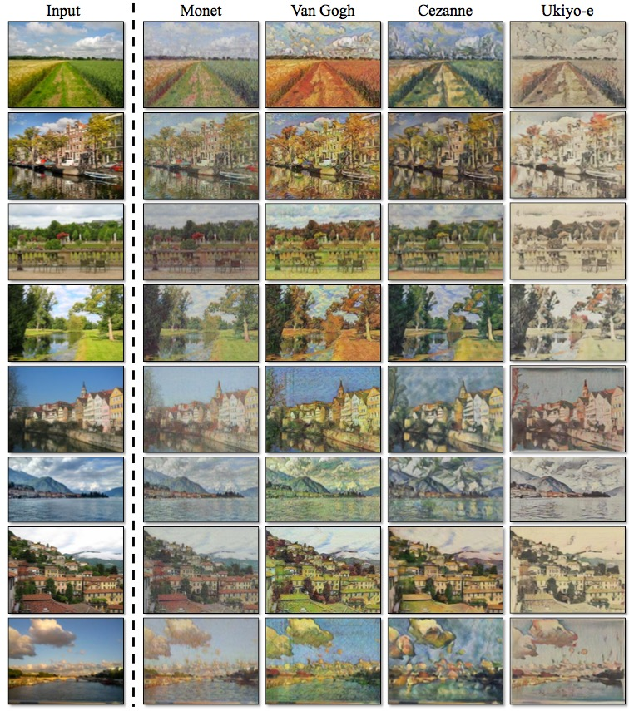
Photos to Paintings
(Zhu et al., 2017; arXiv:1703:10593v2 [cs.CV])

Slide 15
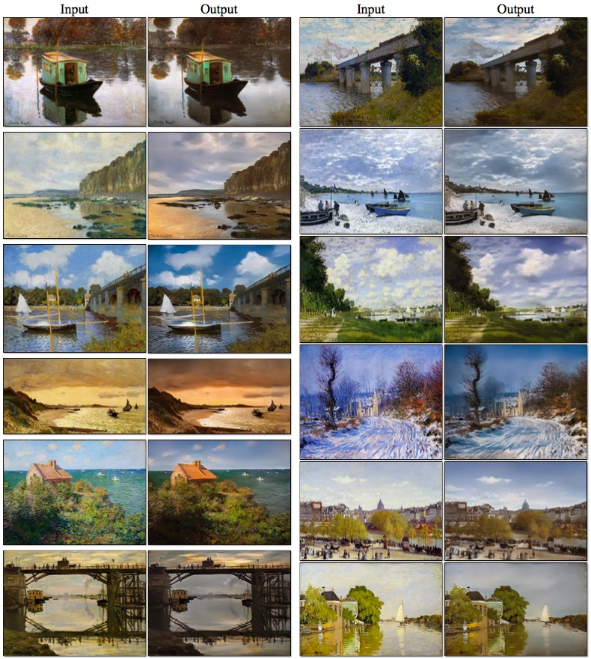
Paintings to Photos
(Zhu et al., 2017; arXiv:1703:10593v2 [cs.CV])

Slide 16
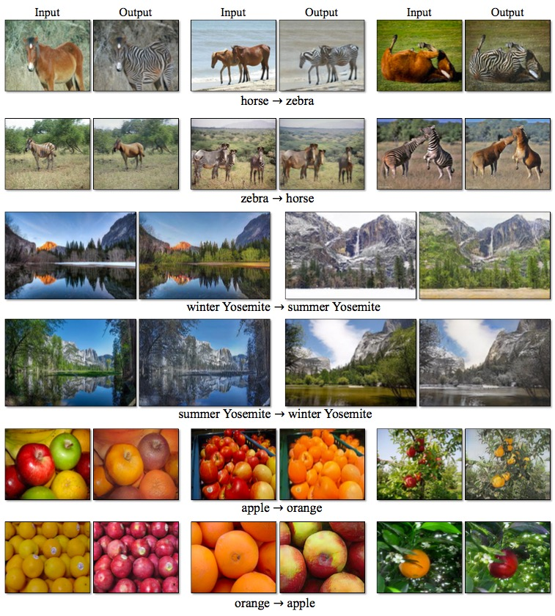
GANs for image translation
(Zhu et al., 2017; arXiv:1703:10593v2 [cs.CV])

Slide 17
Spectral normalization to stabilize GAN training:
https://arxiv.org/pdf/1802.05957.pdf

Slide 18
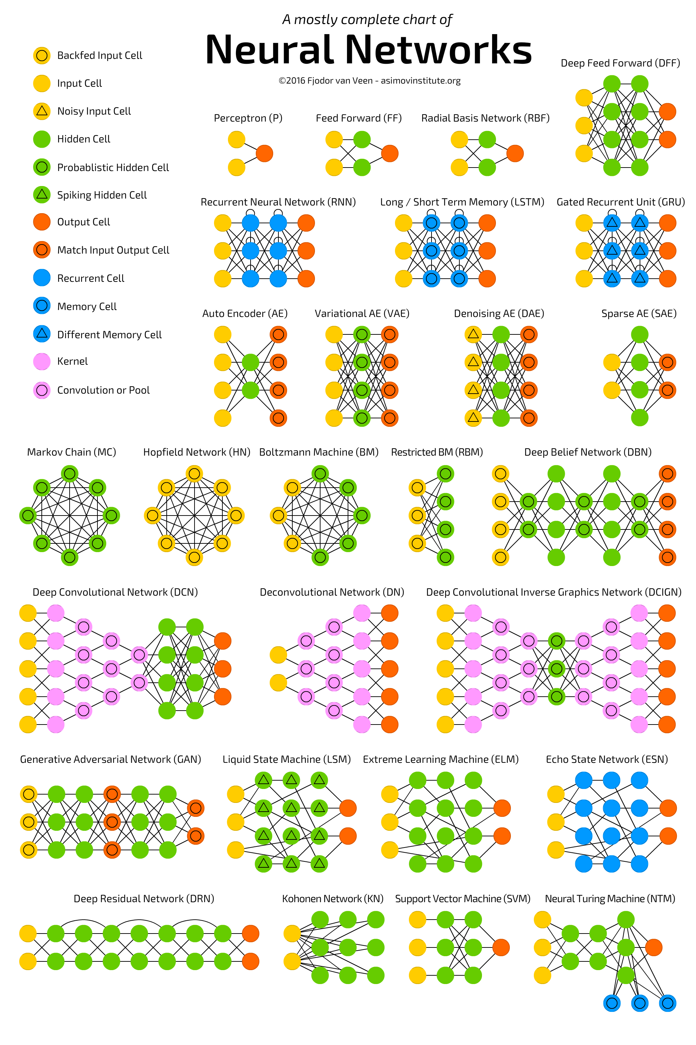
Basic math:
Calculus
Linear algebra
Statistics
Probability
…
Advanced math:
Geometry
Topology
Algebra
Analysis
Combinatorics
Graph theory
Spectral graph
Hypergraph
Algebraic topology
Algebraic geometry
Geometric algebra
Differential geometry
Homotopy
Spectral sequence
Manifold convergence
Kullback-Leibler divergence
Jensen-Shannon divergence
Optimal transport
Wasserstein metrics
Gromov Wasserstein
…
Stefan Kojouharov

Slide 19
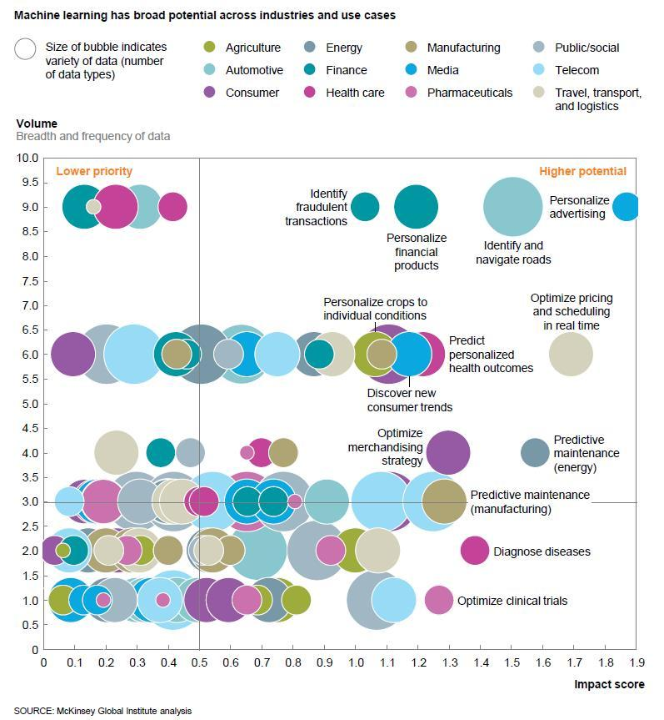

Slide 20
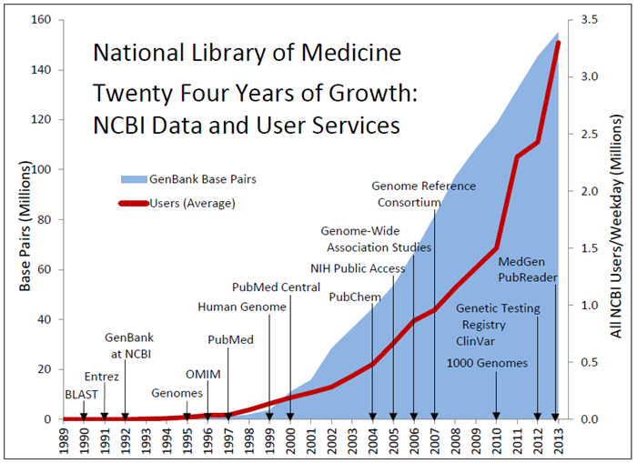
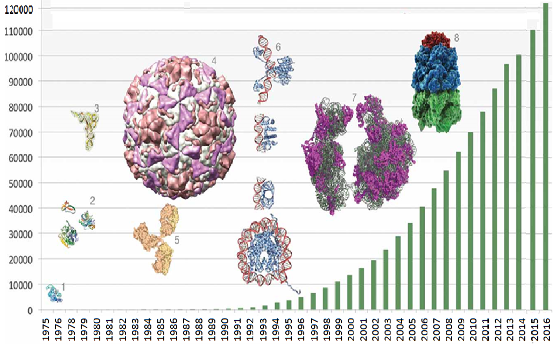
Biological data
GenBank
PDB

Slide 21

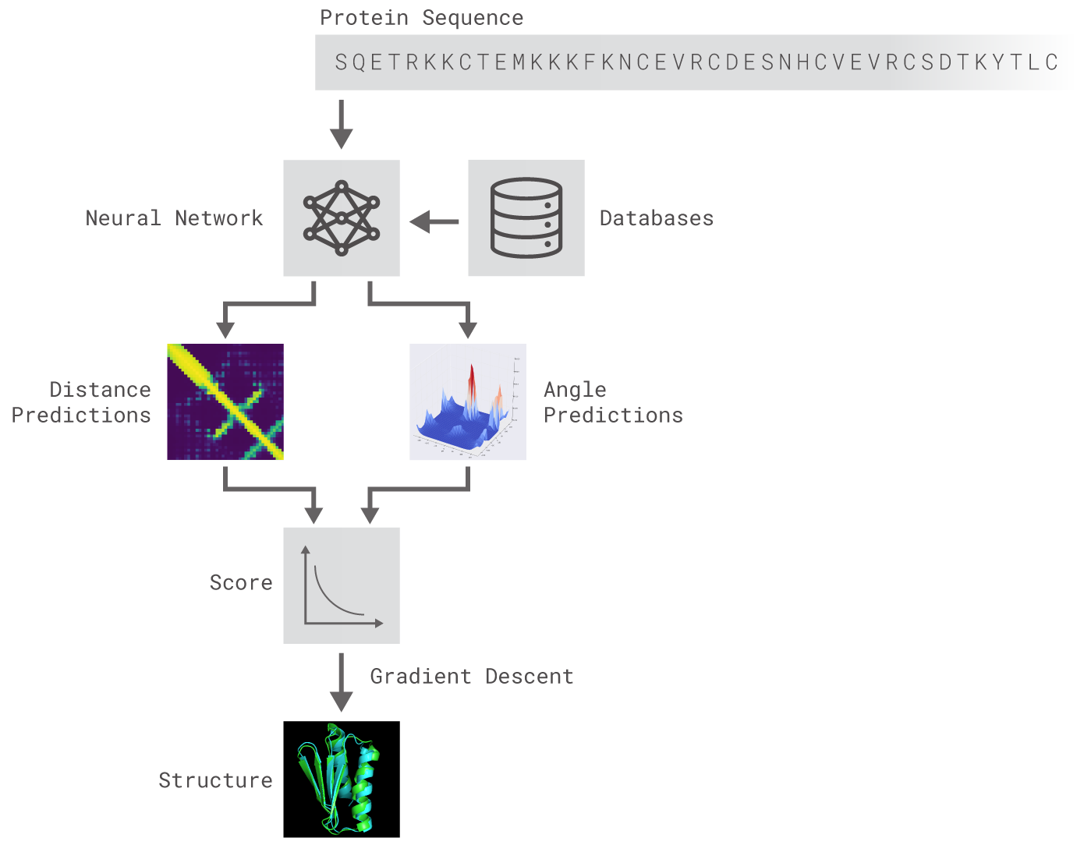

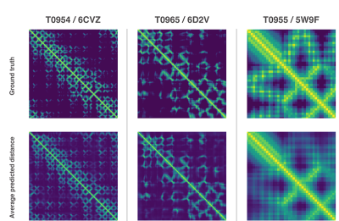
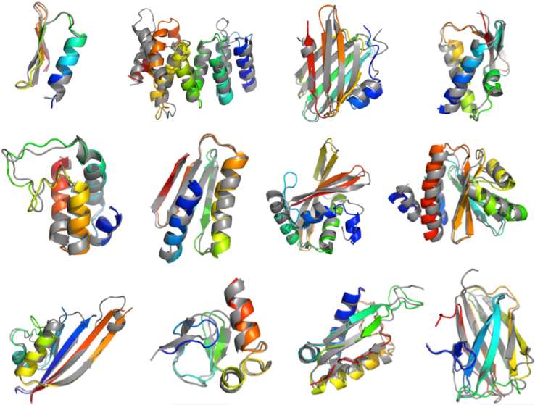
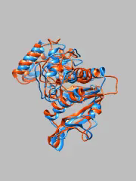
won 25 of 43 contests and was ranked 1St among 98 competitors in CASP 13.

Slide 22
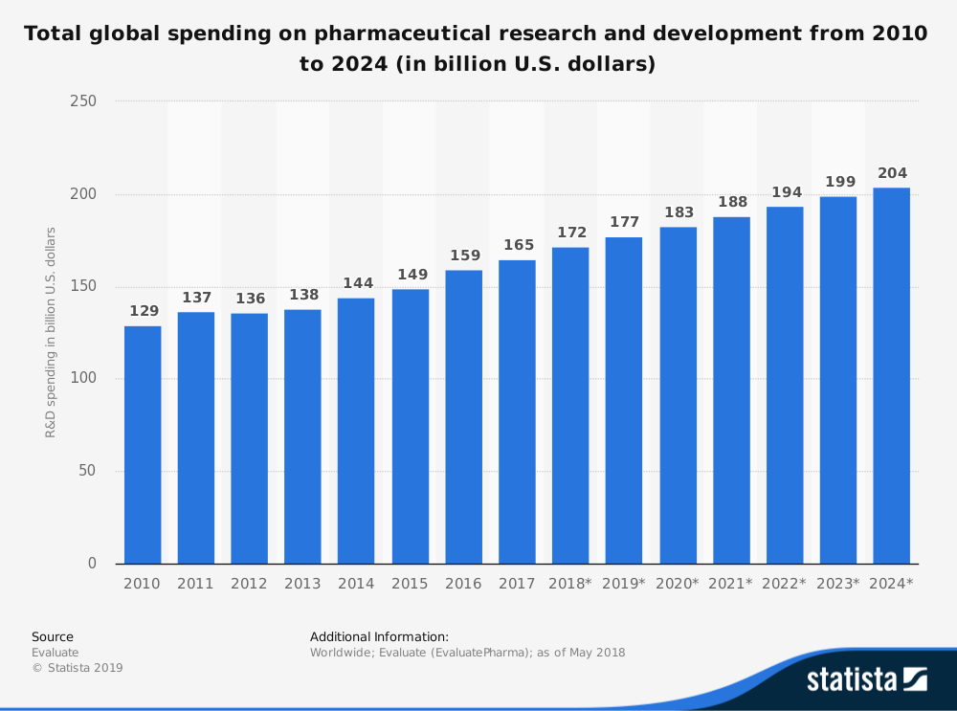
NSF Budget: ~ $8 billion
NIH Budget: ~ $34 billion

Slide 23
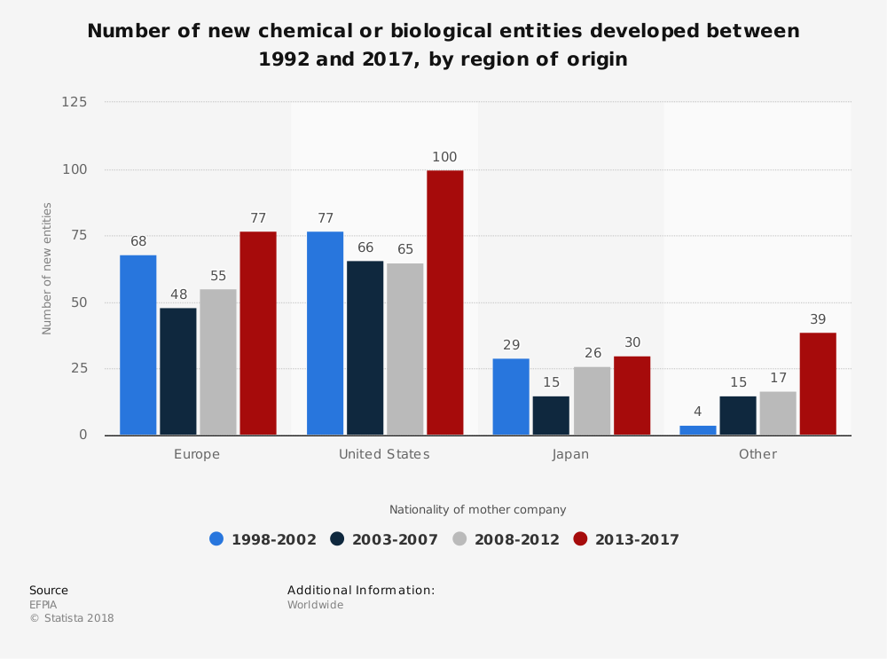
It takes over 10 years and $2.6 billion to bring a new drug to market.

Slide 24
Drug Discovery Process (simplified)
Clinical Trials
Target Discovery
Lead Discovery
Lead Optimization
Preclinical Development
Toxicology
In vivo safety pharmacology
Formulation
Dose prediction
Phase 1
Phase 2
Phase 3
Launch
Target identification
Microarray profiling
Target validation
Assay development
Biochemistry
Clinical/Animal
disease models
High-throughput
Screening (HTS)
Fragment-based
screening
Focused libraries
Screening collection
Medicinal Chemistry
Structure-based
drug design
Selectivity screens
ADMET screens
Cellular/Animal
disease models
Pharmacokinetics
PK
tolerability
Efficacy
Safety
&
Efficacy
Indication
Discovery & expansion
Discovery
Development
Use
Med. Chem. ML,
Clinical Candidates
Drugs
>450,000 distinct compounds
~25,000 distinct lead series
~1,300
drugs
~12,000 candidates
Courtesy: John Overington

Slide 25
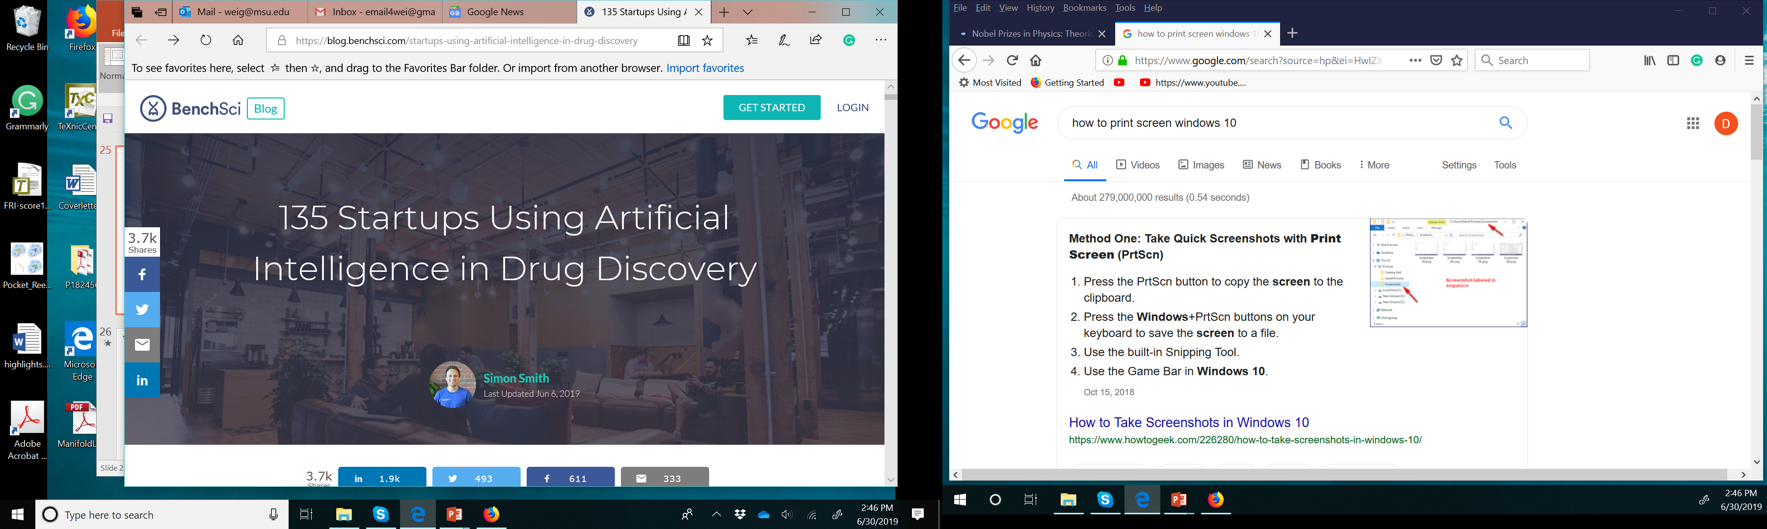
Nobel Prizes in Physics: Theorists vs. Experimentalists (30%/70%)

Slide 26
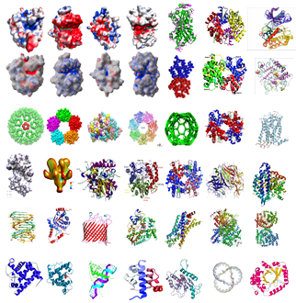
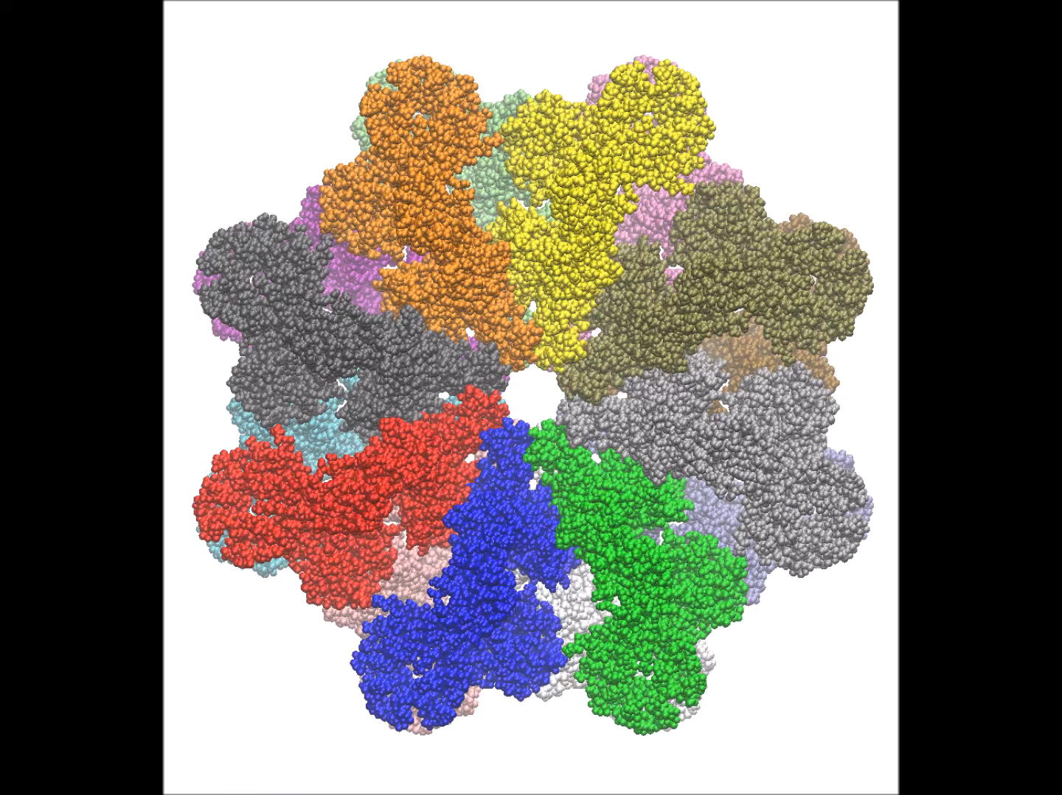
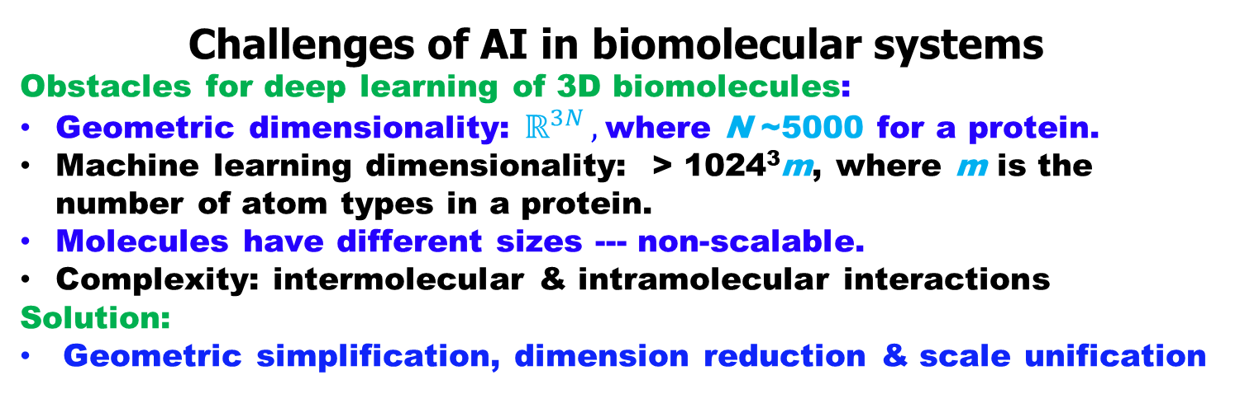
Challenges of AI in biomolecular systems
Obstacles for deep learning of 3D biomolecules:
Geometric dimensionality: $ℝ^{3N },$ where N ~5000 for a protein.
Machine learning dimensionality: > 1024³m, where m is the number of atom types in a protein.
Molecules have different sizes --- non-scalable.
Complexity: intermolecular & intramolecular interactions
Solution:
Geometric simplification, dimension reduction & scale unification

Slide 27
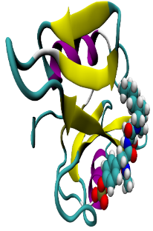








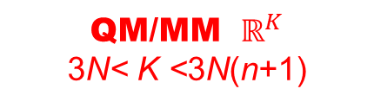
Two schools of thinking
Given a protein with N atom and an average of n electrons in each atom
Quantum
Mechanics
Fundamentalism; Mechanistic
QM/MM $ℝ^{K}$
3N< K <3N(n+1)
$$ℝ^{3Nn+3N }$$
Molecular
Mechanics
$$ℝ^{3N }$$
Multiscale
Coarse-grain
$ℝ^{M }$(3<M<3N)
Poisson-Boltzmann, PNP, etc. $ℝ^{3 }$
Differentiable
Manifold
$$ℝ^{2}$$
Algebraic Topology $ℝ^{1 }$
Basic hypothesis:
Intrinsic physics lies on low-dimensional manifolds in a high dimensional space
Graph
Theory
$$ℝ^{0 }$$
Reductionism; Data-driven
Geo-Top
Indices
$$ℝ^{0 }$$

Slide 28

Biophysics
Structure data
Sequence data
Bioinformatics
Systems biology
Systems physiology
Algebraic topology
Differential geometry
Graph theory
Multiscale PDEs
de Rham-Hodge
Machine learning
Deep learning
Manifold learning
Transfer learning
GAN
Drug Design & Discovery
in the Wei Lab

Slide 29
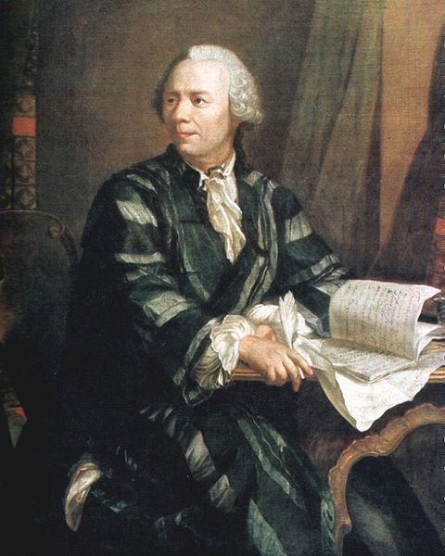
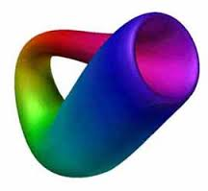
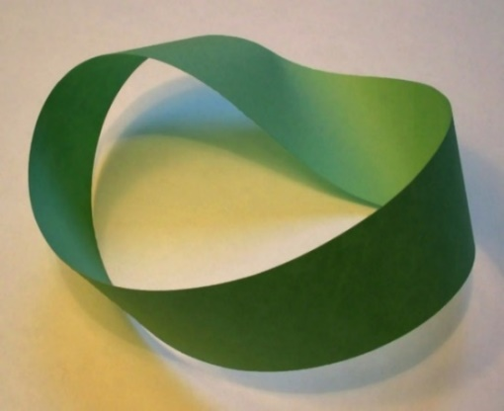
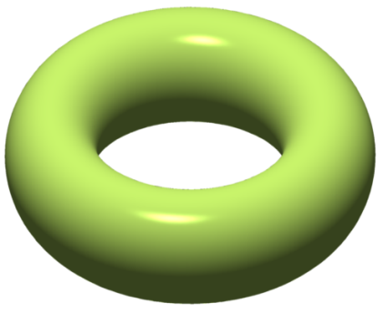



Classical Topology
Möbius Strips (1858)
Klein Bottle (1882)
Leonhard Paul Euler
(Swiss Mathematician, April 15, 1707 – Sept 18 1783)
Torus
Double Torus
Seven Bridges of Konigsberg
Augustin-Louis Cauchy,
Ludwig Schläfli,
Johann Benedict Listing,
Bernhard Riemann, and
Enrico Betti
Leonhard Euler (1735)

Slide 30




Topological invariants: Betti numbers
β₀ is the number of connected components.
β₁ is the number of tunnels or circles.
β₂ is the number of cavities or voids.
Point
Circle
Sphere
Torus

Slide 31

Vietoris-Rips complexes of planar point sets
Simplexes:
0-simplex 1-simplex 2-simplex 3-simplex
Simplicial complexes of ten points:

Slide 32








Persistent homology
Simplexes:
Frosini and Nandi (1999), Robins (1999),
Edelsbrunner, Letscher and Zomorodian (2002), Zomorodian and Carlsson (2005),
Edelsbrunner and Harer, (2007) Kaczynski, Mischaikow and Mrozek (2004),
Ghrist (2008),
……
0-simplex 1-simplex 2-simplex 3-simplex
$$K=\left\{\sum_{j}{c_{j}σ_{j}^{k}}\right\}$$
k-chain:
Chain group:
$$C_{k}\left(K,ℤ_{2}\right)$$
Boundary operator:
$$∂_{k}σ^{k}=\sum_{j=0}^{k}{{\left(−1\right)}^{j}}\left\{v_{0},v_{1},…, \hat{v_{j}},…,v_{k}\right\}$$
Cycle group:
$$Z_{k}=Ker ∂_{k}$$
Boundary group:
$$B_{k}=Im ∂_{k+1}$$
$$H_{k}=\frac{Z_{k}}{B_{k}}$$
Homology group:
Betti number:
$β_{k}=Rank\left(H_{k}\right)$
Xia, Wei, IJNMBE, 2014; Xia, Feng, Tong, Wei, JCC, 2015
Filtration

Slide 33

Algebraic Topology
Vietoris-Rips complexes, persistent homology and topological fingerprint
(Xia, Wei, 2014)

Slide 34















Topological fingerprints of an alpha helix
(Xia & Wei, IJNMBE, 2014, 2015)

Slide 35


Algebraic Topology
2D persistent homology of protein 1UBQ unfolding
Radius
Time
(Xia & Wei, JCC, 2015)
Kelin Xia

Slide 36






Persistent cohomology
D1
D2
D3
Wasserstein curves
Zixuan Cang
(Cang & Wei, 2018)

Slide 37

de Rham-Hodge theory and discrete exterior calculus
Hodge decomposition:
(Zhao, Wang, Tong & Wei, 2018)
A vector field = Harmonic + curl-free + divergent-free
Maxwell theory
Quantum mechanics/Solid state theory
Quantum field theory/Yang-Mills theory
Cryo-EM data:

Slide 38






Mathematical learning architecture in the Wei lab
Cang and Wei, PLOS CB,2017
Cang and Wei, Bioinformatics,2017
Wu and Wei, JCC,2018
Wu and Wei, JCIM,2018
Cang and Wei, PLOS CB,2017
Wang et al. , 2019

Slide 39





Topological learning based predictions
Classification of ligands & decoys
DUD database 128,374 protein-ligand/decoy pairs
Prediction RMSD of LogP (Star set)
Cang, Mu and Wei, PLOS CB,2018
Wu and Wei, JCC,2018
Predicting mutations on 2648 globular proteins
Predicting mutations on 223 membrane proteins
Binding affinity prediction of PDBBind v2013 core set of 195 protein-ligand complexes
(Cang and Wei, Bioinformatics, 2017)
Cang and Wei, PLOS CB,2017

Slide 40
Performance of algebraic graph learning (AGL-Score)
(Nguyen & Wei, JCIM, 2019)

Slide 41
Performance of algebraic graph learning (AGL-Score)
(Nguyen & Wei, JCIM, 2019)

Slide 42


Work with Pfizer: Drug lead analysis
Machine learning models vs. S$oftware$
Rank binding affinities of 362 compounds (fully blind)

Slide 43

Work with Pfizer: Drug lead analysis
Enrichment Curve
Rank binding affinities of 362 compounds (fully blind, top 10% are assumed to be ``active’’.)

Slide 44









Drug Design Data Resource (D3R) Grand Challenge
Given data
Math based GAN
Predicted complex
Final predictions to be compared with experiments
Predicted
Experimental
Drug pose
(Nguyen et al, JCAMD, 2018)

Slide 45

Autoencoder (AE), autodecoder (AD) and latent space (LS)
N1CCN(CC1)C(C(F)=C2)=CC(=C2C4=O)N (C3CC3)C=C4C(=O)O
N1CCN(CC1)C(C(F)=C2)=CC(=C2C4=O)N (C3CC3)C=C4C(=O)O
SS-AE
SS-AD
LS
SMILES String (SS) SMILES String (SS)
Trained with millions of molecules
3D-AE
3D-AD
SS-AE
SS-AD
LS
Autoencoder (AE)-Latent space (LS)-Autodecoder (AD)

Slide 46





Generative Adversarial Network for New Drug Candidates
Produce ~1 million new drug candidates per day
Training set
3D-AD
SS-AD
$$x$$
3D-AE
No
$$z$$
SS-AE
LS
Yes
$$z$$
3D-AD
SS-AD
3D-AD
LS
SS-AD
LS
Discriminator
Generator
$$\hat{x}$$
Generator
$$\hat{x}$$
Feedback to the LS

Slide 47

Conditional Mathematical GAN for Drug Design
Constraints:
Binding affinity
Solubility
Permeability
Toxicity
Synthesizability Clearance
Partition coefficient
…
GAN Variants:
Wasserstein GAN
Conditional GAN
L2 GAN
Relaxed WGAN
Fisher GAN
Banach GAN
Gromov-Hausdorff
…

Slide 48




























Hong
(MSU)
Lee
(MSU)
Munch
(MSU)
Tong
(MSU)
Baker
(PNNL)
Bates
(MSU)
Bazil
MSU
Dickson
(MSU)
Dong
(MSU)
Hu
(MSU)
X Ye
(UKLR)
S Yang
CU KH
S.N. Yu
NY
Y.H. Sun
Denver
L. H. Hu
Chicago
J. Park
Indiana
Y Zhou
CSU
W Geng
SMU
Duan Chen
UNCC
Zhan Chen
GSU
Lin Mu
UGA
Shan Zhao
Alabama
ZX Cang
UCI
Y Cao
P.I.
ZX Zhao
Foshan U
CJ Chen
HZUST
KL Xia
NTU
B Wang
UCLA
K Opron
UM
KD Wu
C. One

