Slide 1
Open Discussion of the Future of Blinded Prediction Challenges

Slide 2
NIH Proposal for Next Phase of D3R
submitted early 2019
Grand Challenges (at least a few more)
Containerized workflows for ongoing testing, replication, dissemination
Orders of magnitude increase in rate of blinded challenges
Major components of training and outreach

Slide 3
Stronger Statistics in Docking Evaluations
continuous evaluation of ligand pose predictions (CELPP)
PDB identifies forthcoming structures
PDB releases structures
CELPP Challenge File
CELPP evaluations
~40 cases
CELPP Participants

Slide 4
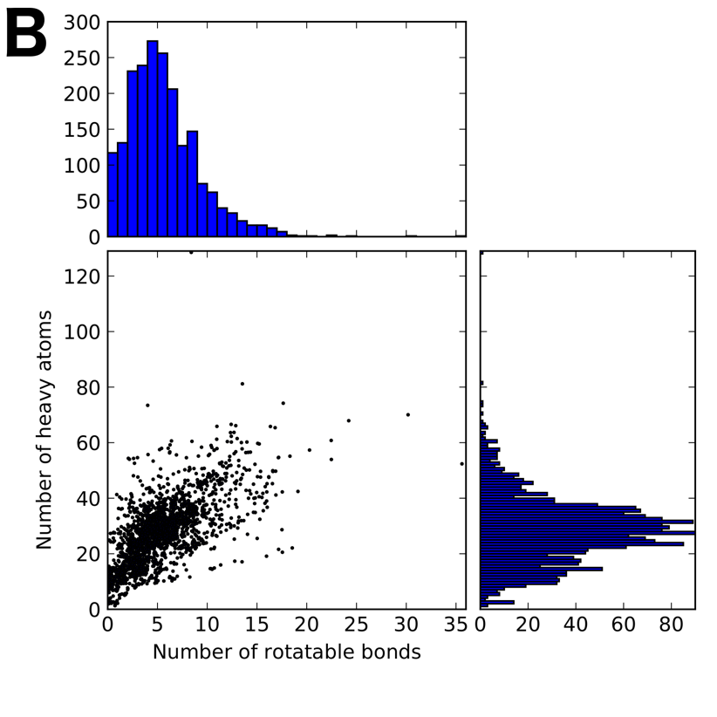
CELPP Challenges and Participants
>2,000 cross-docking cases over 64 weeks
Two orders of magnitude more tests than in all prior community-wide pose-prediction exercises combined
Five “in-house” docking servers
Autodock Vina
Two GLIDE methods
OE Fred
rDOCK
Four anonymized external participants
Wagner et al, Structure 2019, 10.1016/j.str.2019.05.012

Slide 5
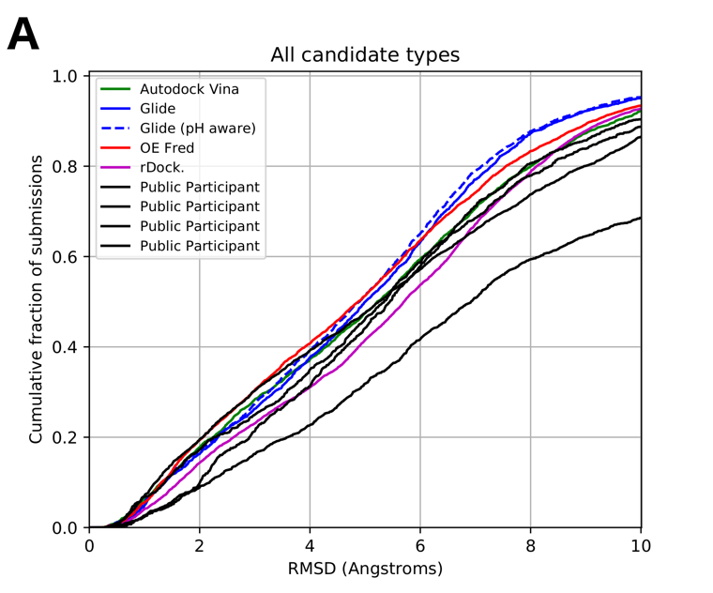
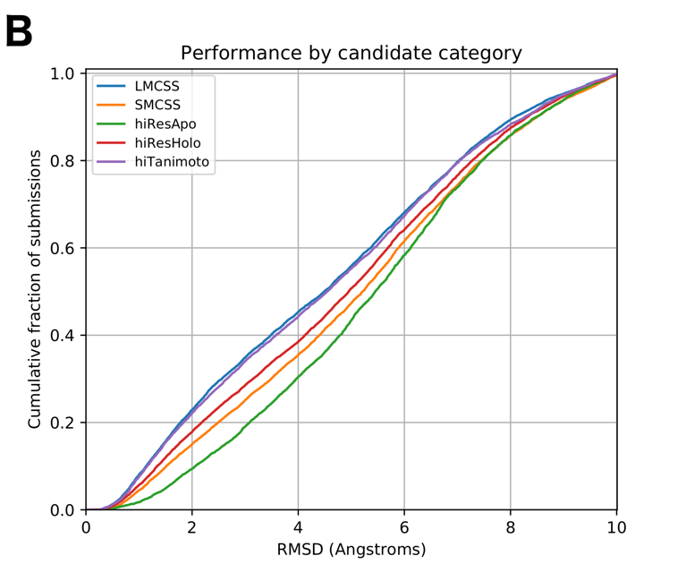
Initial Docking Results
>2,000 CELPP cross-docking cases over 64 weeks
Wagner et al, Structure 2019, 10.1016/j.str.2019.05.012

Slide 6
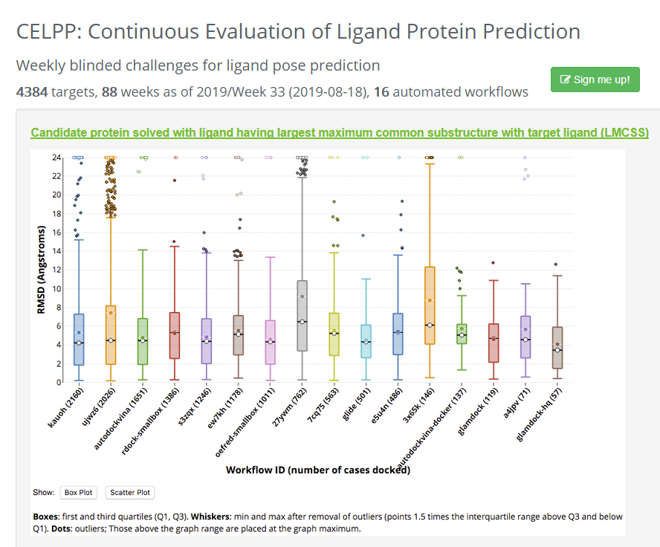
CELPP Results on the D3R Website
https://drugdesigndata.org/about/celpp

Slide 7
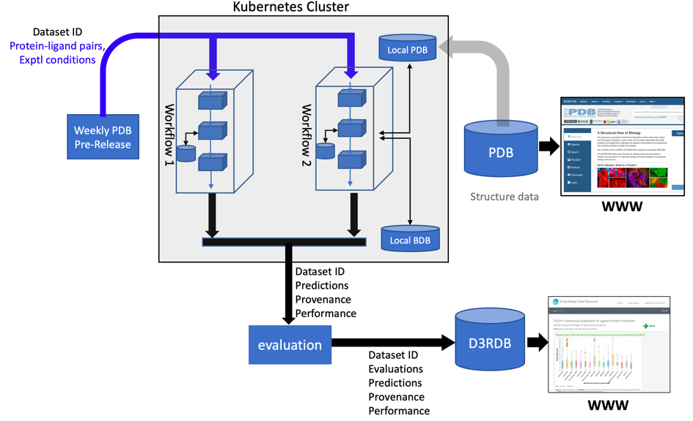
Workflow Version of CELPP
fosters replication, dissemination of methods

Slide 8
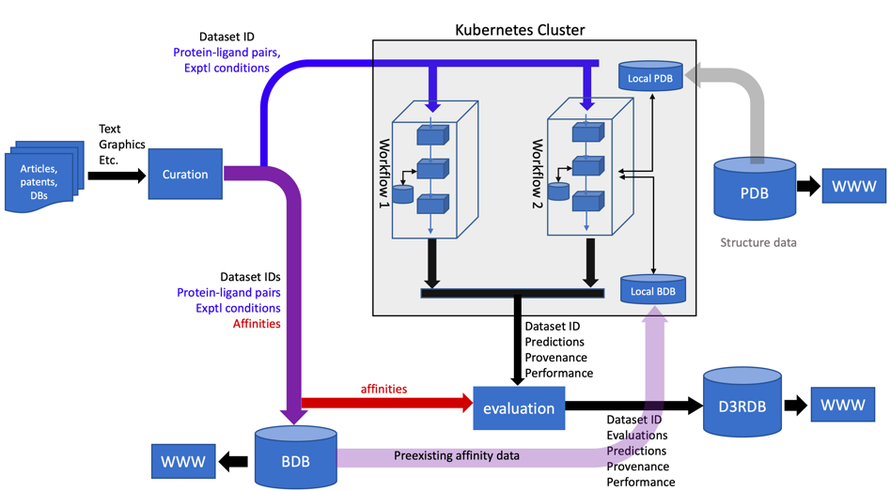
CELPP+: Rolling Affinity-Prediction Challenge
BDB curated 48,000 binding data in one year
BindingDB Curation

Slide 9
Grant Proposal and Reviews
https://drugdesigndata.org/about/publications

Slide 10
Aspects We Could Better Emphasize
Grand Challenges to continue
Pharma interest in using high-performing workflows for real-world drug discovery
Data are on hand for a novel virtual screening challenge
Framework straightforward to extend to other data types; e.g., binding kinetics

Slide 11
Aspects we could better emphasize:
There is interest from several pharma partners to use challenges against blinded data in a first round, then use the best performing methods to make new predictions and generate the next dataset (which has been done in Teach-Discover-Treat, e.g.)
We are brokering a new dataset (with pharma) to run a new virtual screening challenge against 3 different targets; this company also wanted to use the best methods to hunt for new molecules across their larger (protected) small molecule datasets (so fits above point/model)
Once the tech framework is developed for pose prediction and affinity predictions at significantly grander scale, extension of this framework, with relatively minor modifications, becomes possible. E.g., enabling challenges in other categories, such as drug binding kinetics, virtual screening, etc
Framework straightforward to extend to other data types; e.g., binding kinetics

